Slide 1
A72-A12
Bonded at 375C, 40N 15 mins
5h oxide strip
Anneal 12h 500C
Failed at 1N

Slide 2
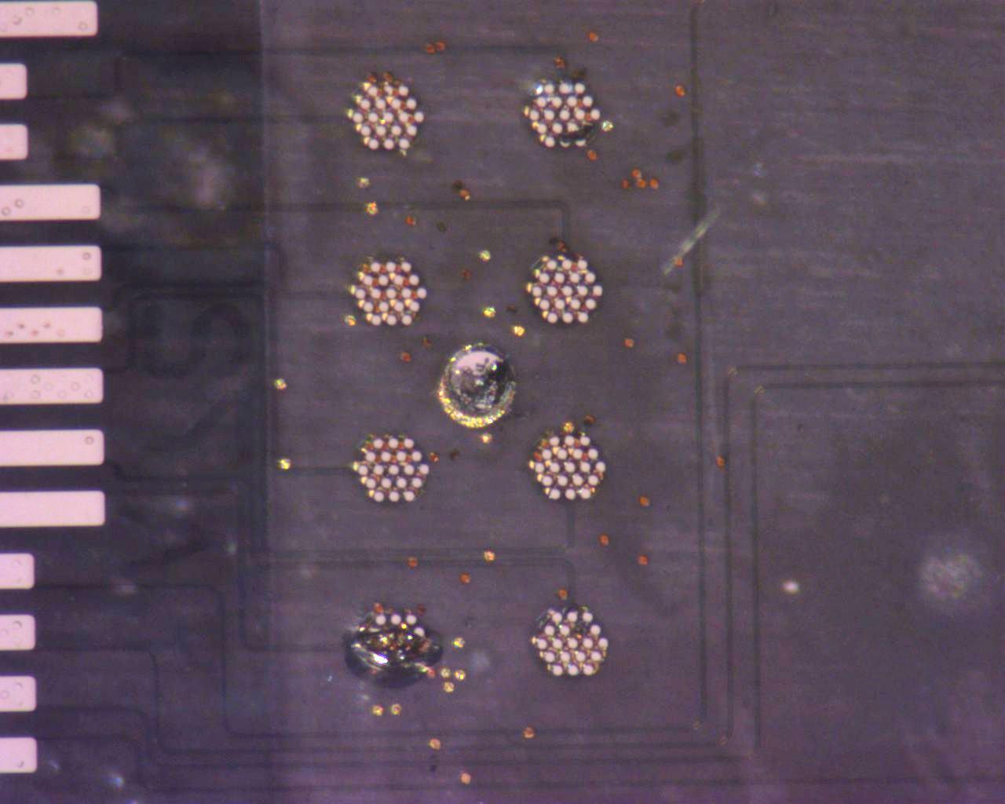
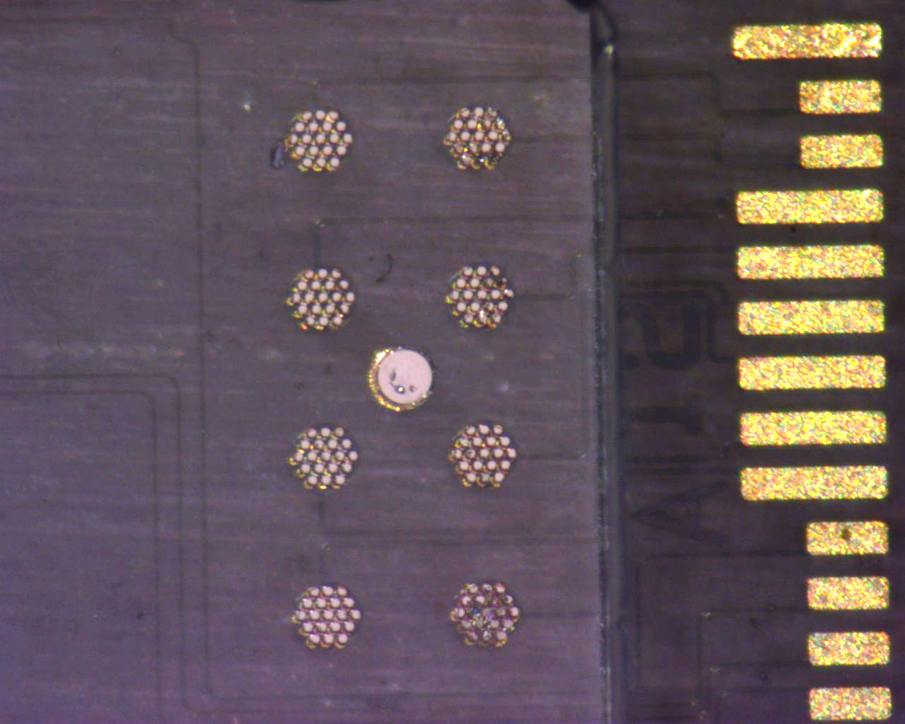
A72 (Back)
Post Anneal

Slide 3
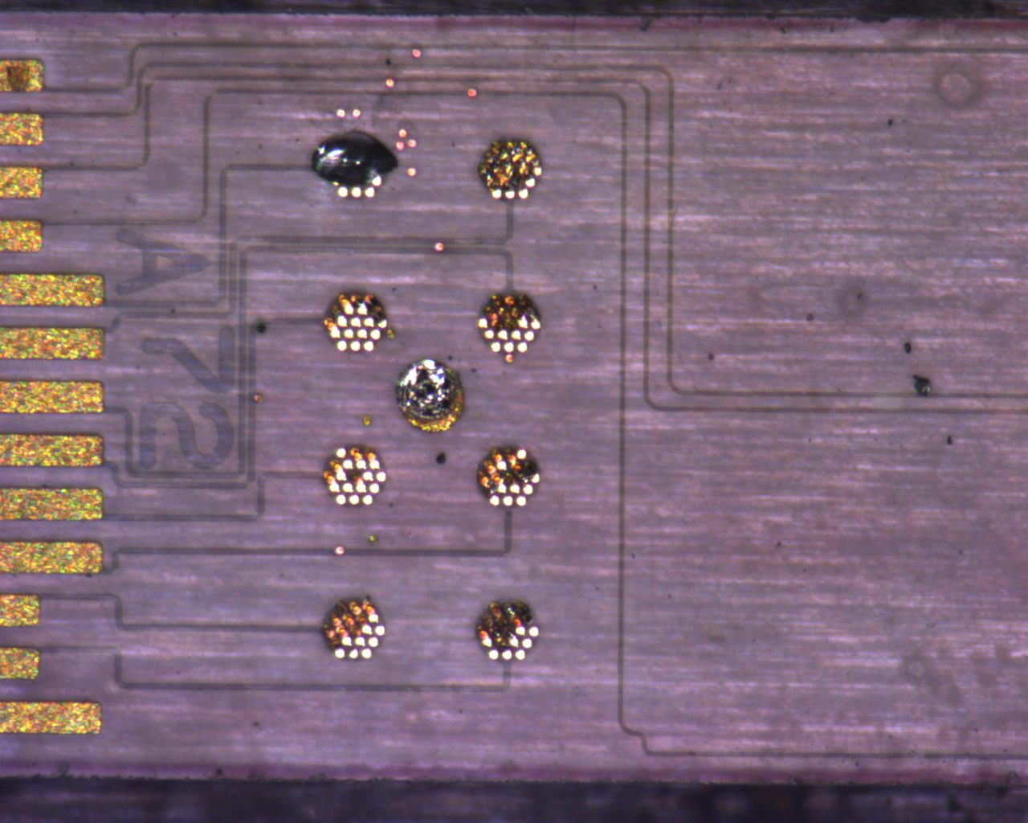
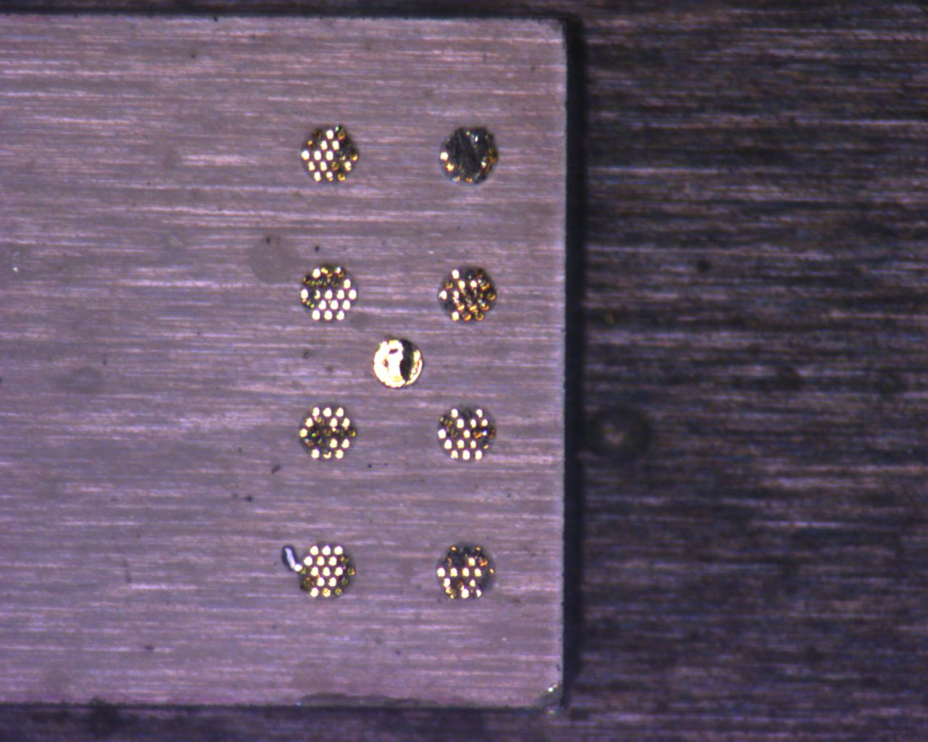
A72 (Front)
Post Pull Test

Slide 4
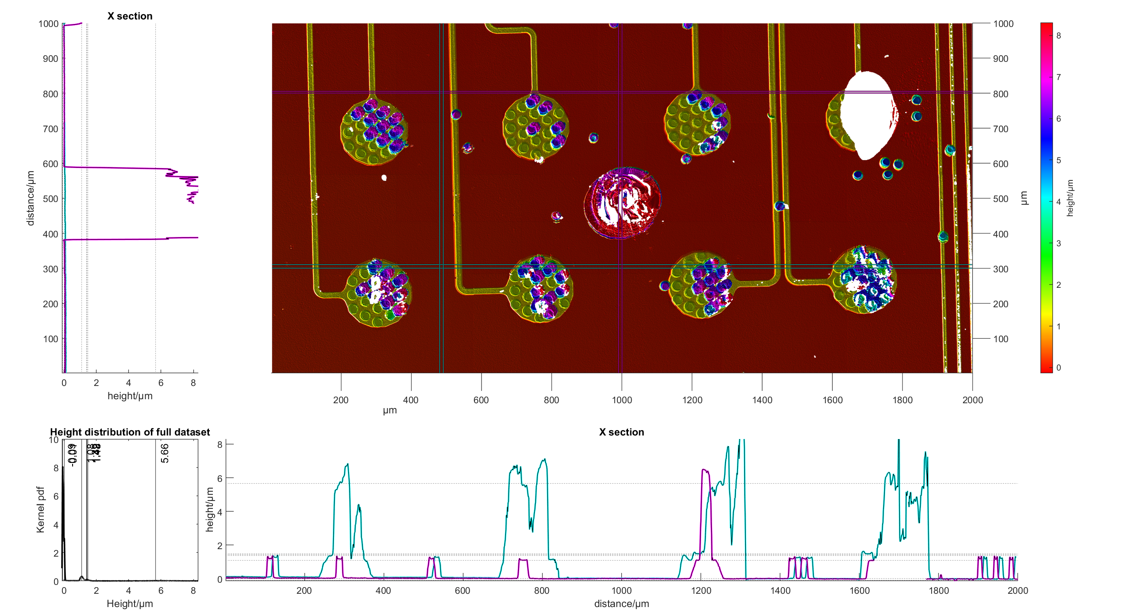
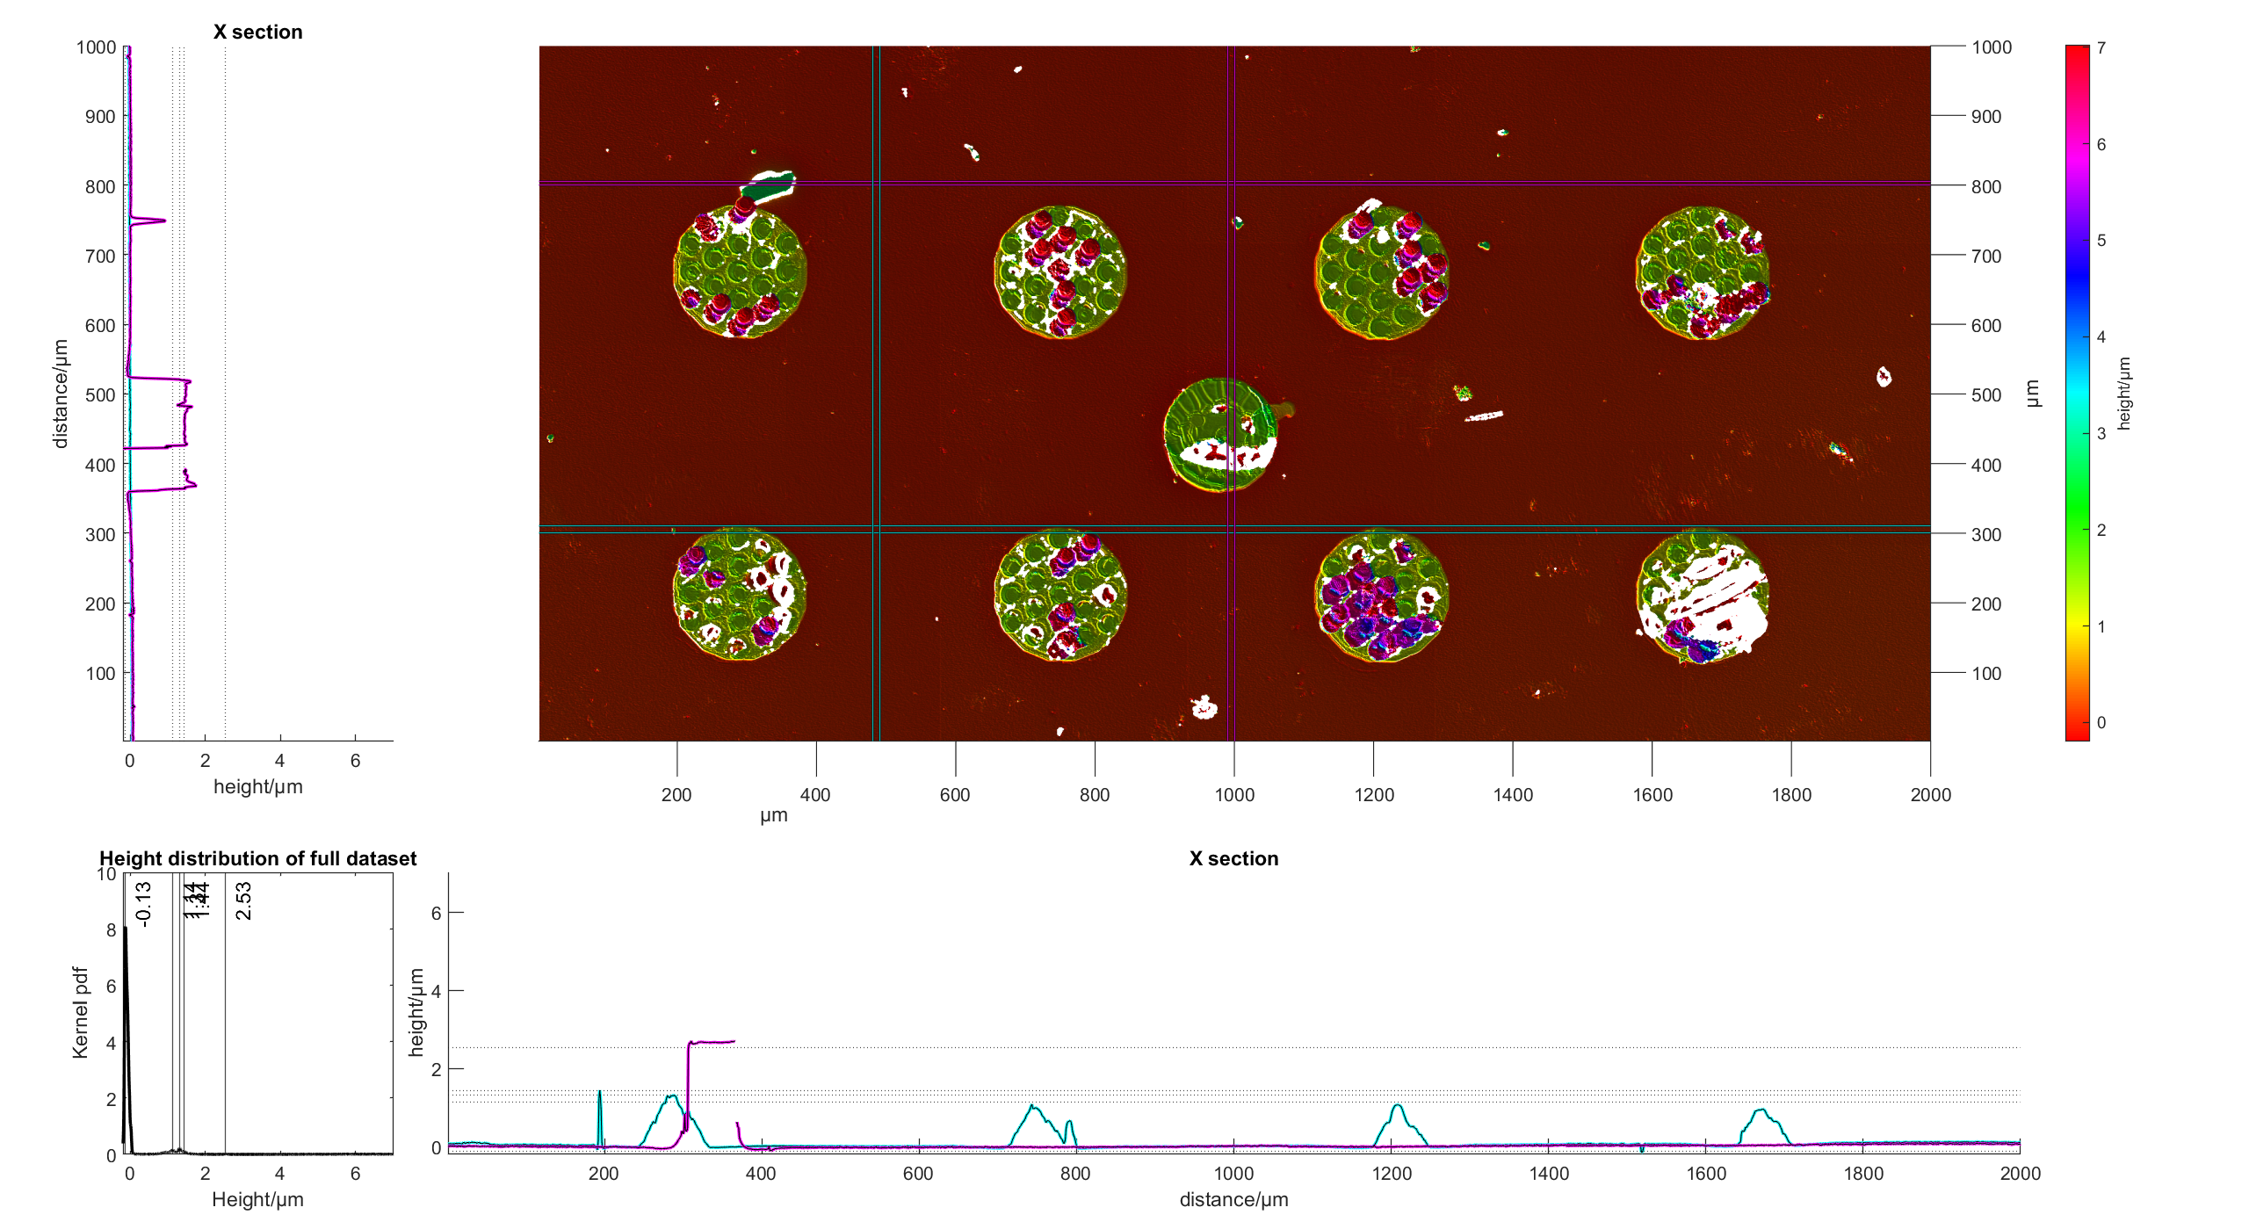
A72 Nearside
Pad 1,2,3 (Purple Area): Vias are 4.77um -> Compression of Gold?
Matches with other strip
Yellow Area: Loss of gold vias, and seeing the adhesion layer metal
Notes:
A72
Need to check between unbonded and compressed strip, whats the change in gold height.

Slide 5
A72 Nearside
Pad4
Pad 4(Purple Area):
Loss of material till a depth of approx. -30um
Glass failure
Indicative of conchidal fracture
Formed only after annealing
Notes:
A72
Need to check between unbonded and compressed strip, whats the change in gold height.

Slide 6
A72 Nearside
Pad4
Pad 5,6,7 (Purple Area):
Vias are 4.77um high -> Compression of Gold?
Matches with other strip
Failure at adhesion layer and gold
Pad 5: Little specks in the middle with no data -> loss of material beyond adhesion layer
Notes:
A72
Need to check between unbonded and compressed strip, whats the change in gold height.

Slide 7
A72 Nearside
Pad4
Pad 8: Not as obvious that there are individual vias removed here
Indicative that failure is at a layer higher, need to cross reference with other strip.
Failure glass, and adhesion layer metal.
Notes:
A72
Need to check between unbonded and compressed strip, whats the change in gold height.

Slide 8
A72 Nearside
Pad4
Pad 9: Definite transfer of gold from other strip, whole pad has transferred over.
Height of feature: 12um.
Looking at glinting from picture is definitely glass failure.
Notes:
A72
Need to check between unbonded and compressed strip, whats the change in gold height.

Slide 9
A72 Nearside
Pad4
Pad 9: Definite transfer of gold from other strip, whole pad has transferred over.
Height of feature: 12um.
Looking at glinting from picture is definitely glass failure.
Notes:
A72
Need to check between unbonded and compressed strip, whats the change in gold height.

Slide 10
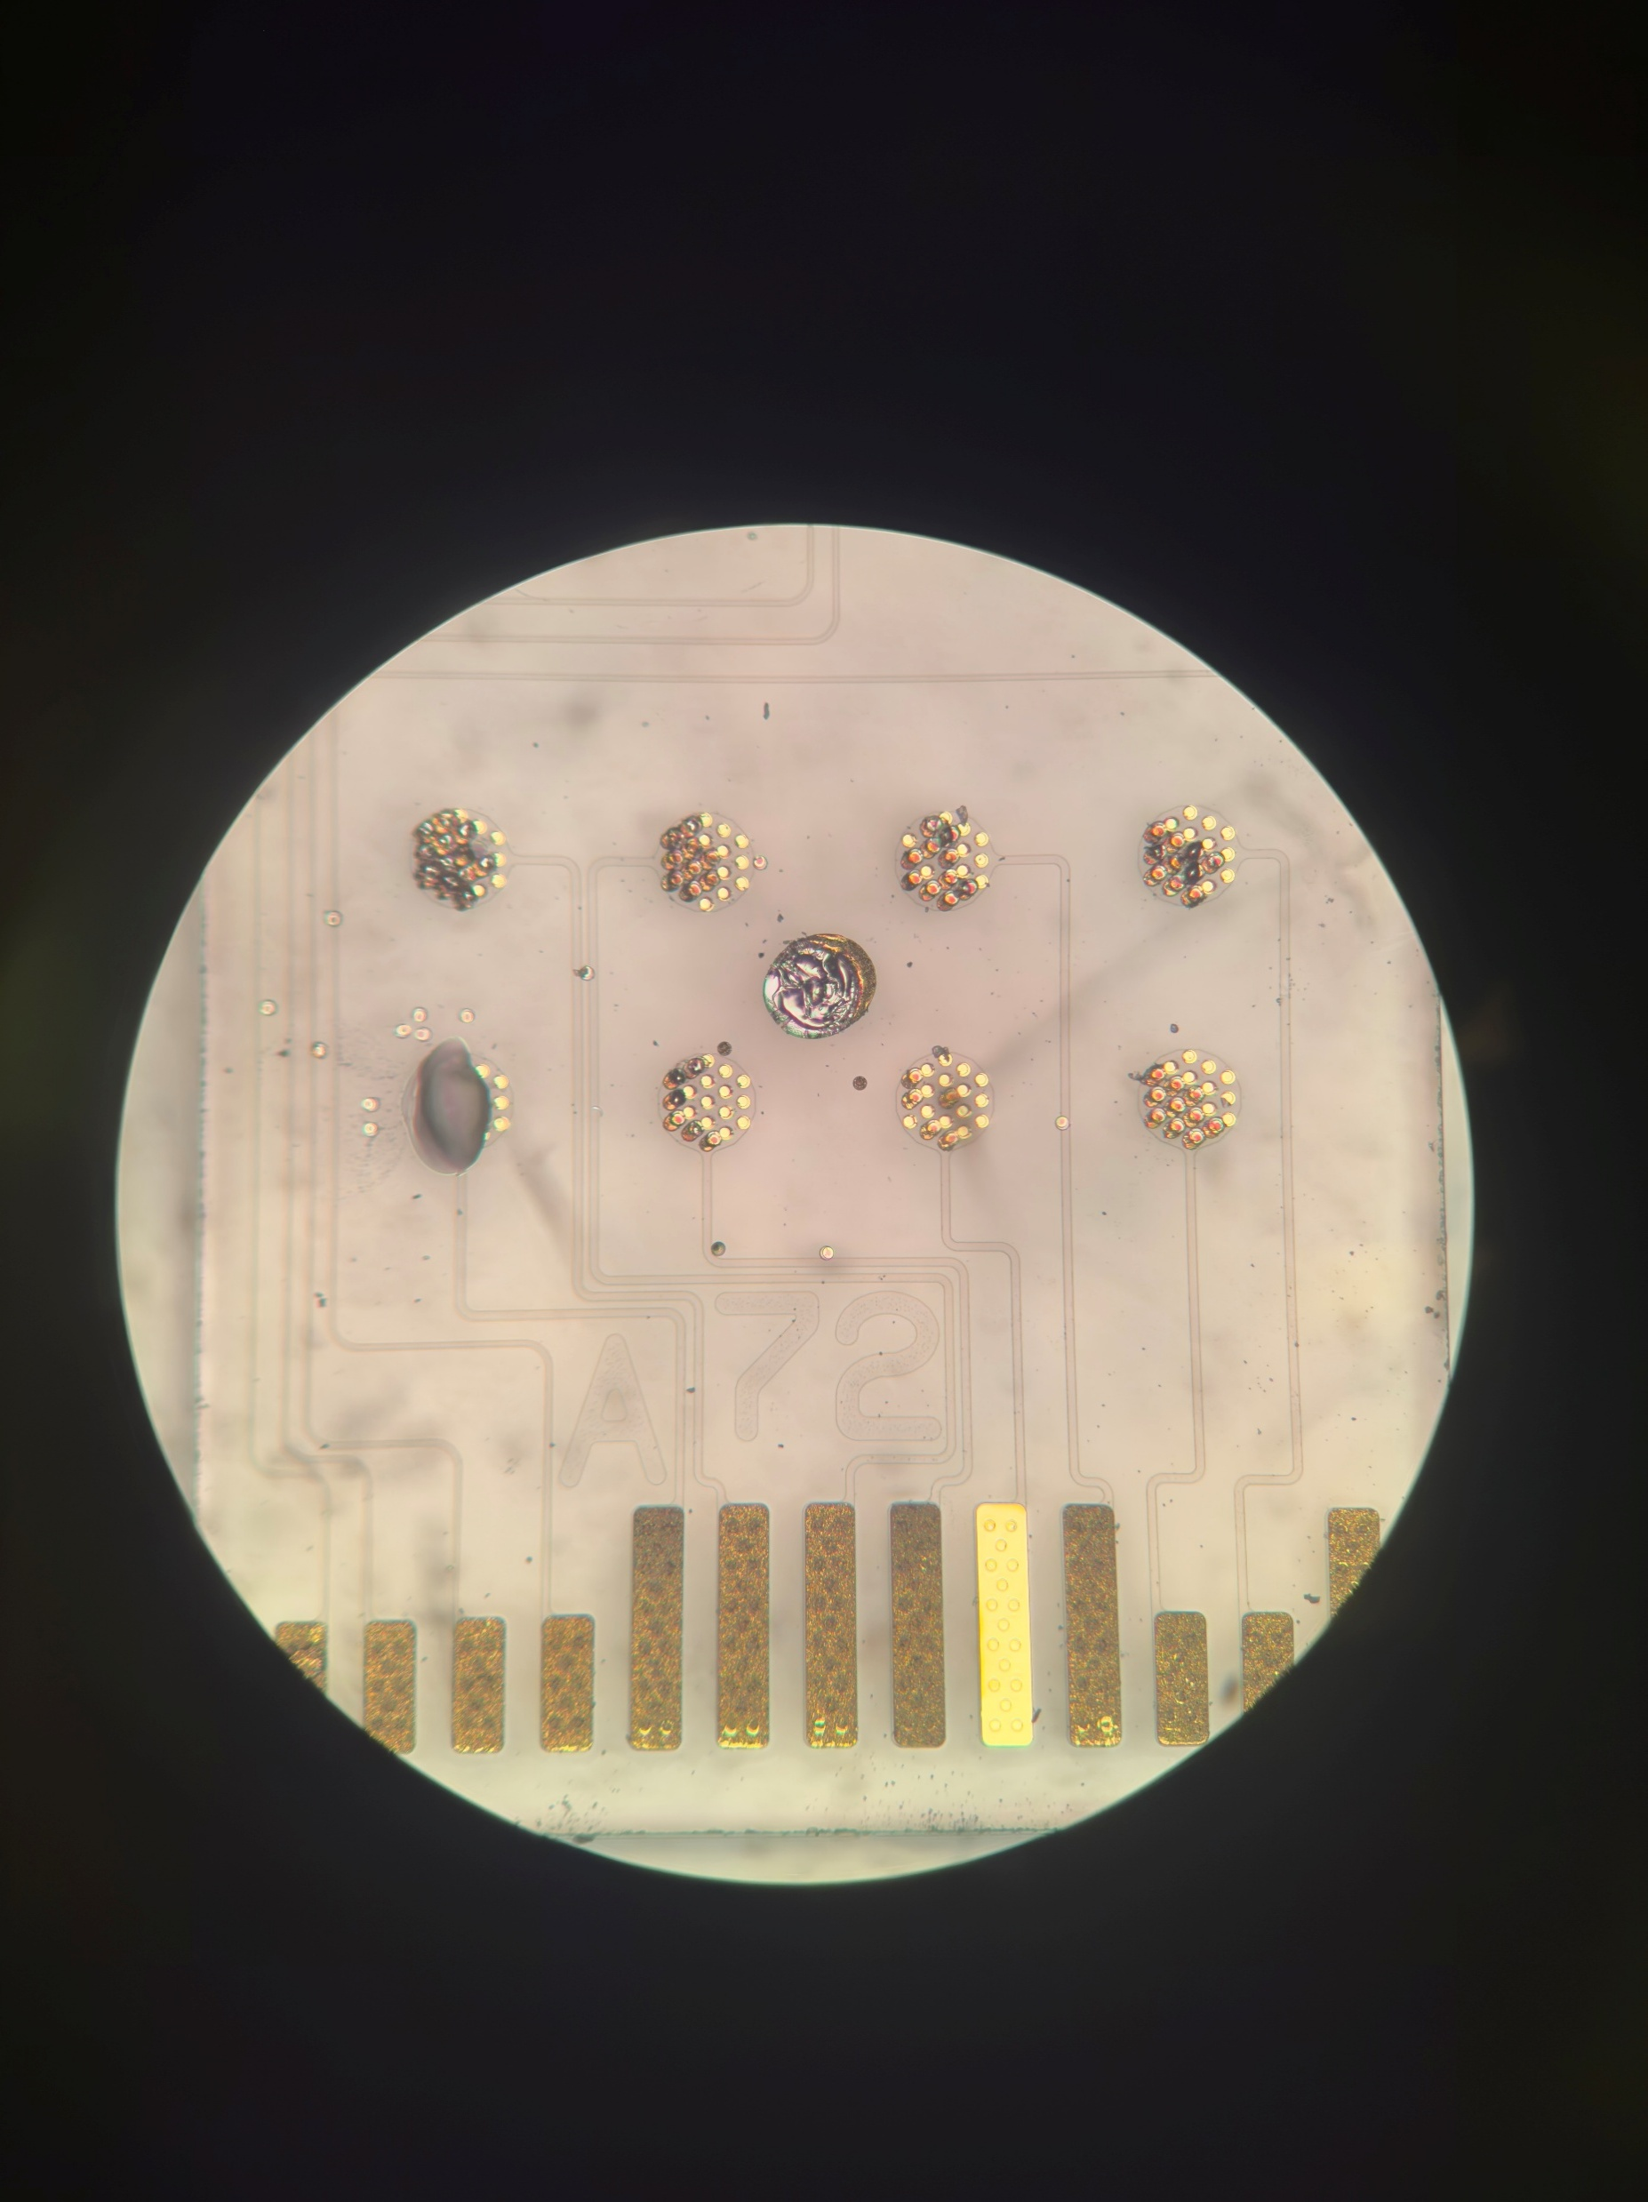
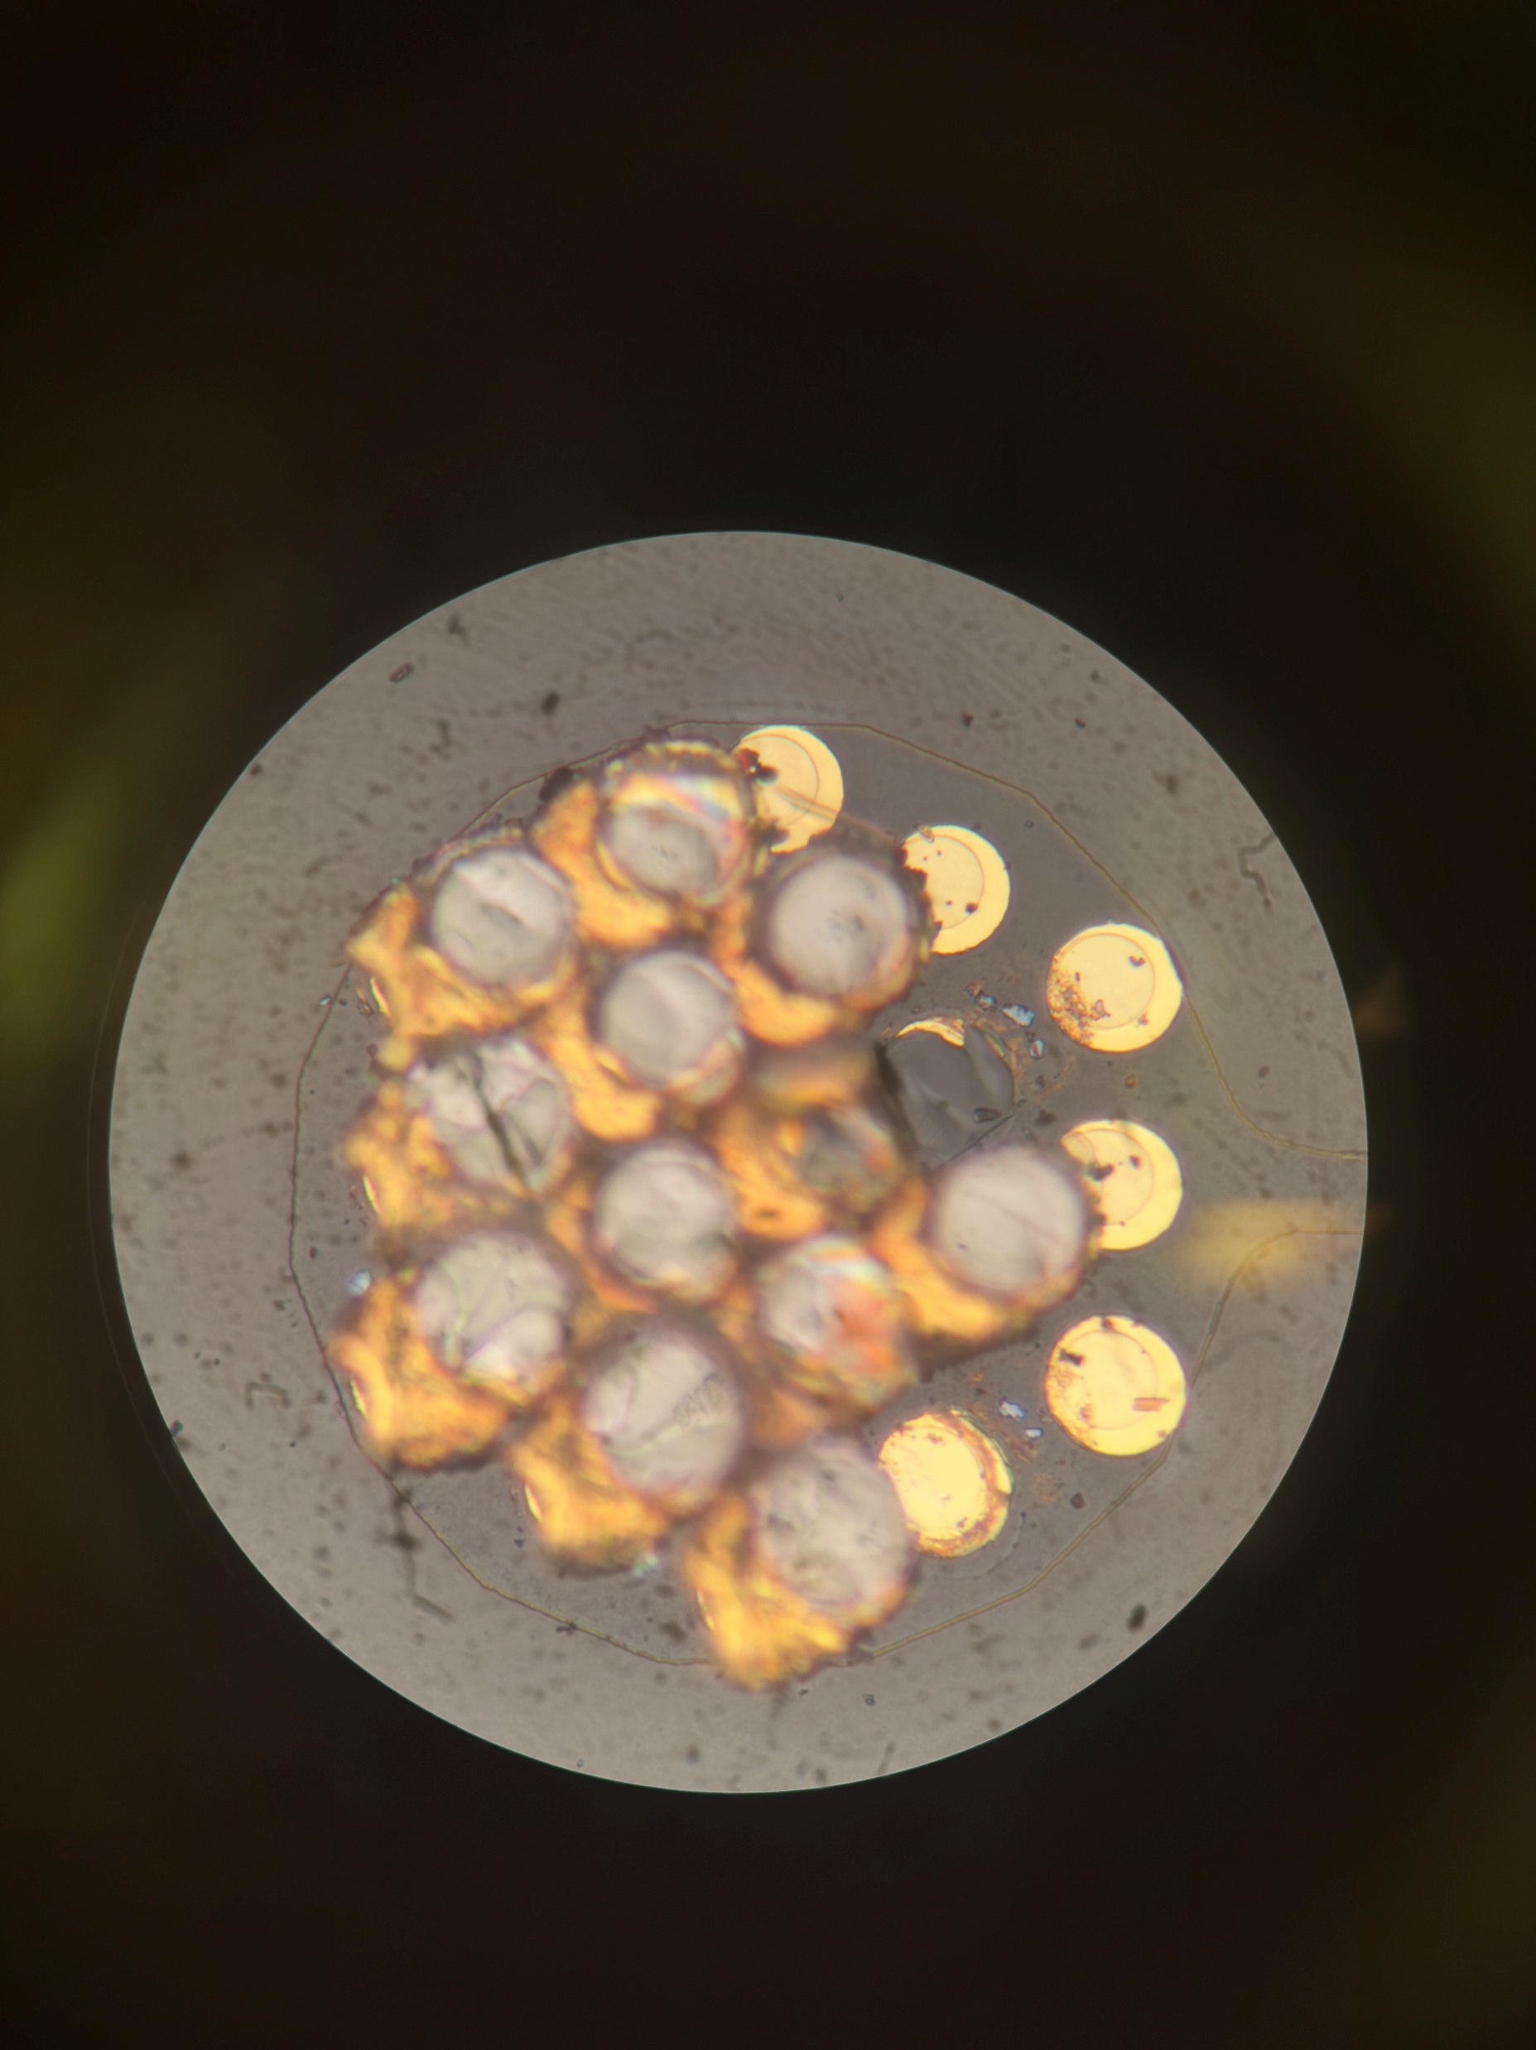
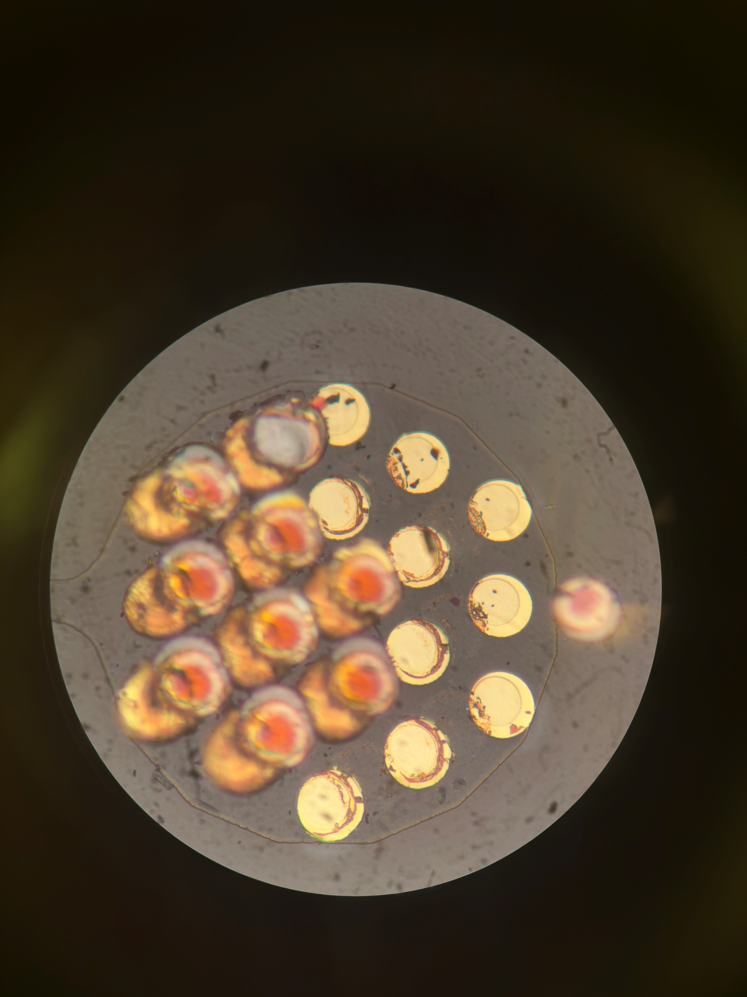
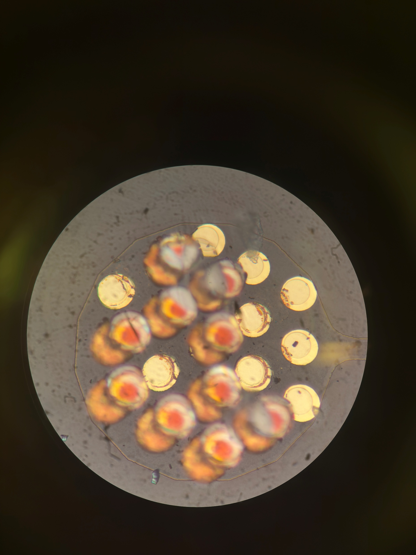
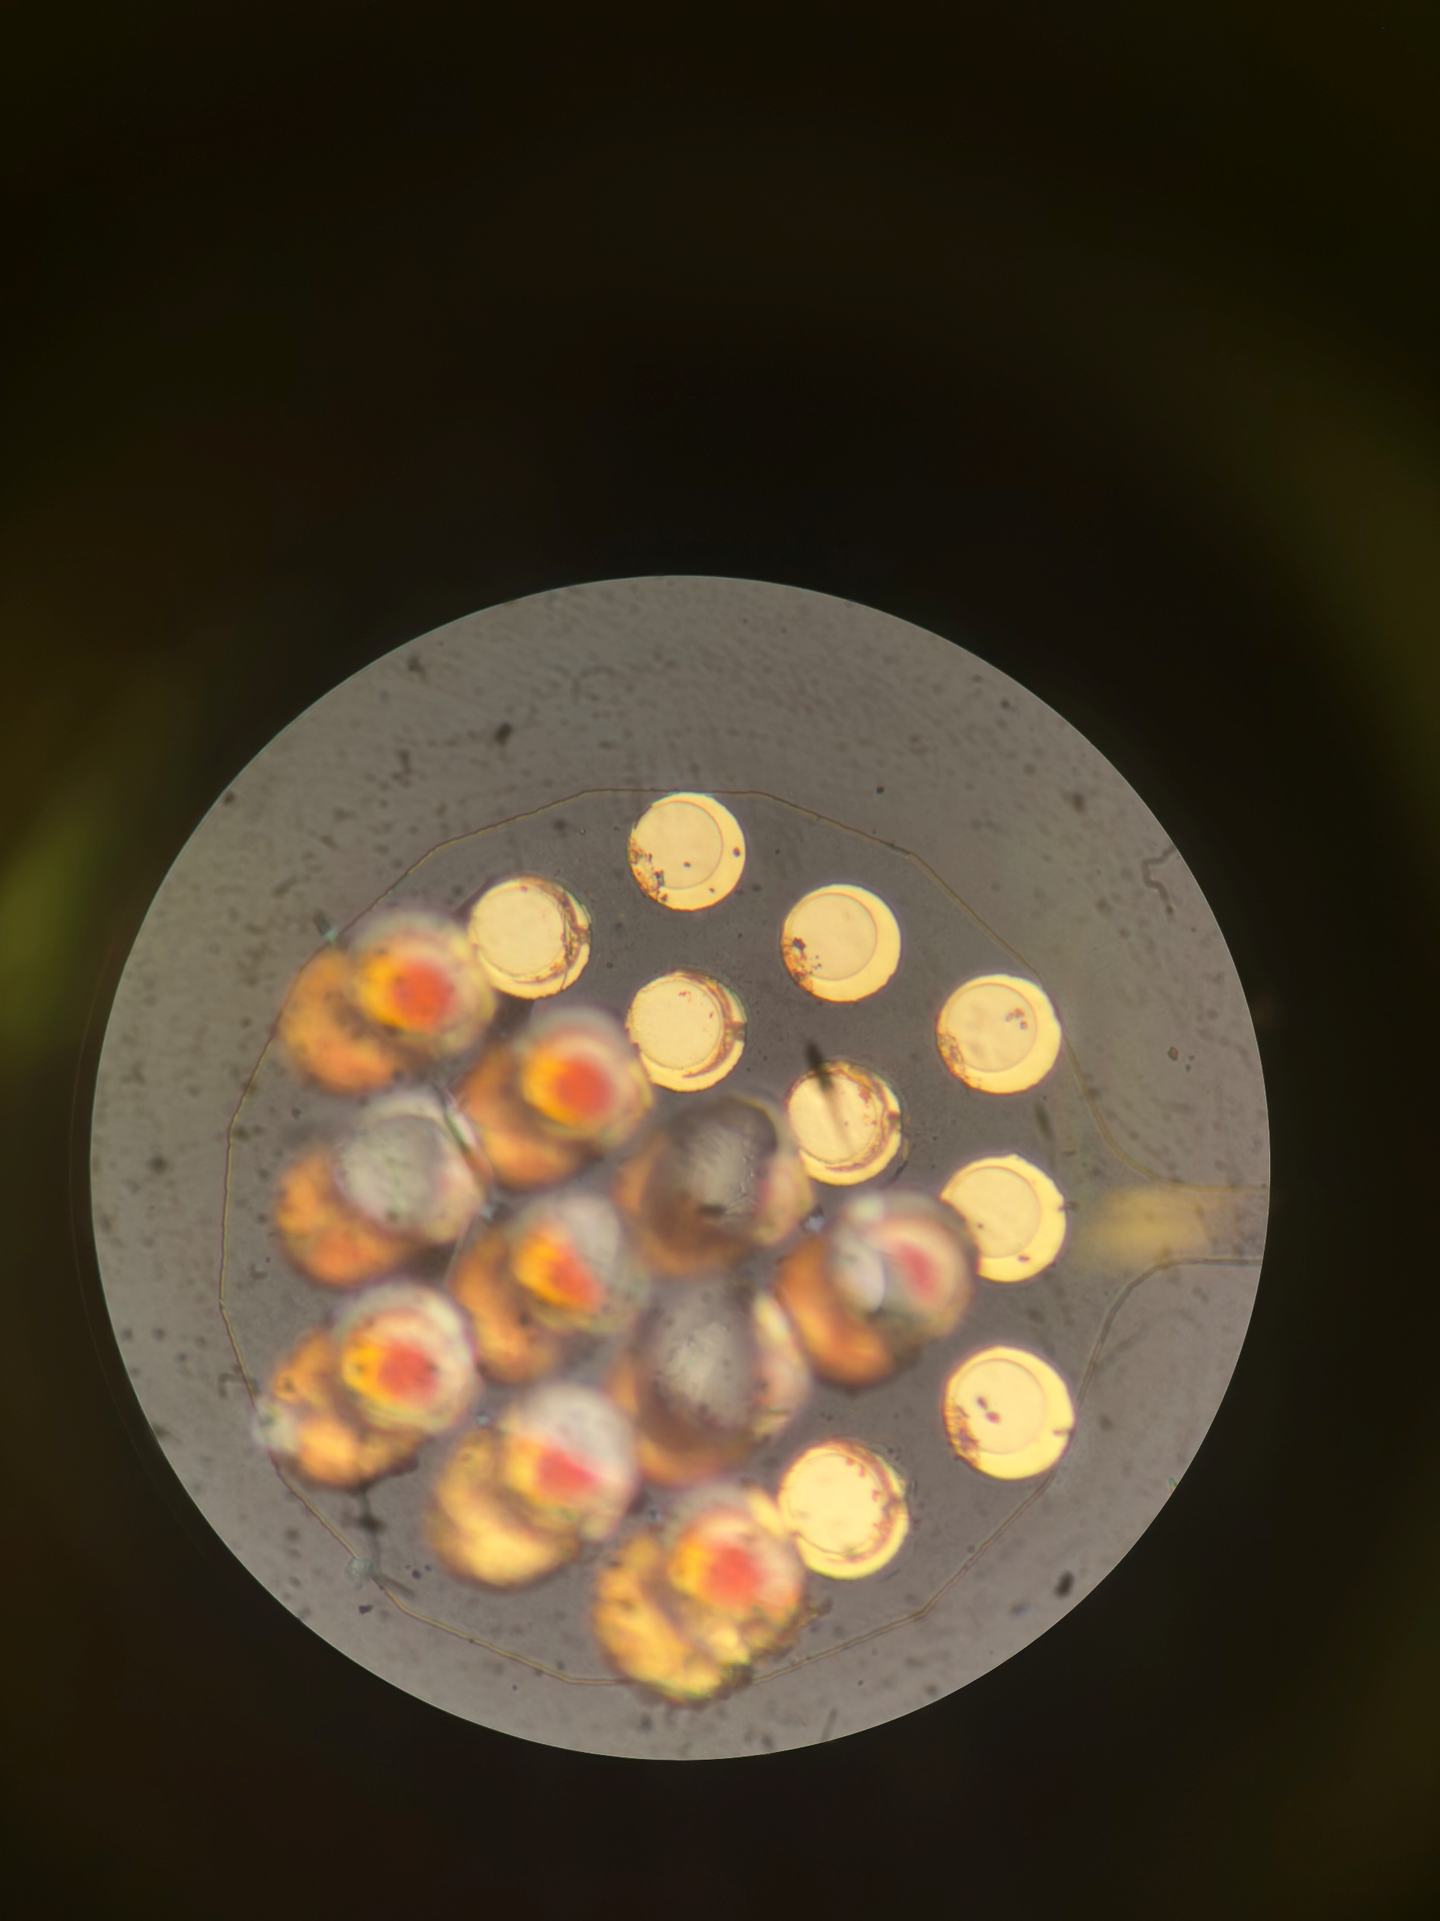
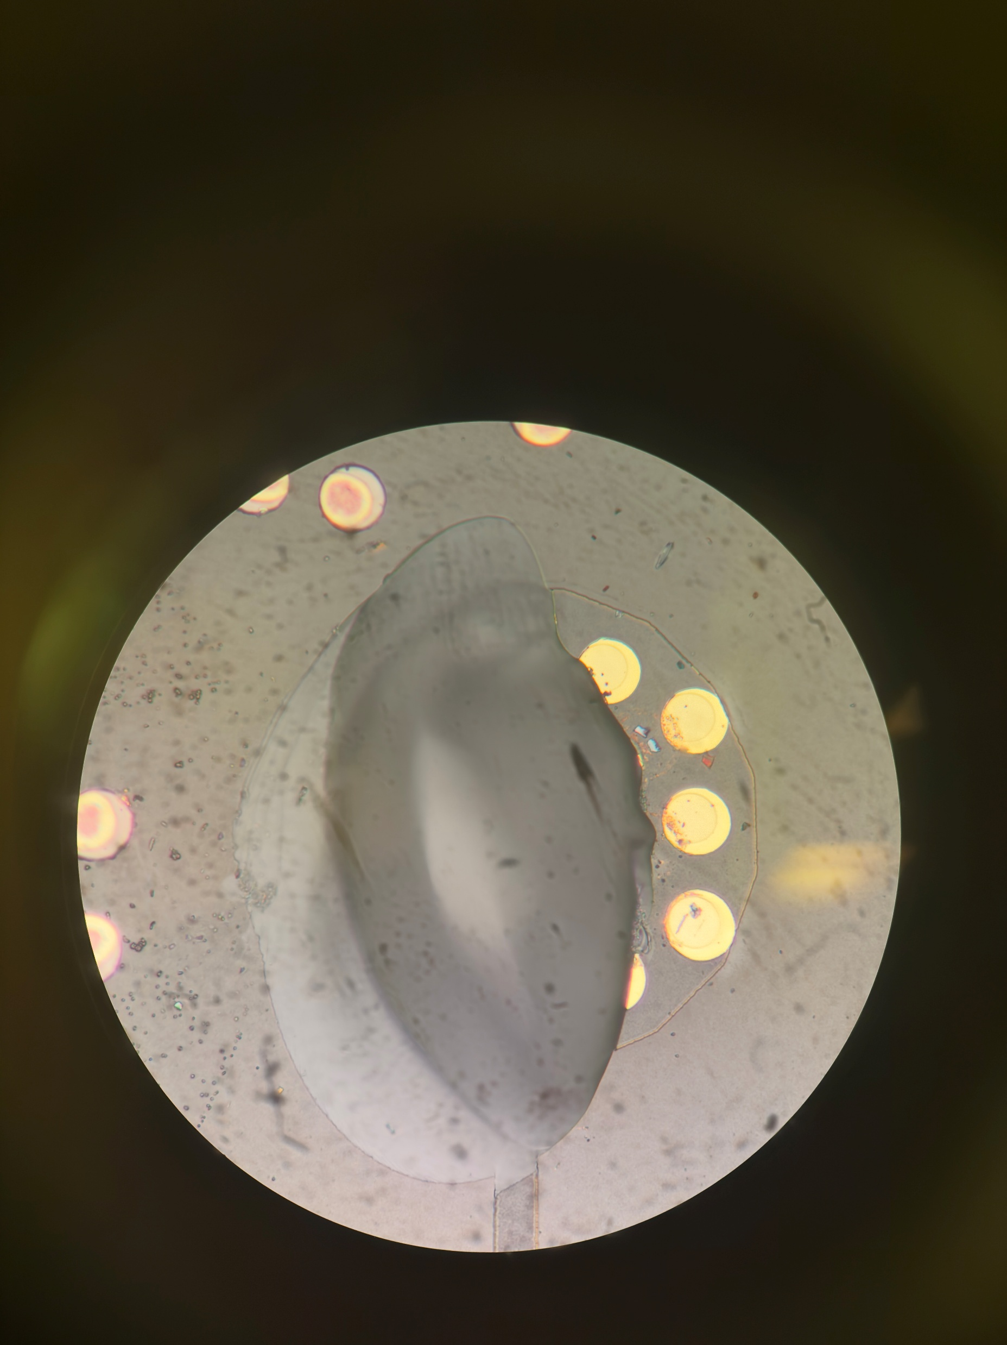
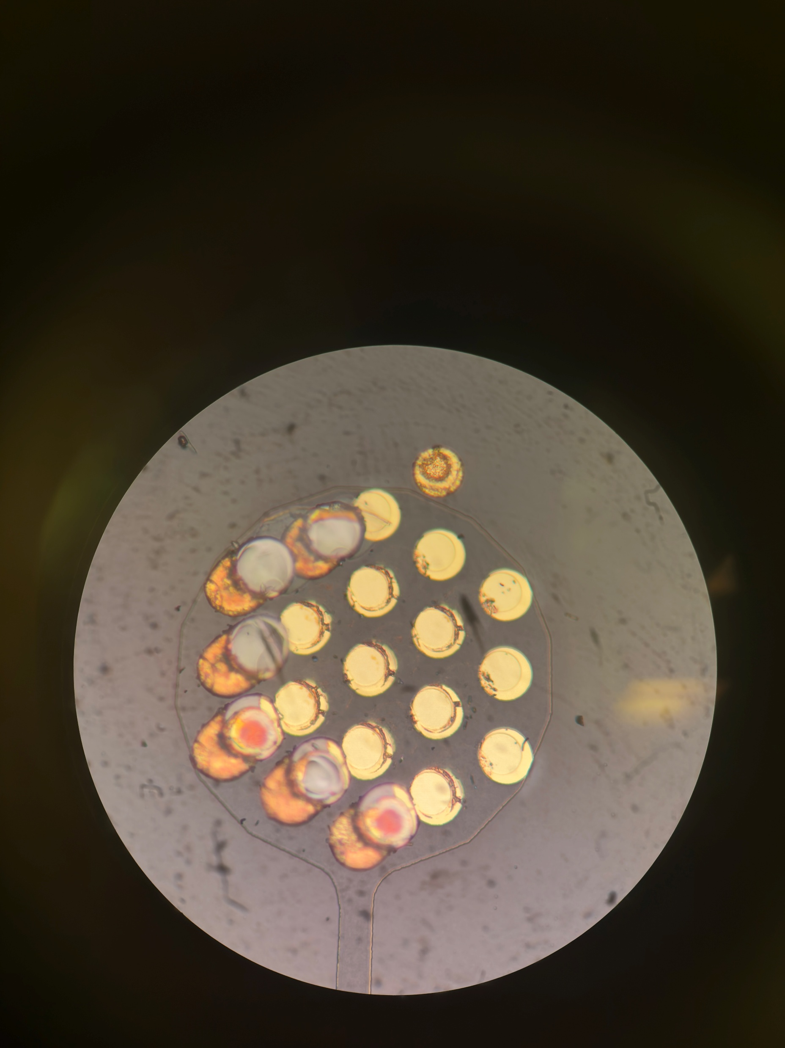
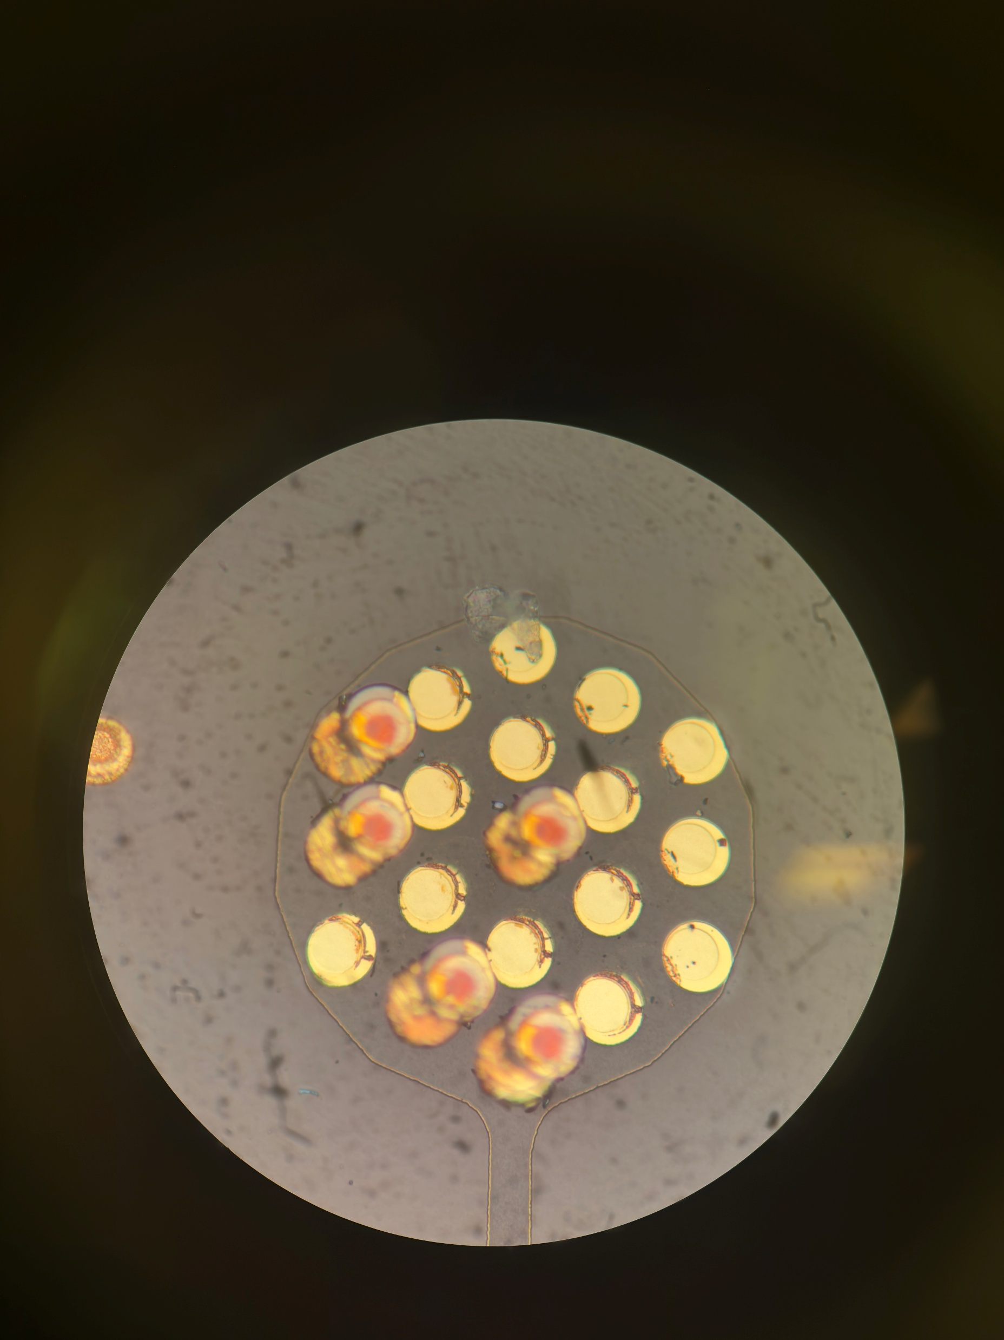
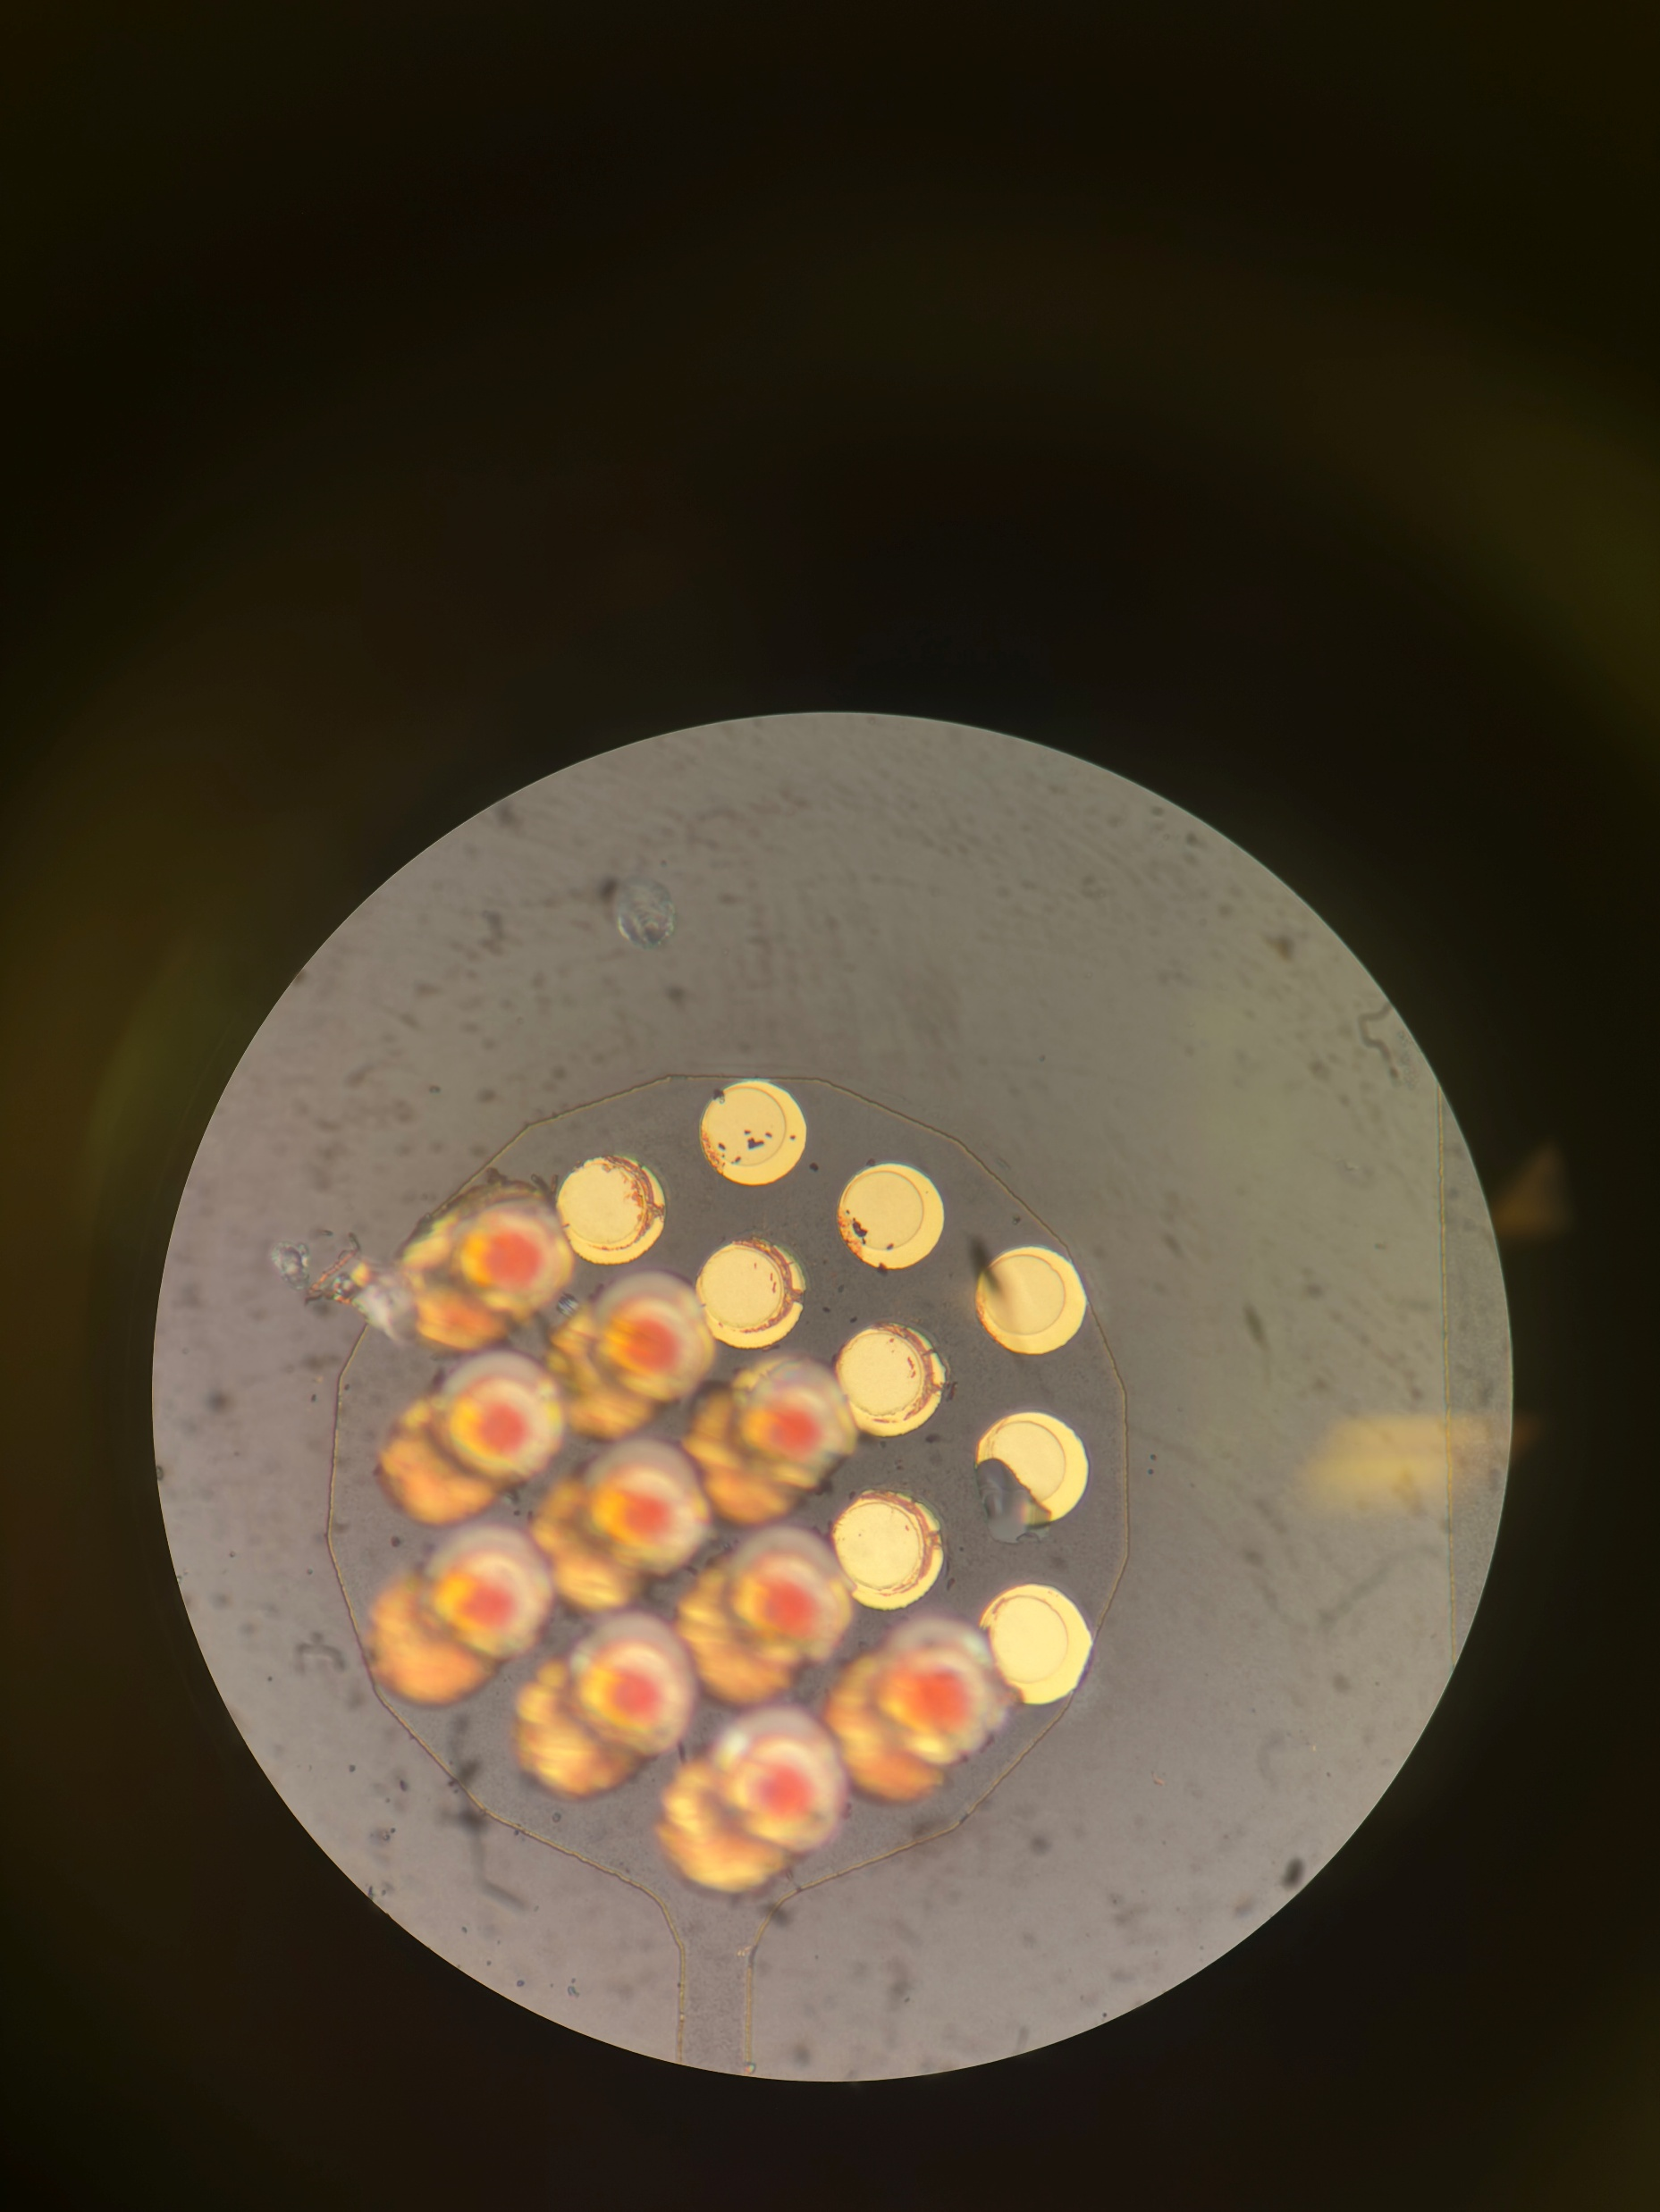
A72 Nearside
Notes:
A72
Need to check between unbonded and compressed strip, whats the change in gold height.

Slide 11
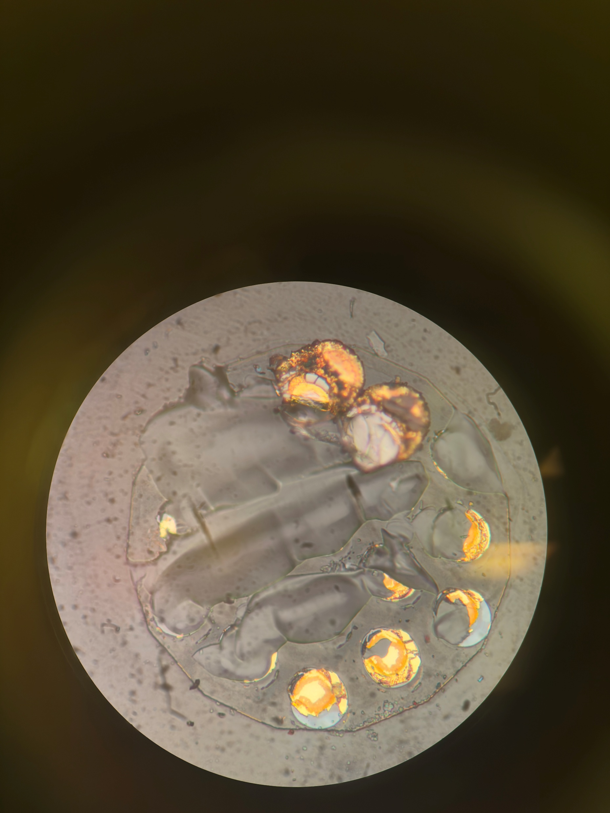
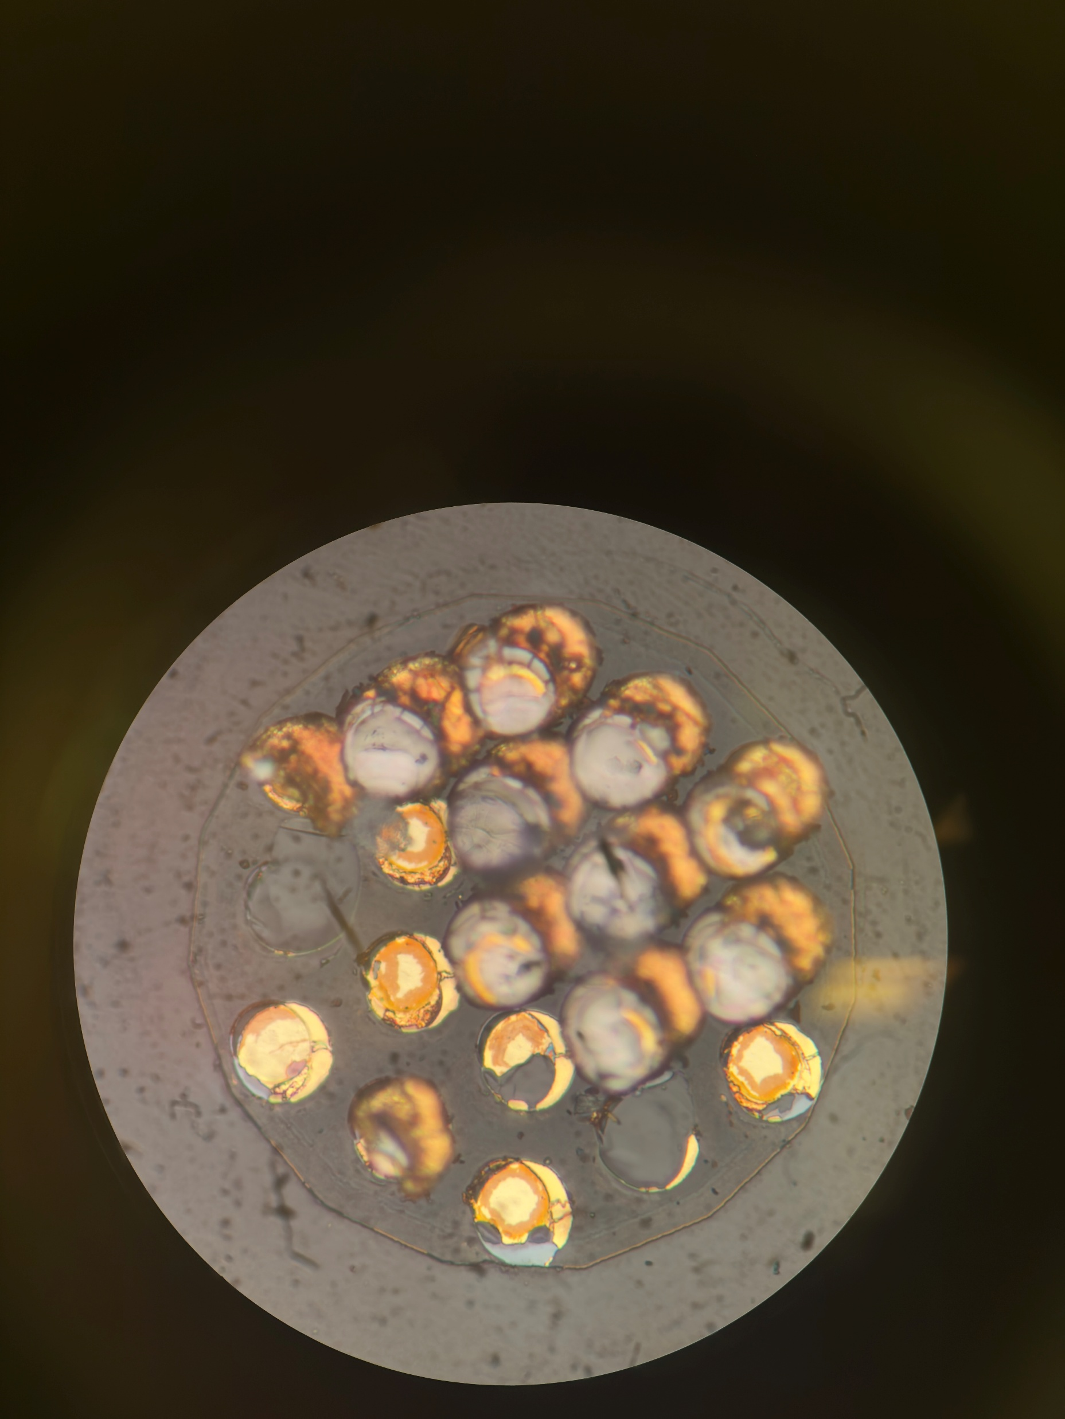
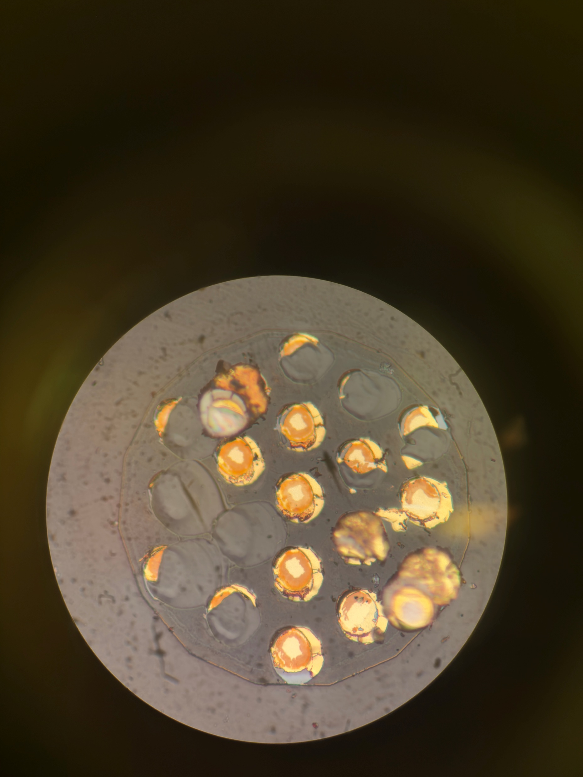
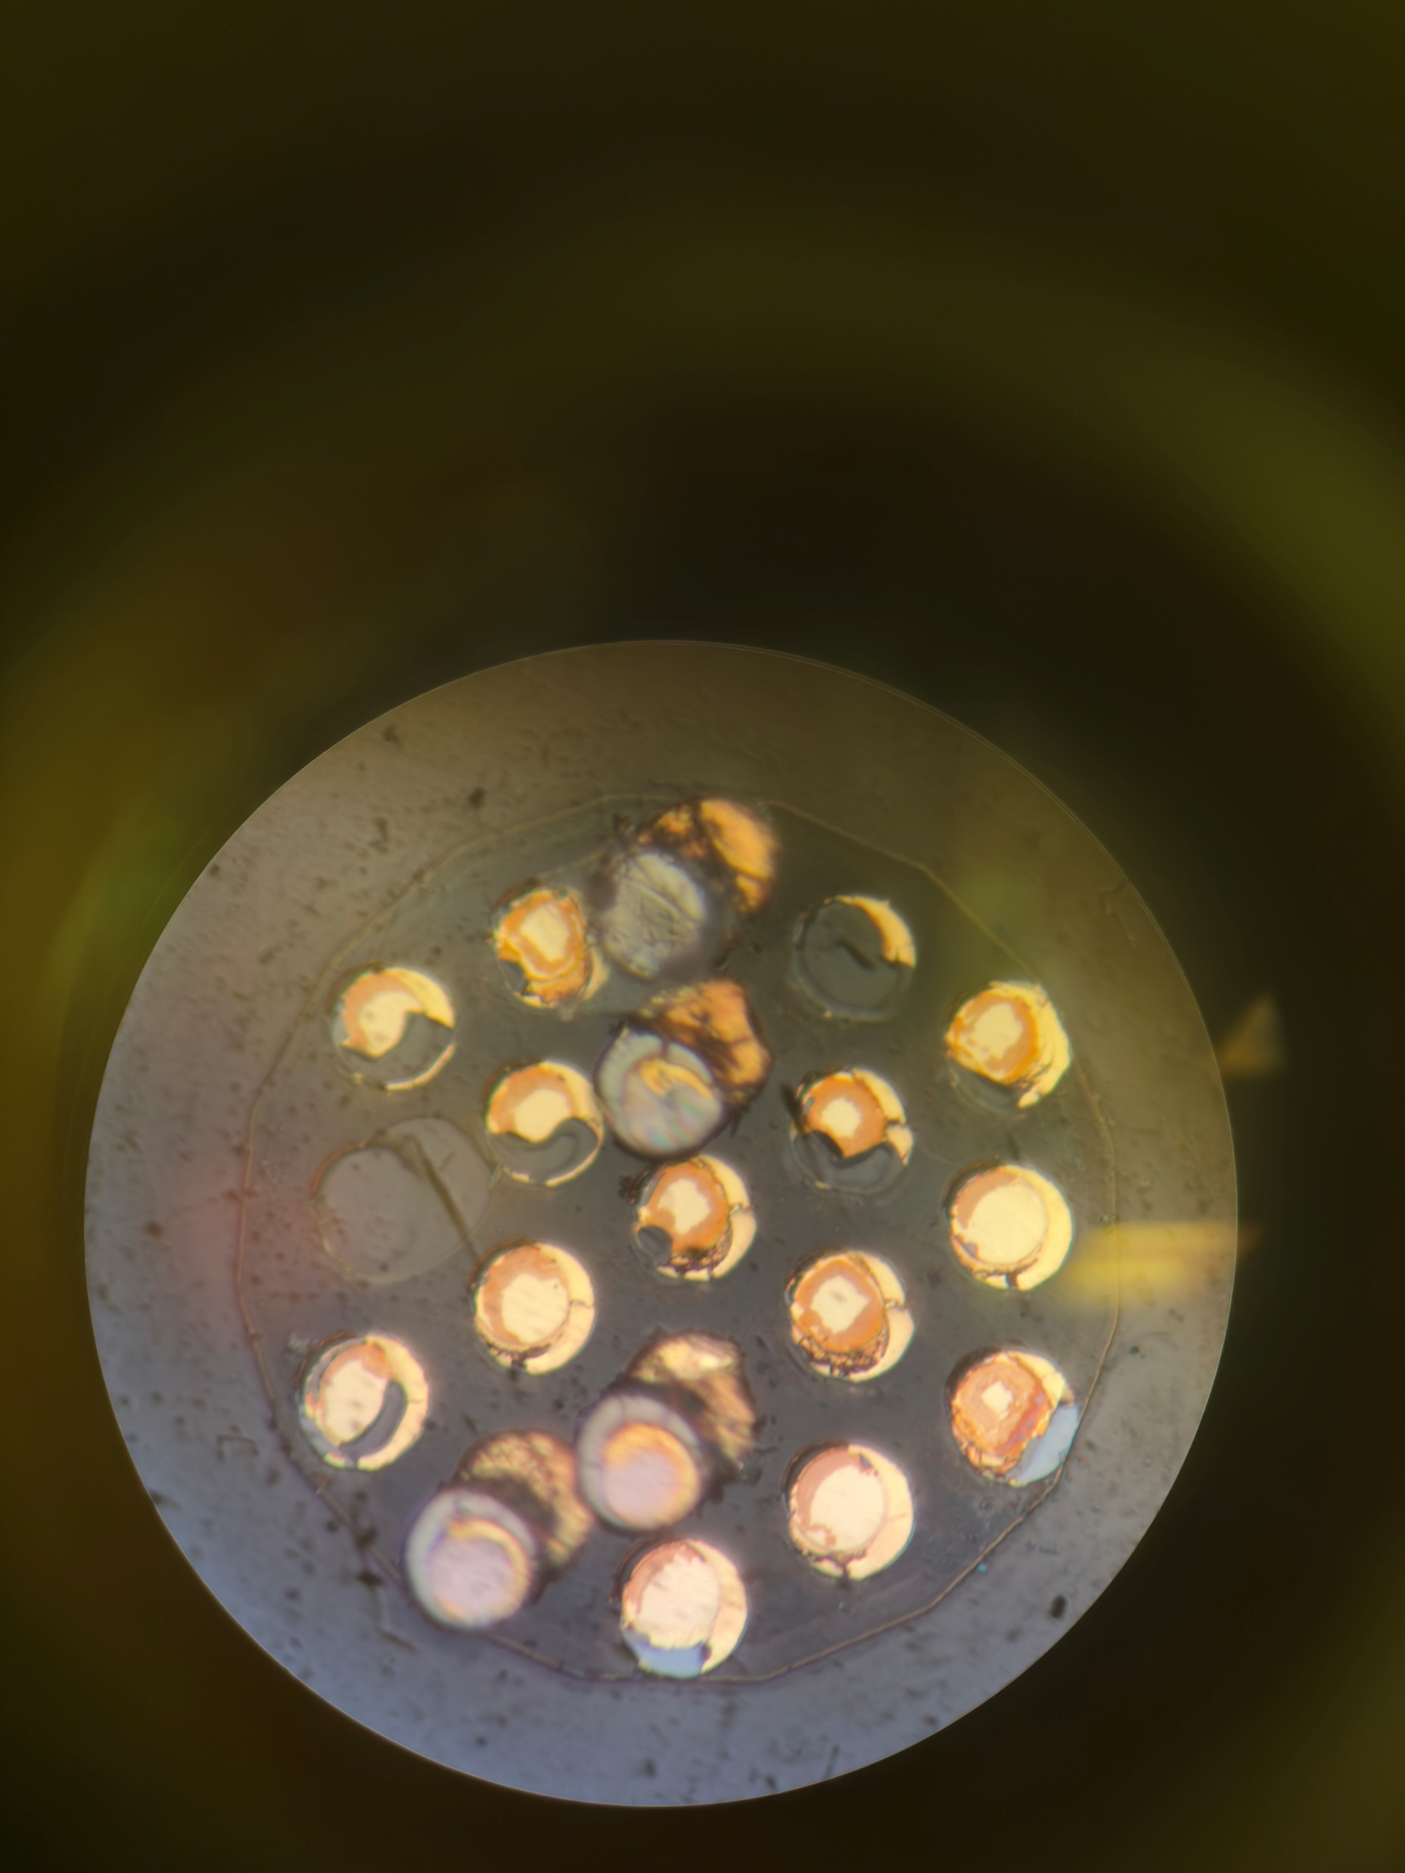
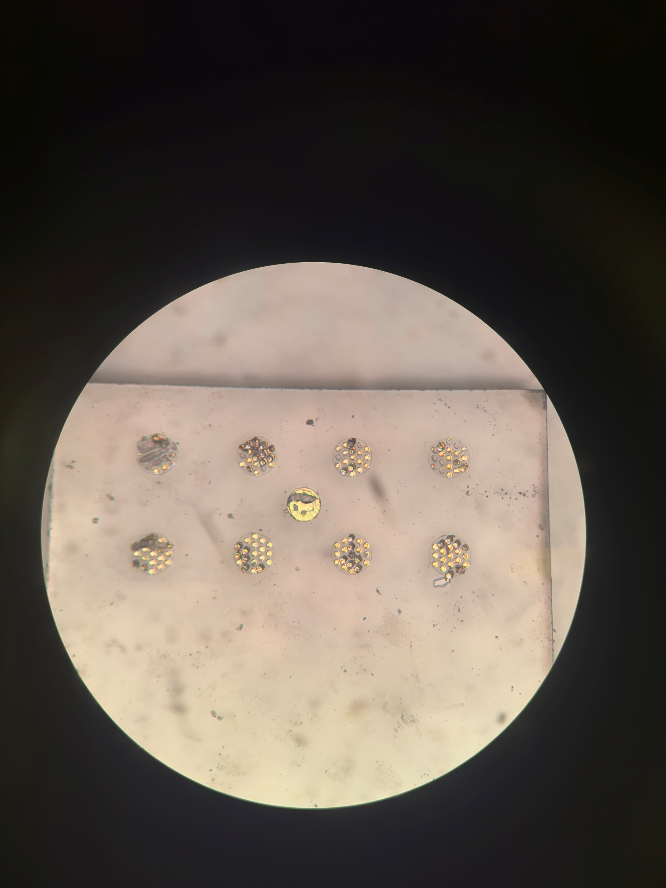
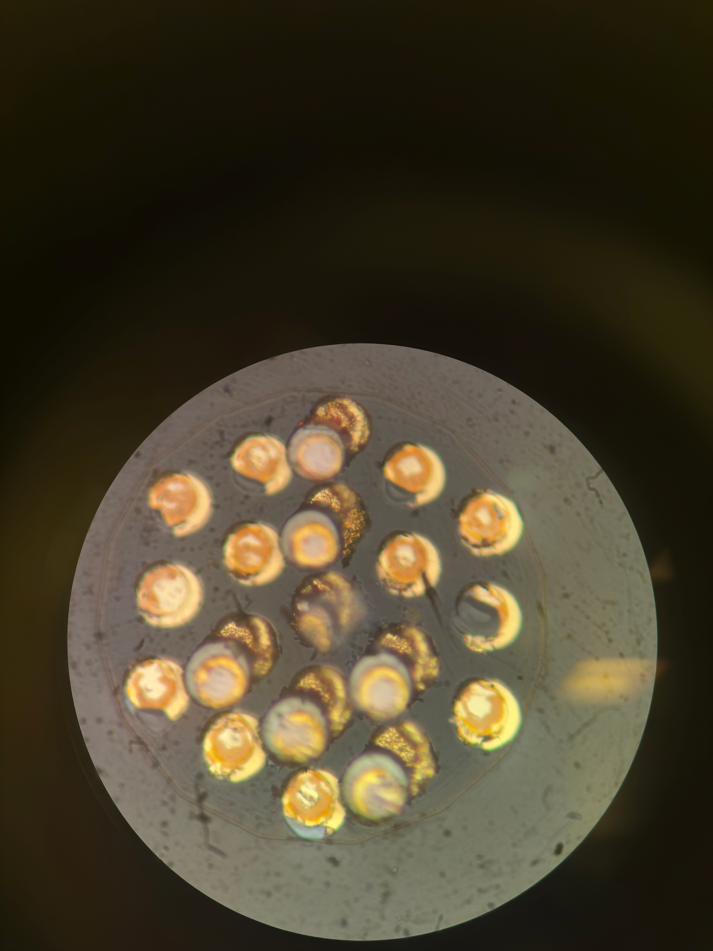
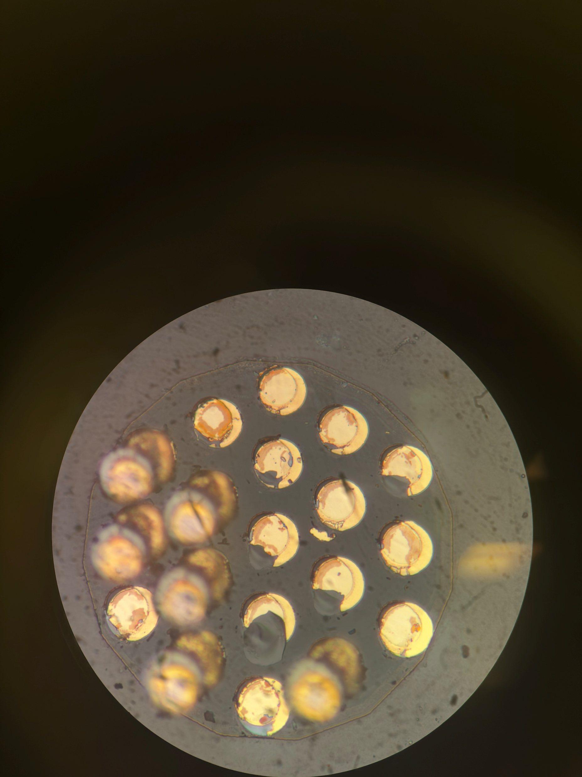
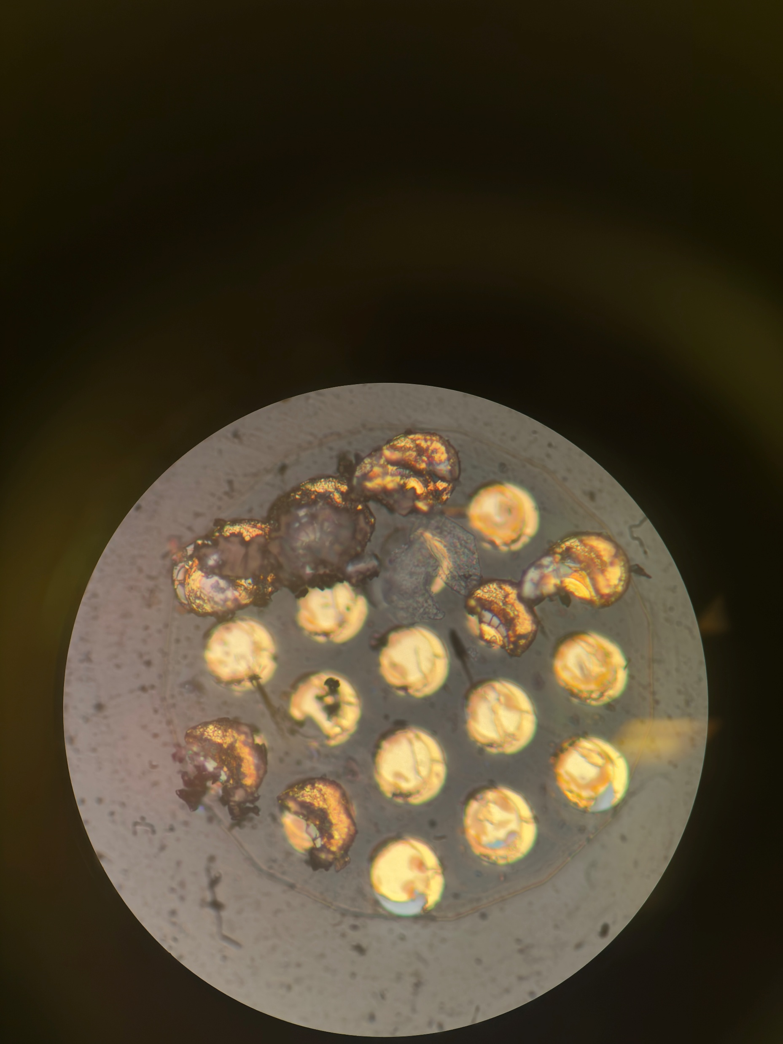
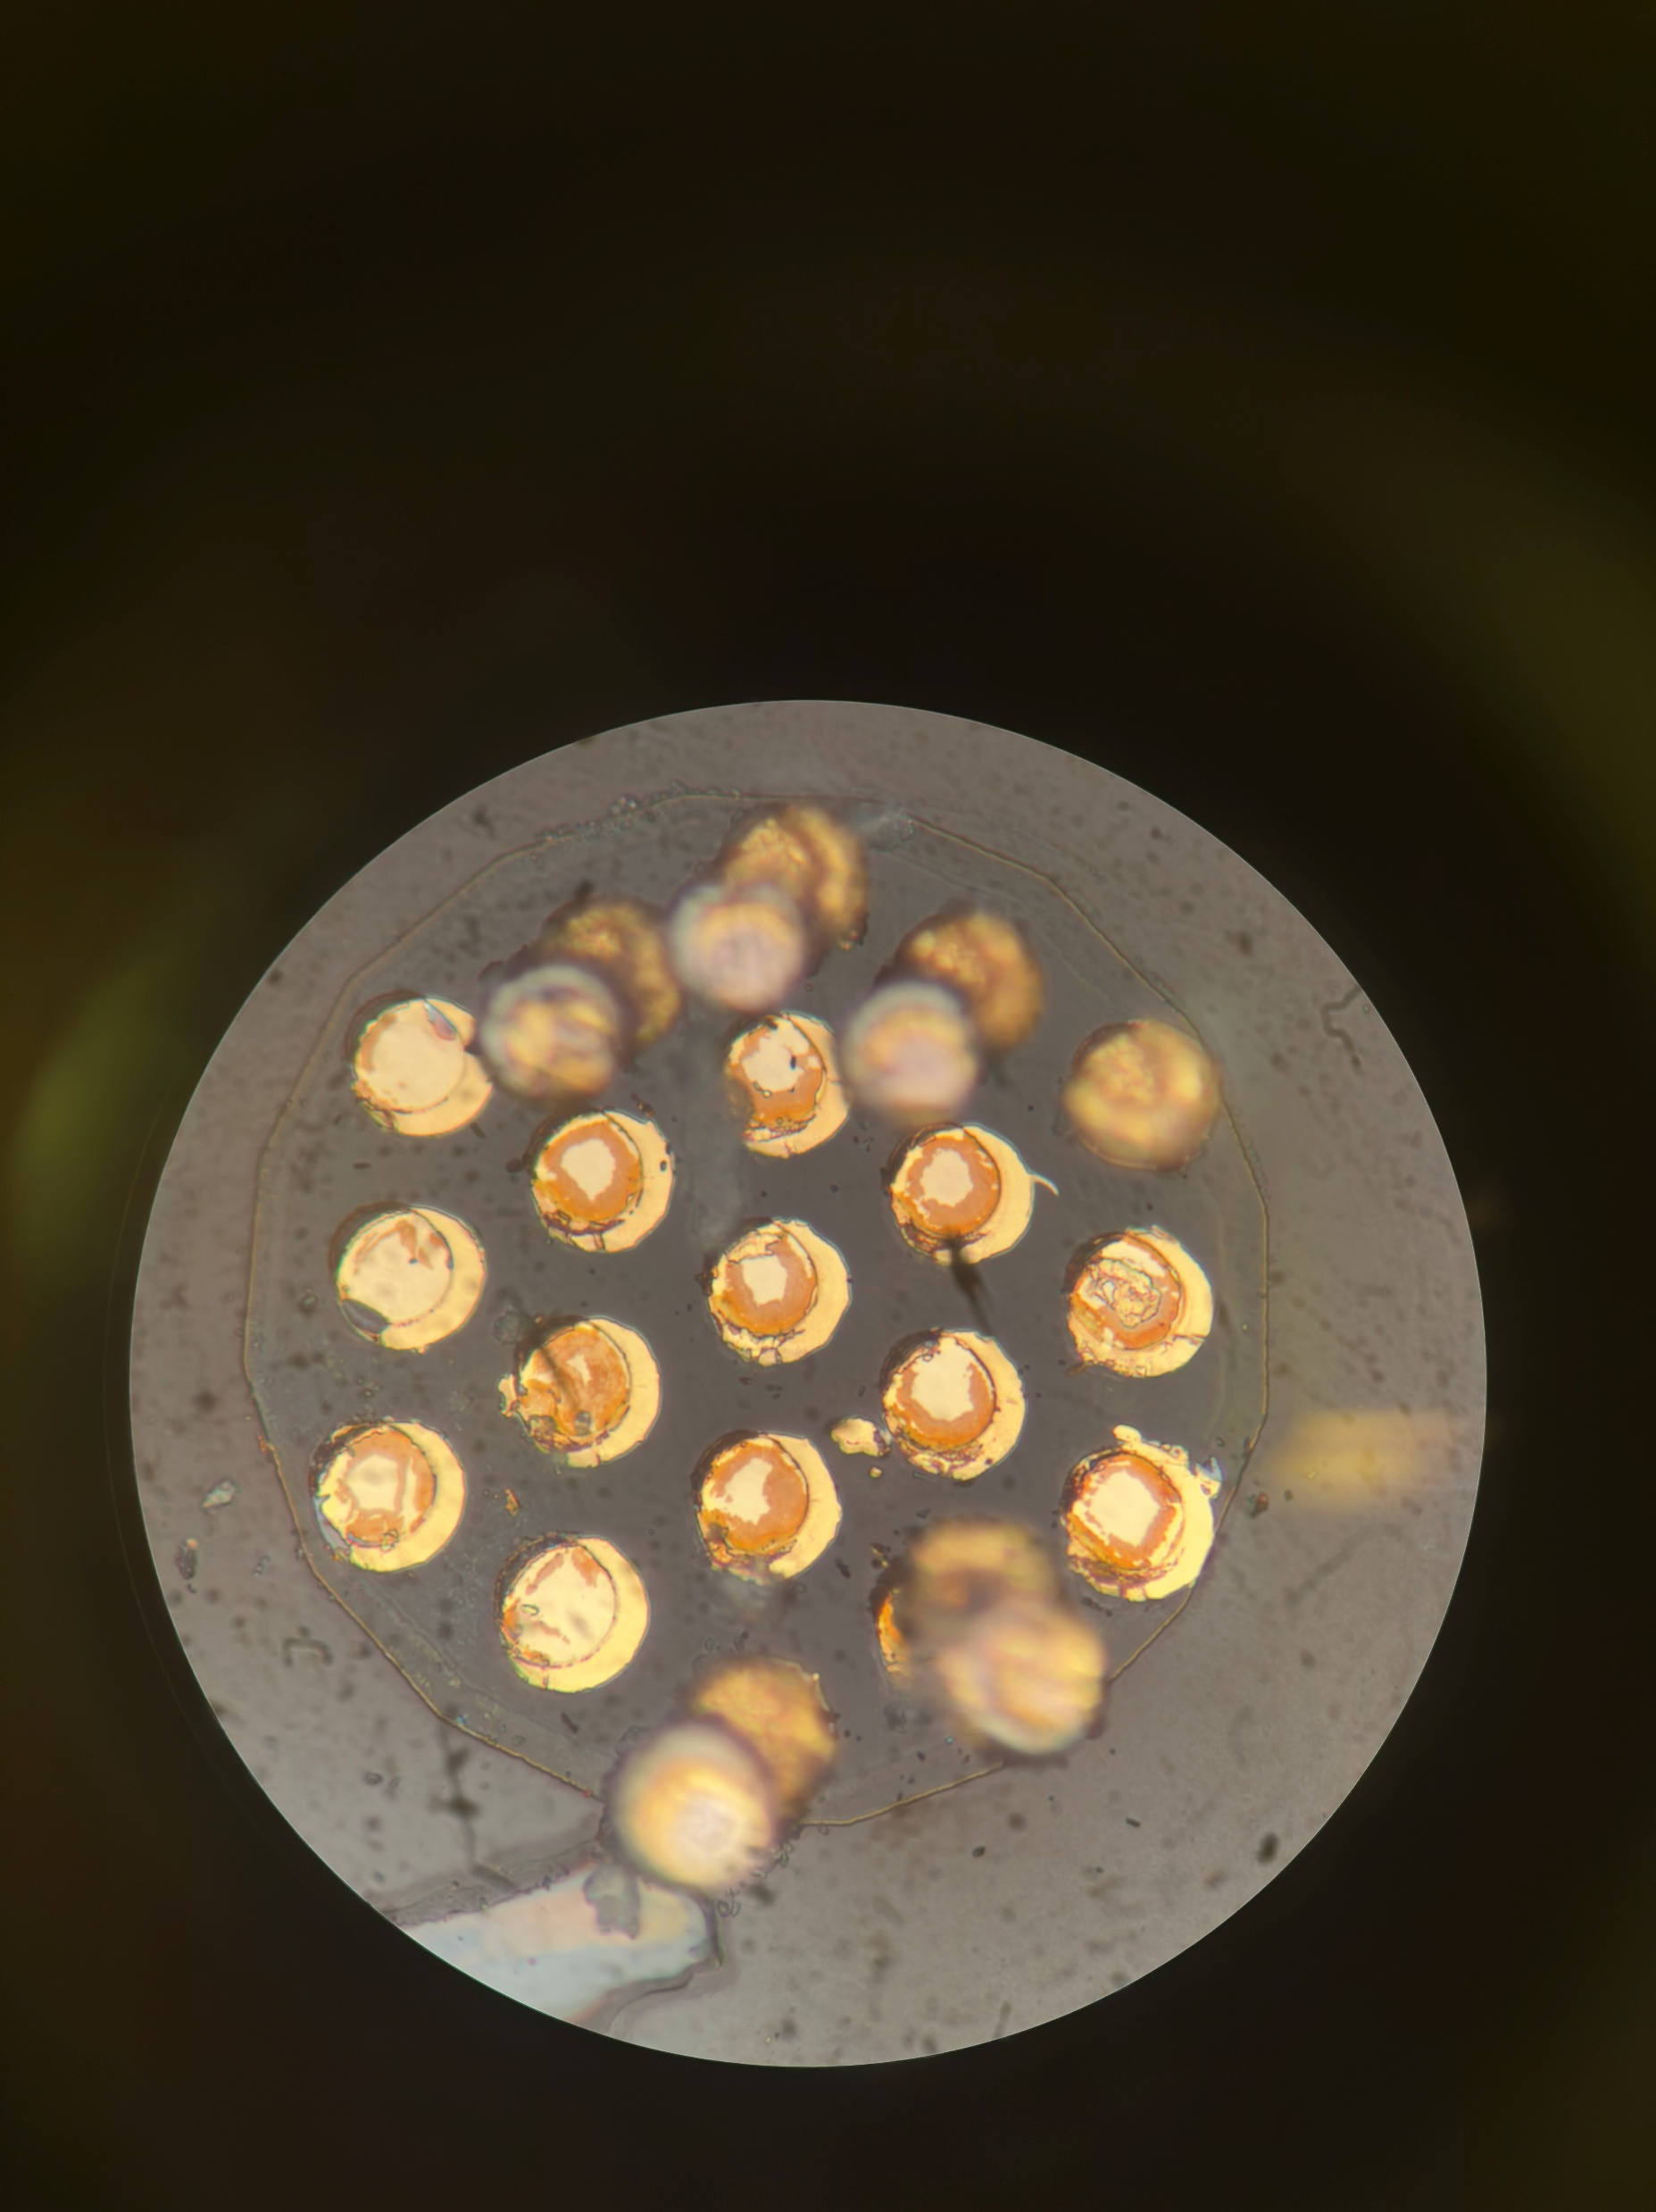
A72 Farside
Notes:
A72
Need to check between unbonded and compressed strip, whats the change in gold height.

Slide 12
A72 Farside
Pad4
Pad 1-4, 5-7: Vias are 7um tall -> Compression of Gold, as taller than 5.5um of unbonded sample
Matches with other strip
Notes:
A72
Need to check between unbonded and compressed strip, whats the change in gold height.

Slide 13
A72 Farside
Pad4
Pad 8: Failure beyond gold/ adhesion metal layer.
Look at detail later.
Failure in glass layer, but specifically under each via, rather than failure on the whole pad.
Similar to compressive failure seen on large pad strips.
Notes:
A72
Need to check between unbonded and compressed strip, whats the change in gold height.

Slide 14
A72 Farside
Pad4
Pad 9: Failure beyond gold/ adhesion metal layer.
Deep cut of 7um into strip.
Glass failure, but more localised
Notes:
A72
Need to check between unbonded and compressed strip, whats the change in gold height.

Slide 15
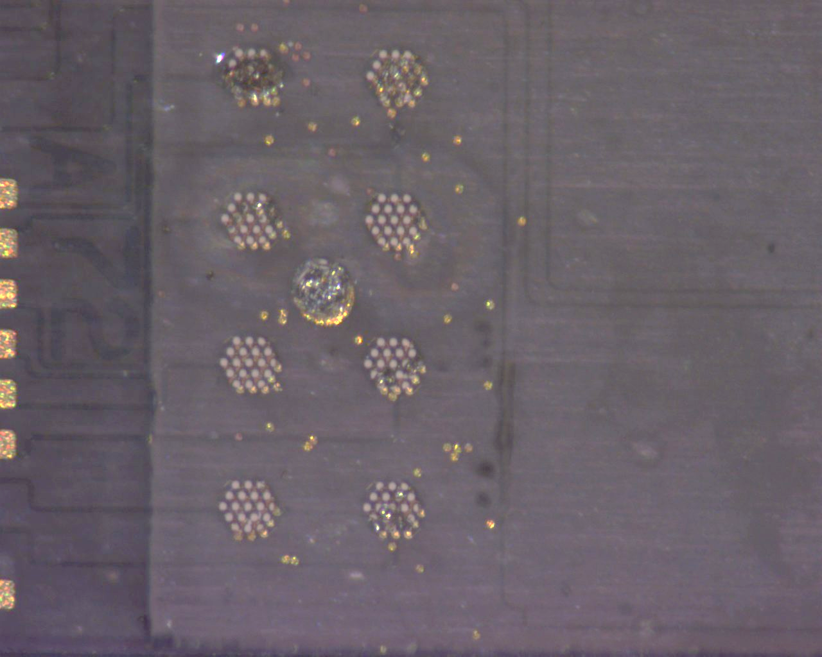
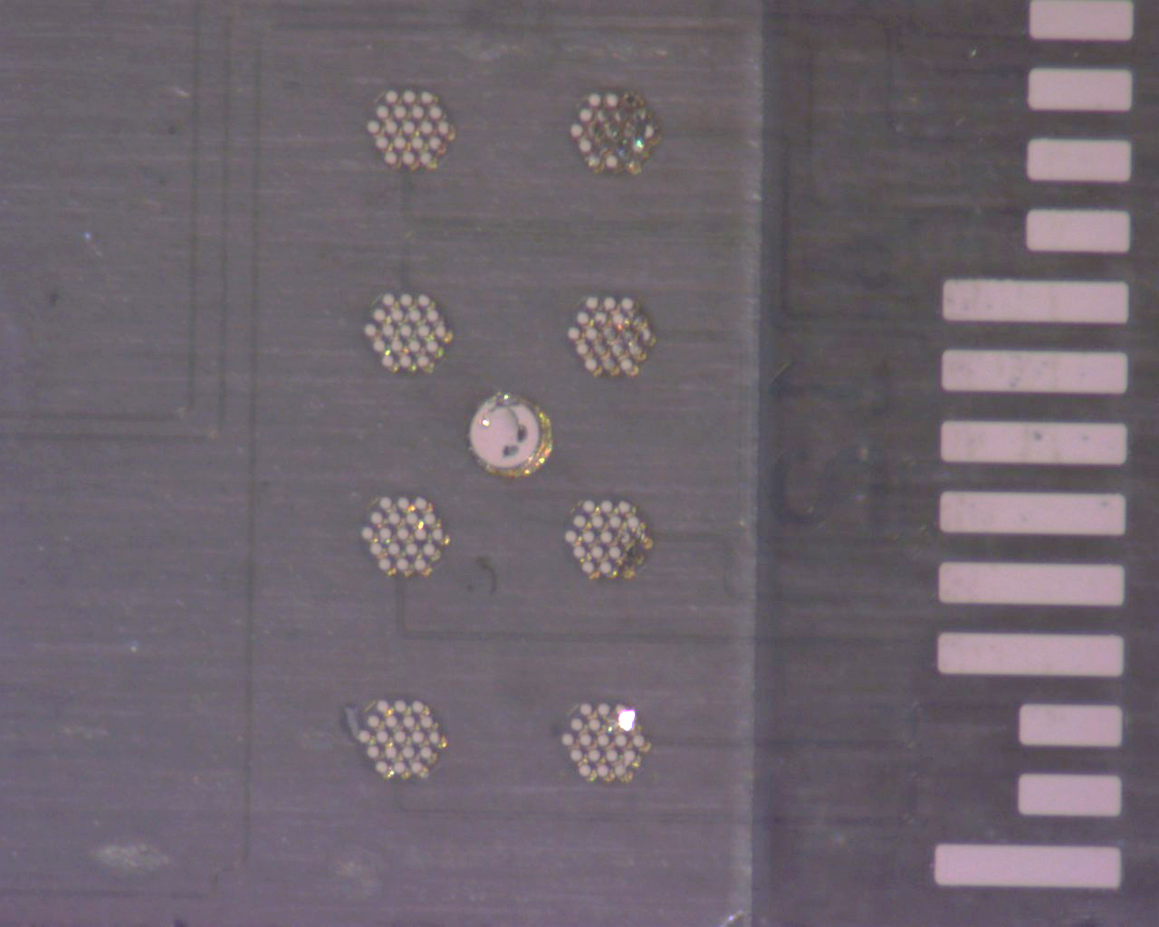
A12 (Back)
Post Anneal

Slide 16
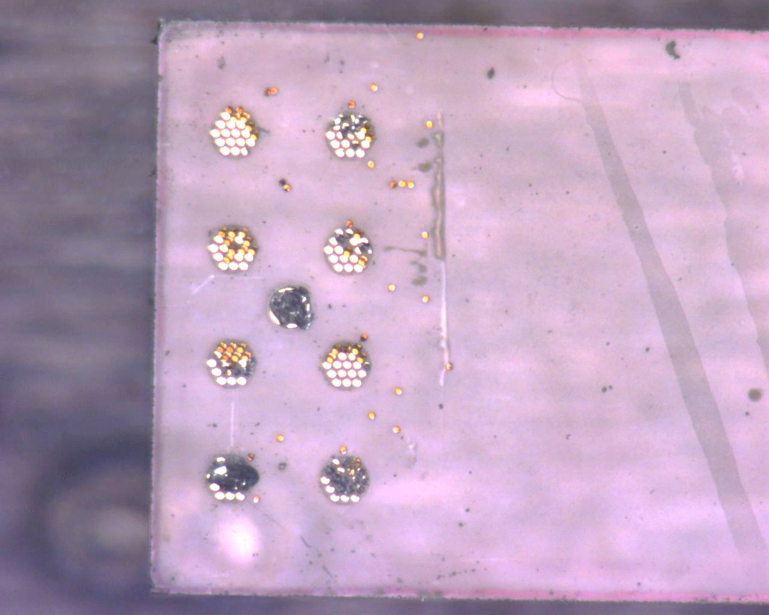
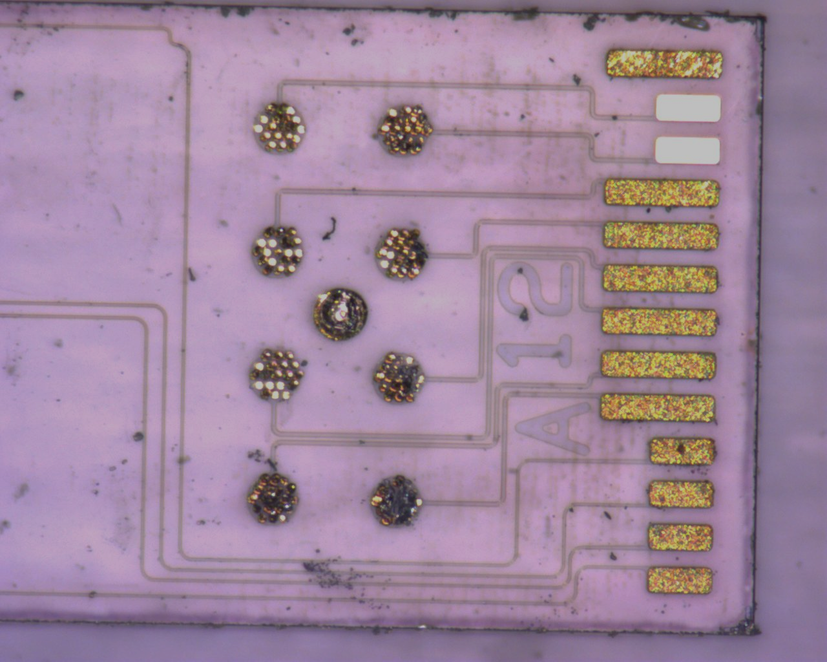
A12 (Front)
Post Pull Test

Slide 17
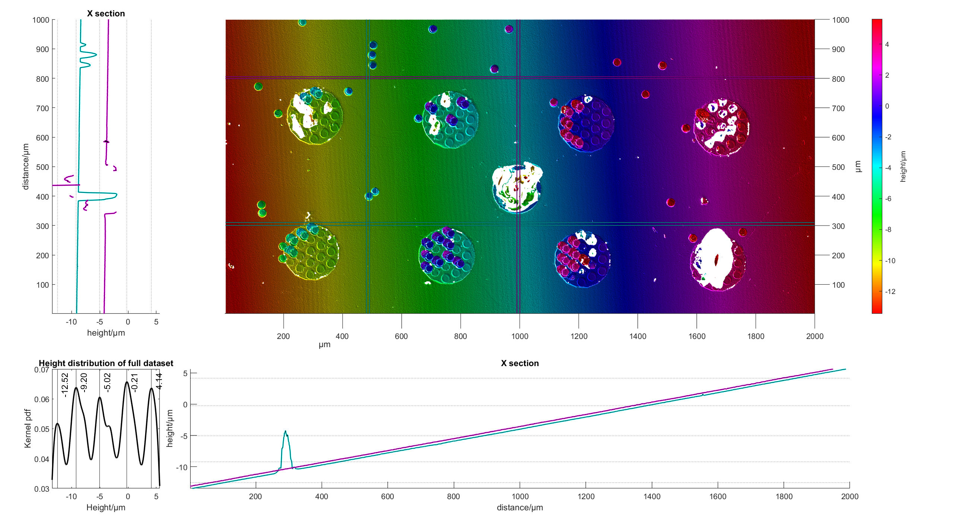
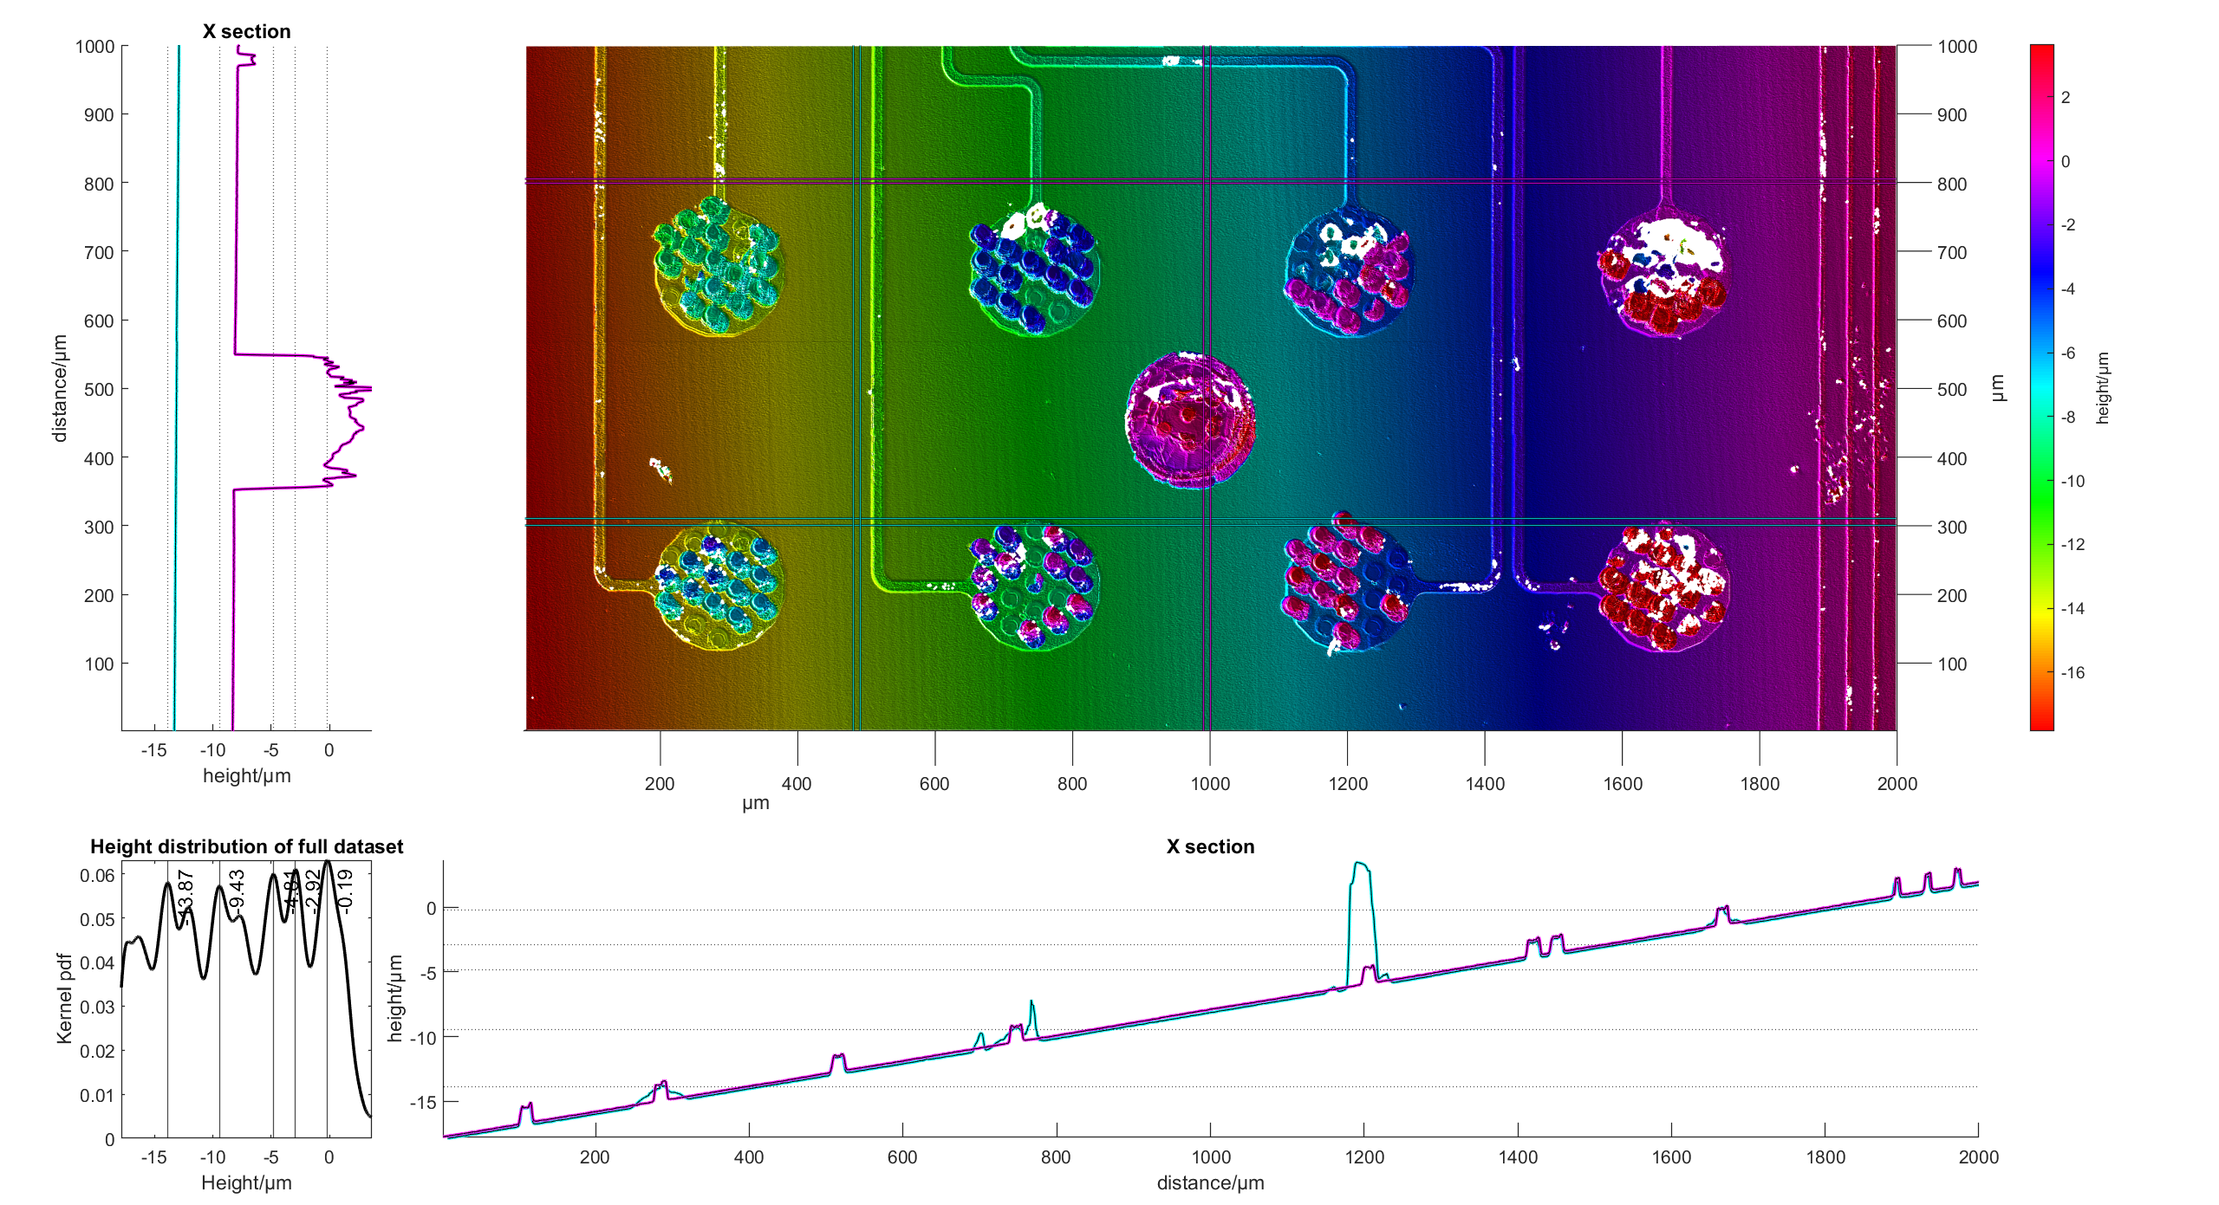
A12
Pad 1,2,3: Outer edge of unbonded due to no contact

Slide 18
A12
Pad 1,2, 3:Rest of Area Pad adhered onto other strip, failure at adhesion layer

Slide 19
A12
Pad 3,4,8: Areas directly underneath vias show troughs of -3.5um.
Goes through adhesion metal and into glass.

Slide 20
A12
Pad 6,7: Areas directly underneath vias show troughs of -1um.
Probably removal of adhesion layer metal to glass?
Z height of adhesion layer(approx. 1um)

Slide 21
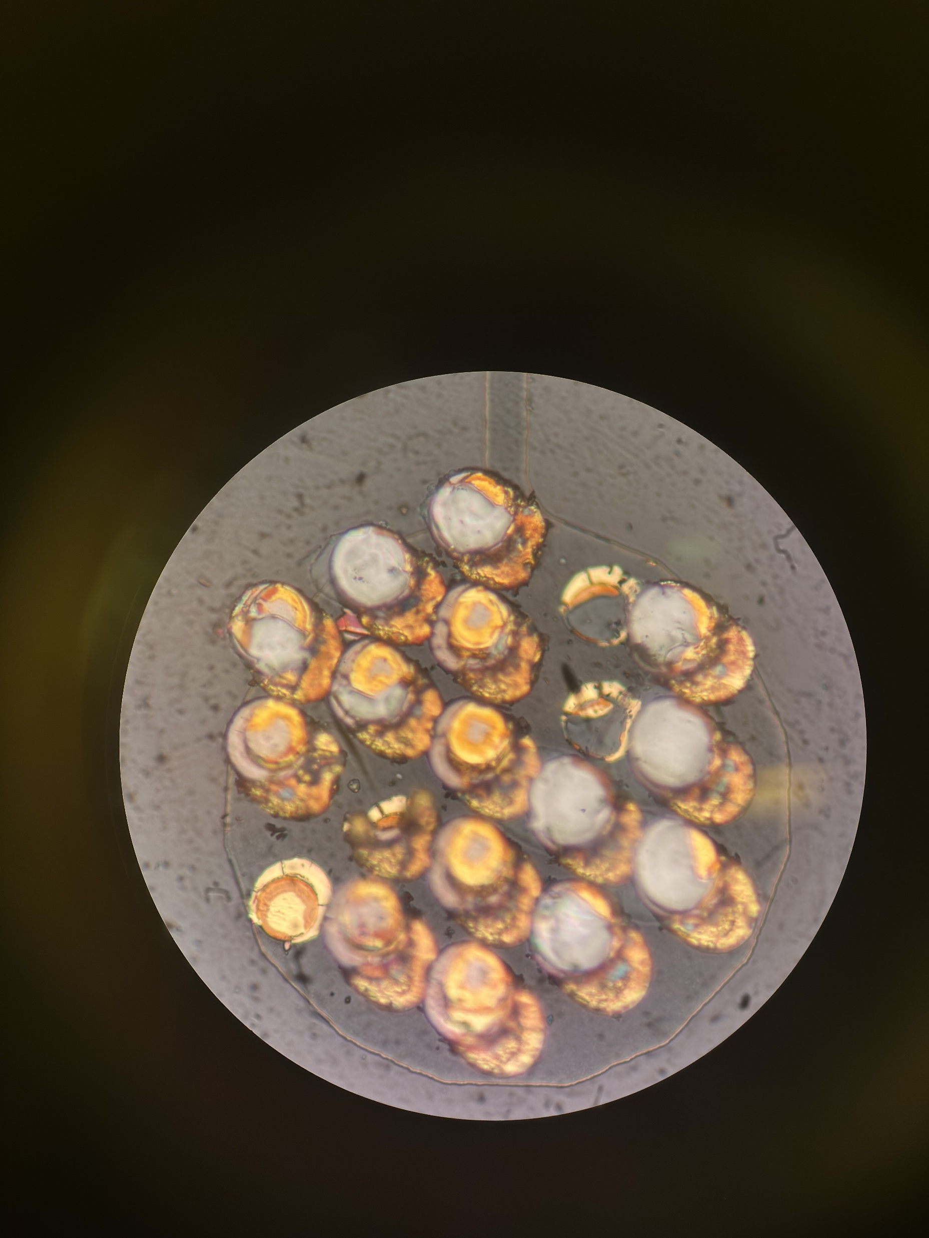
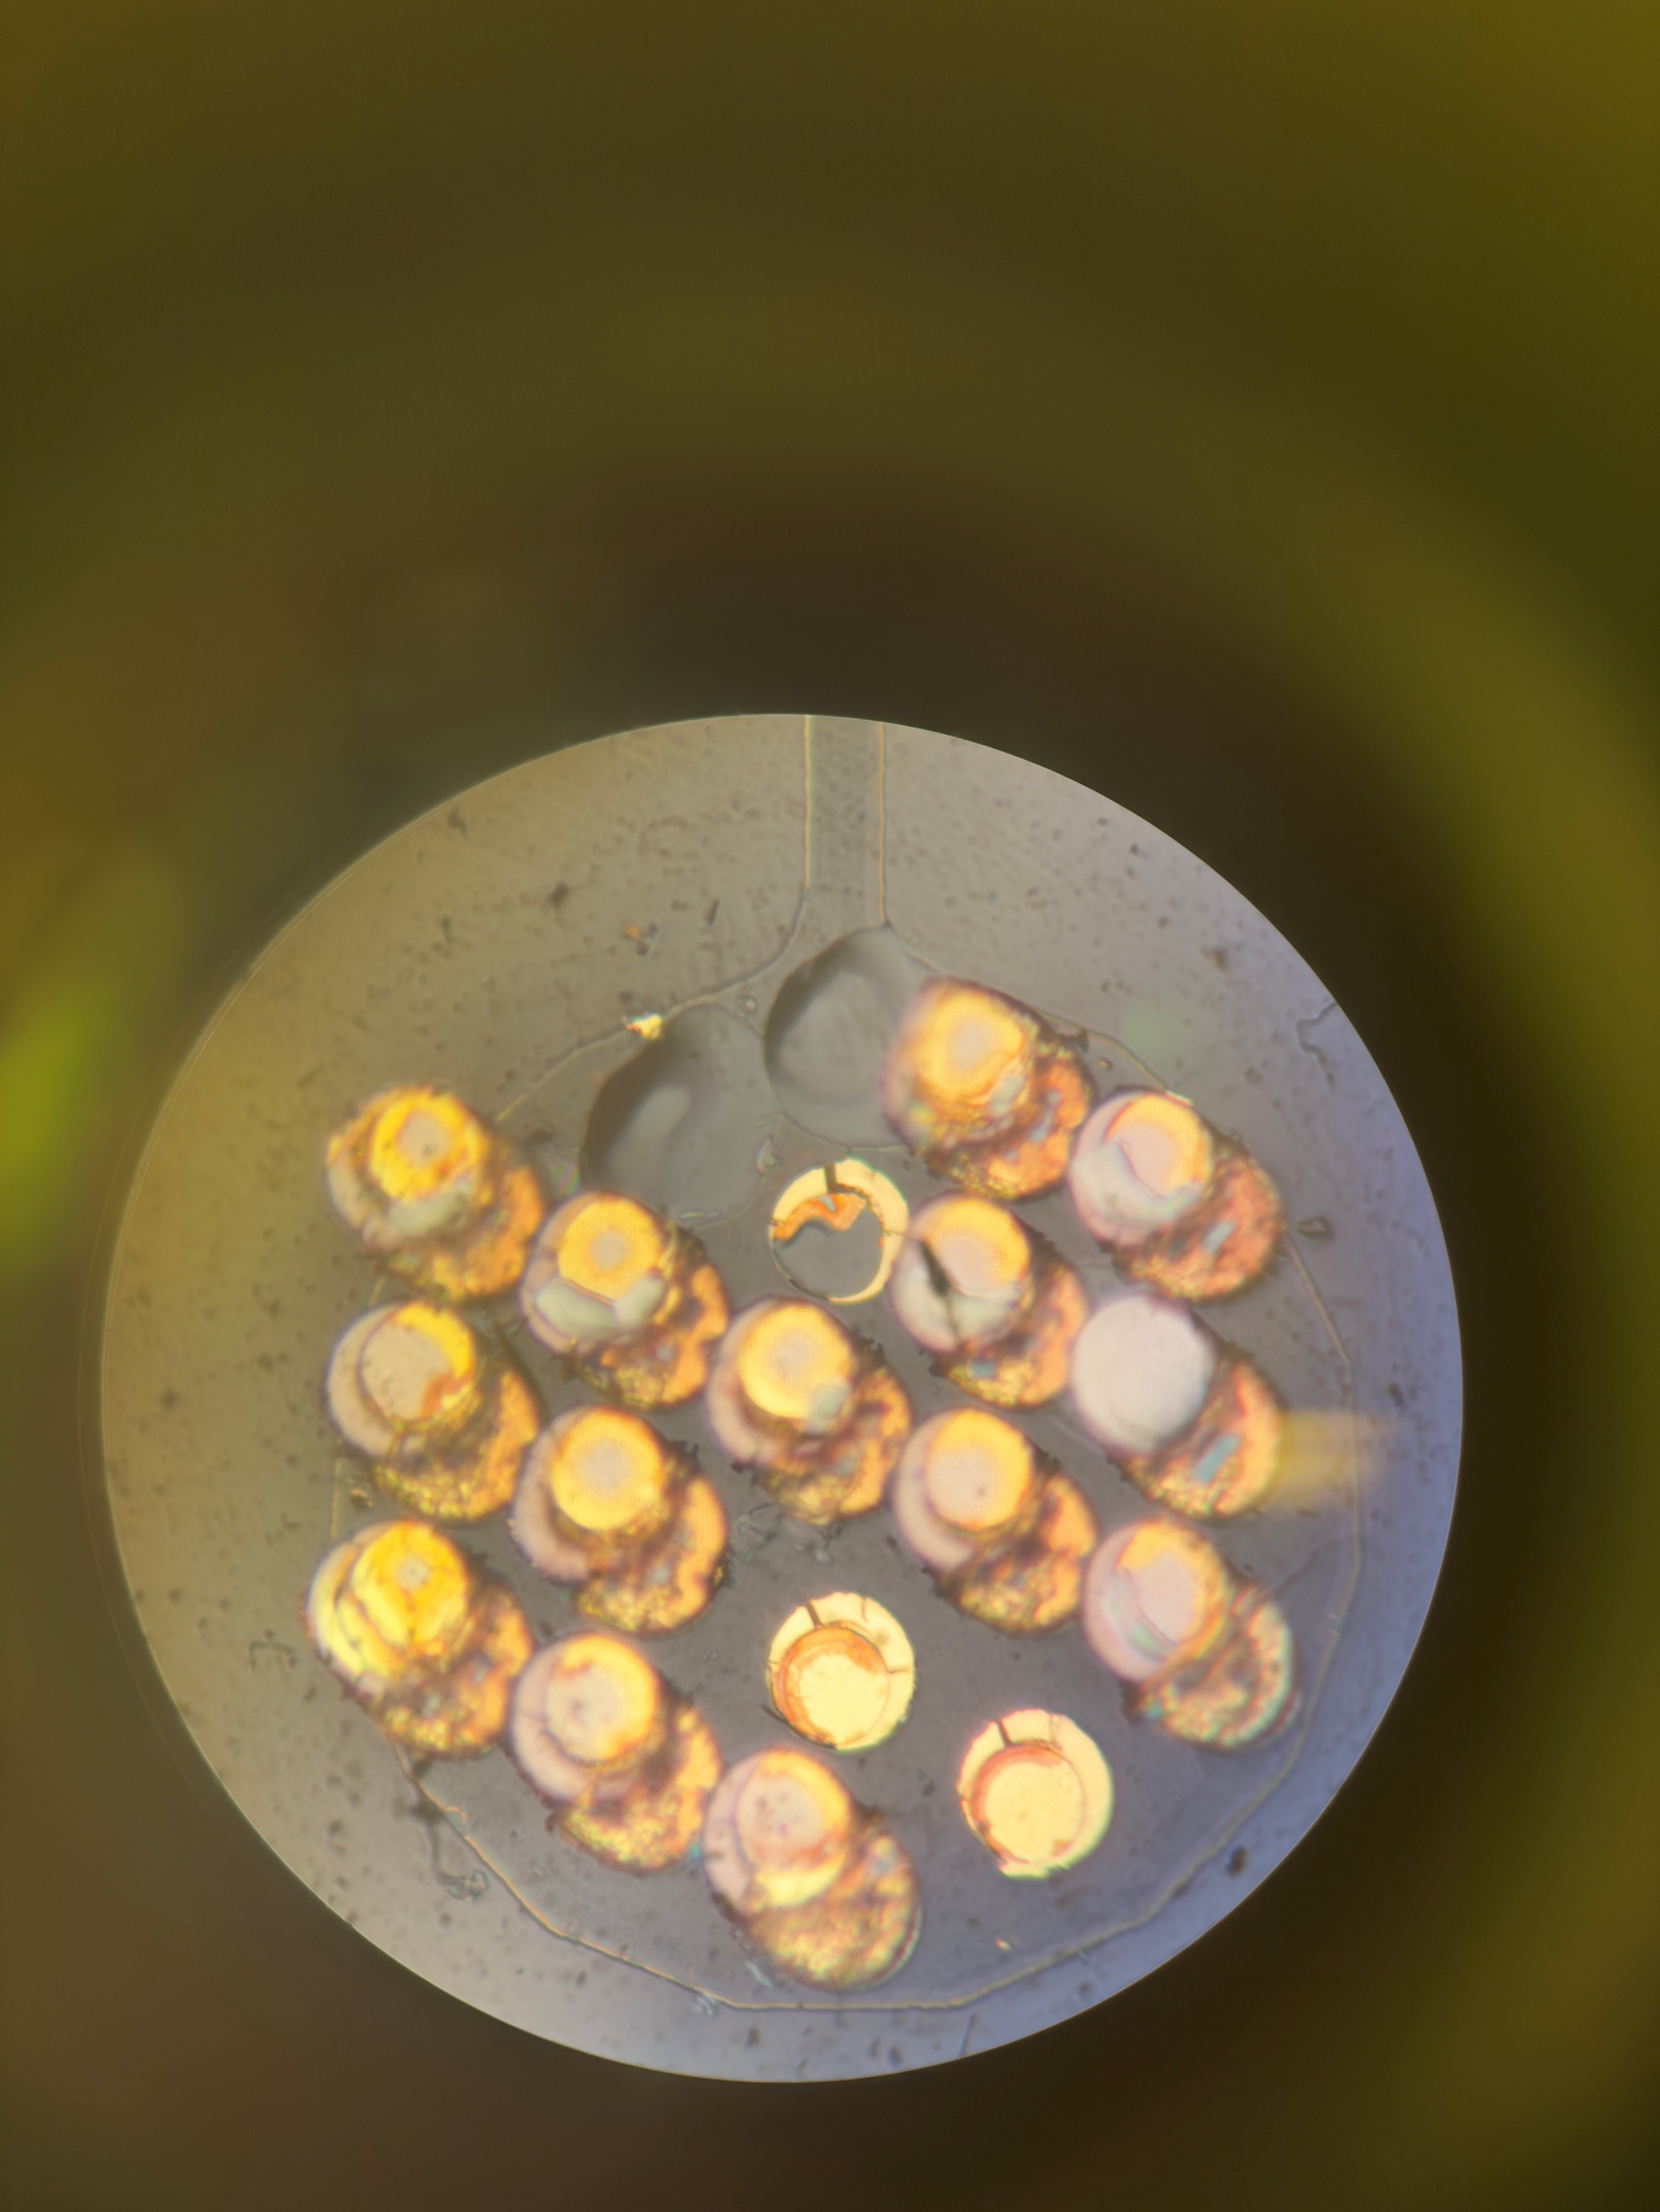
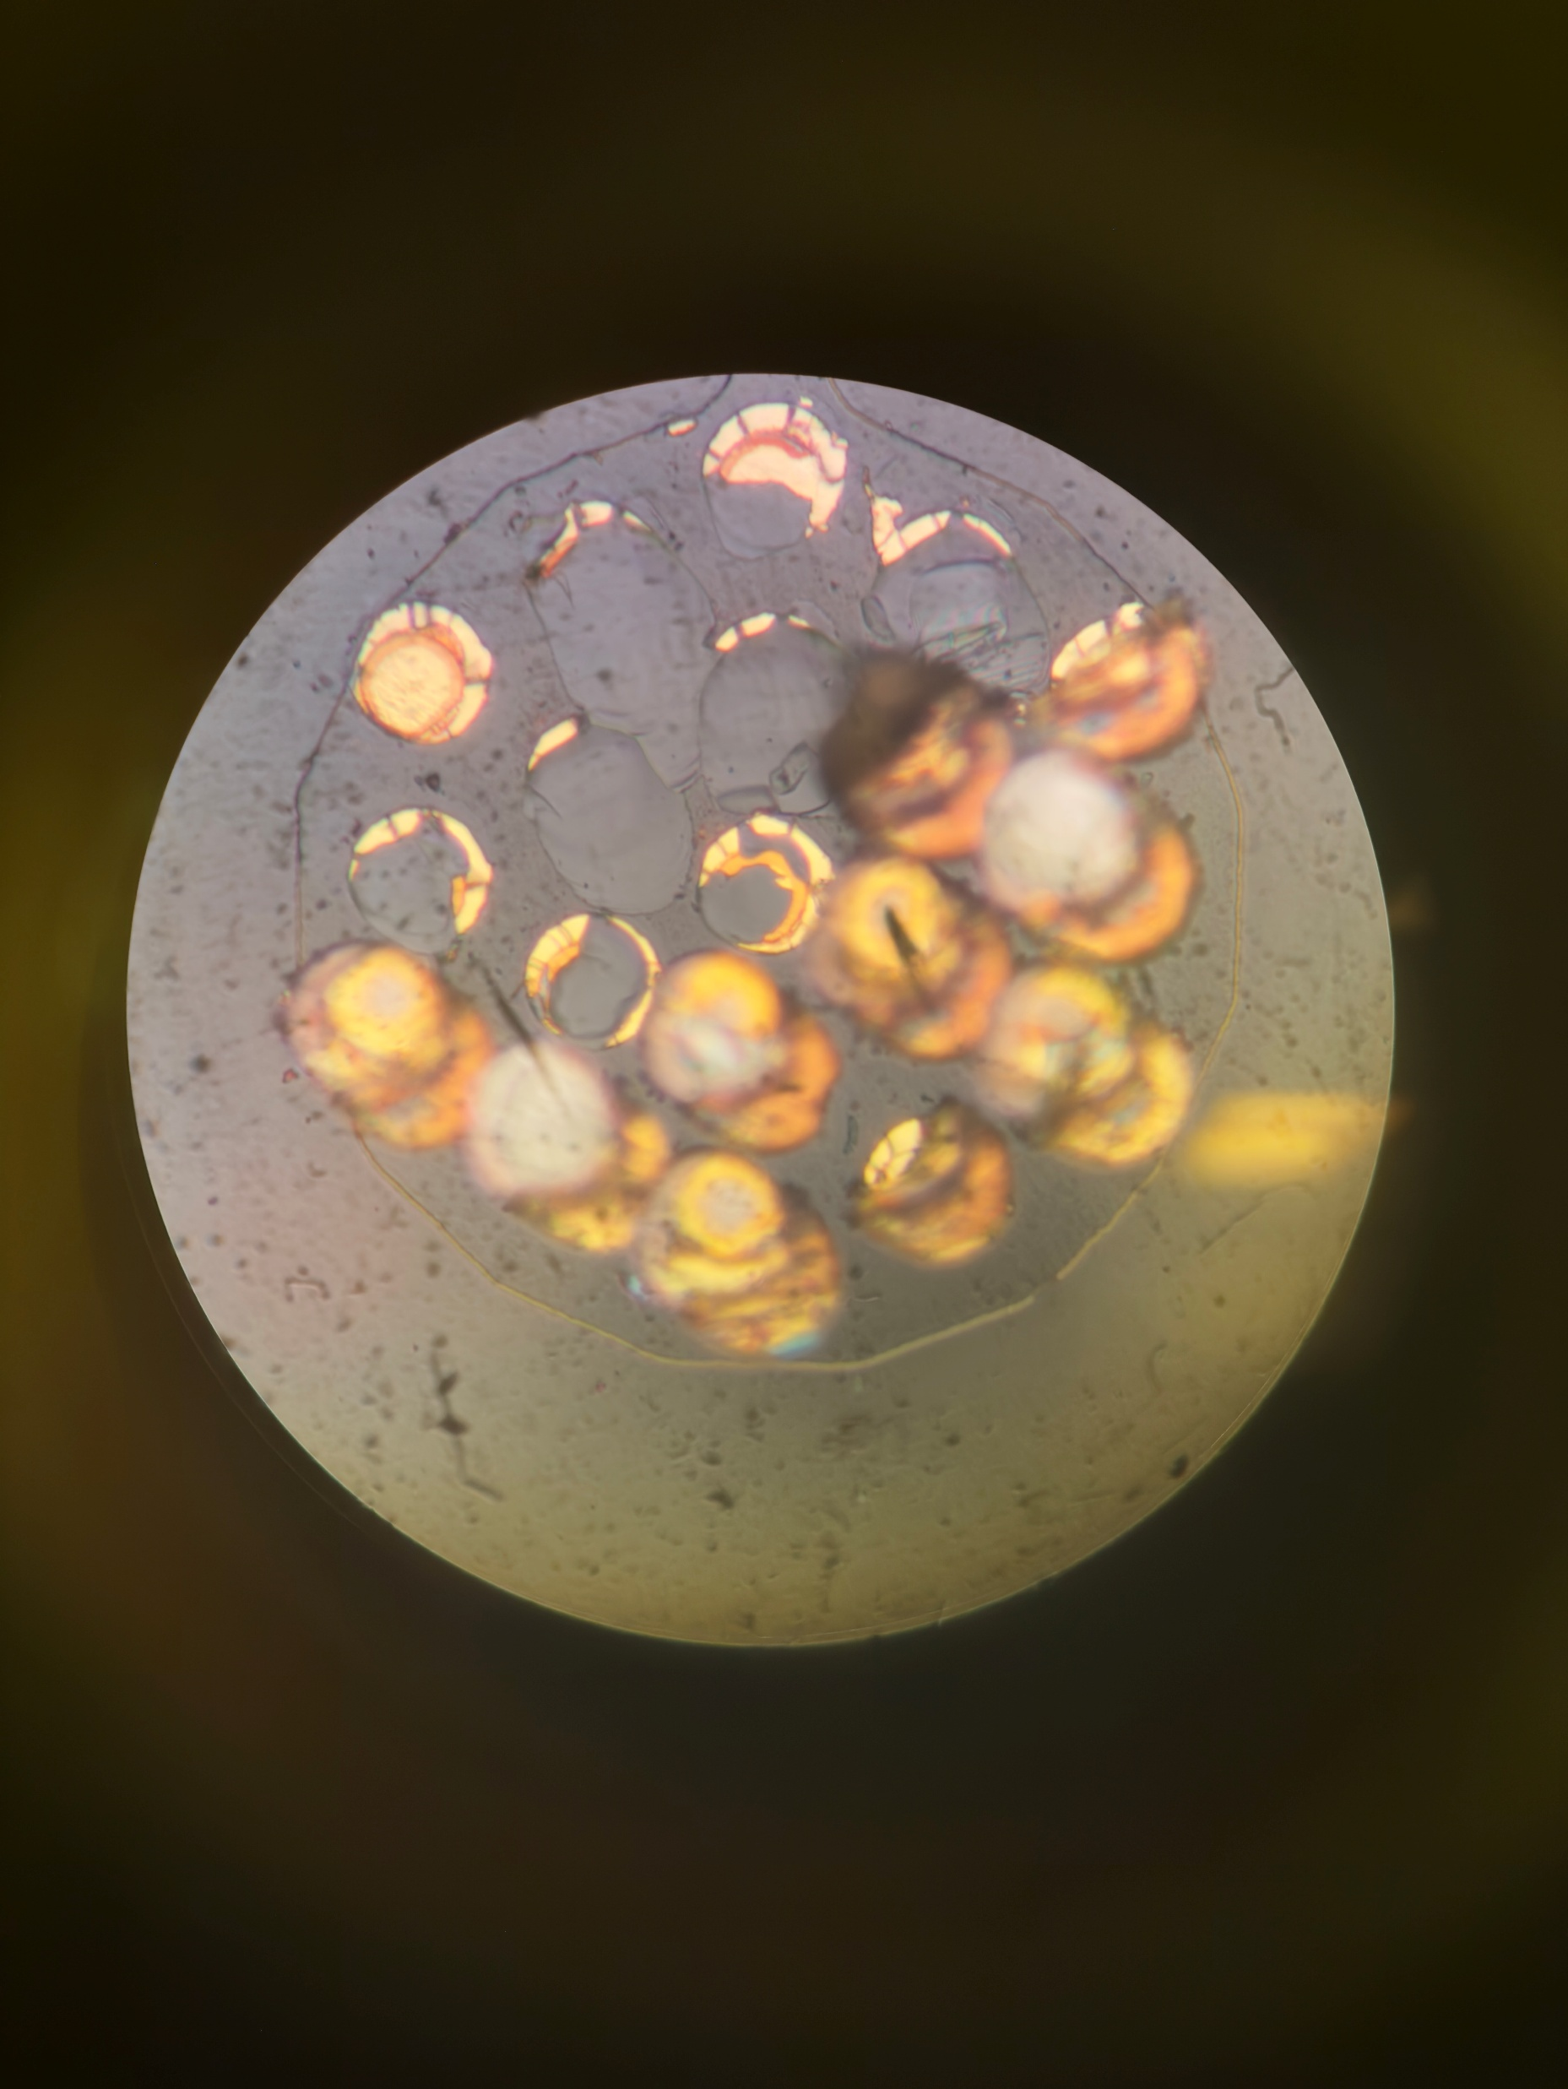
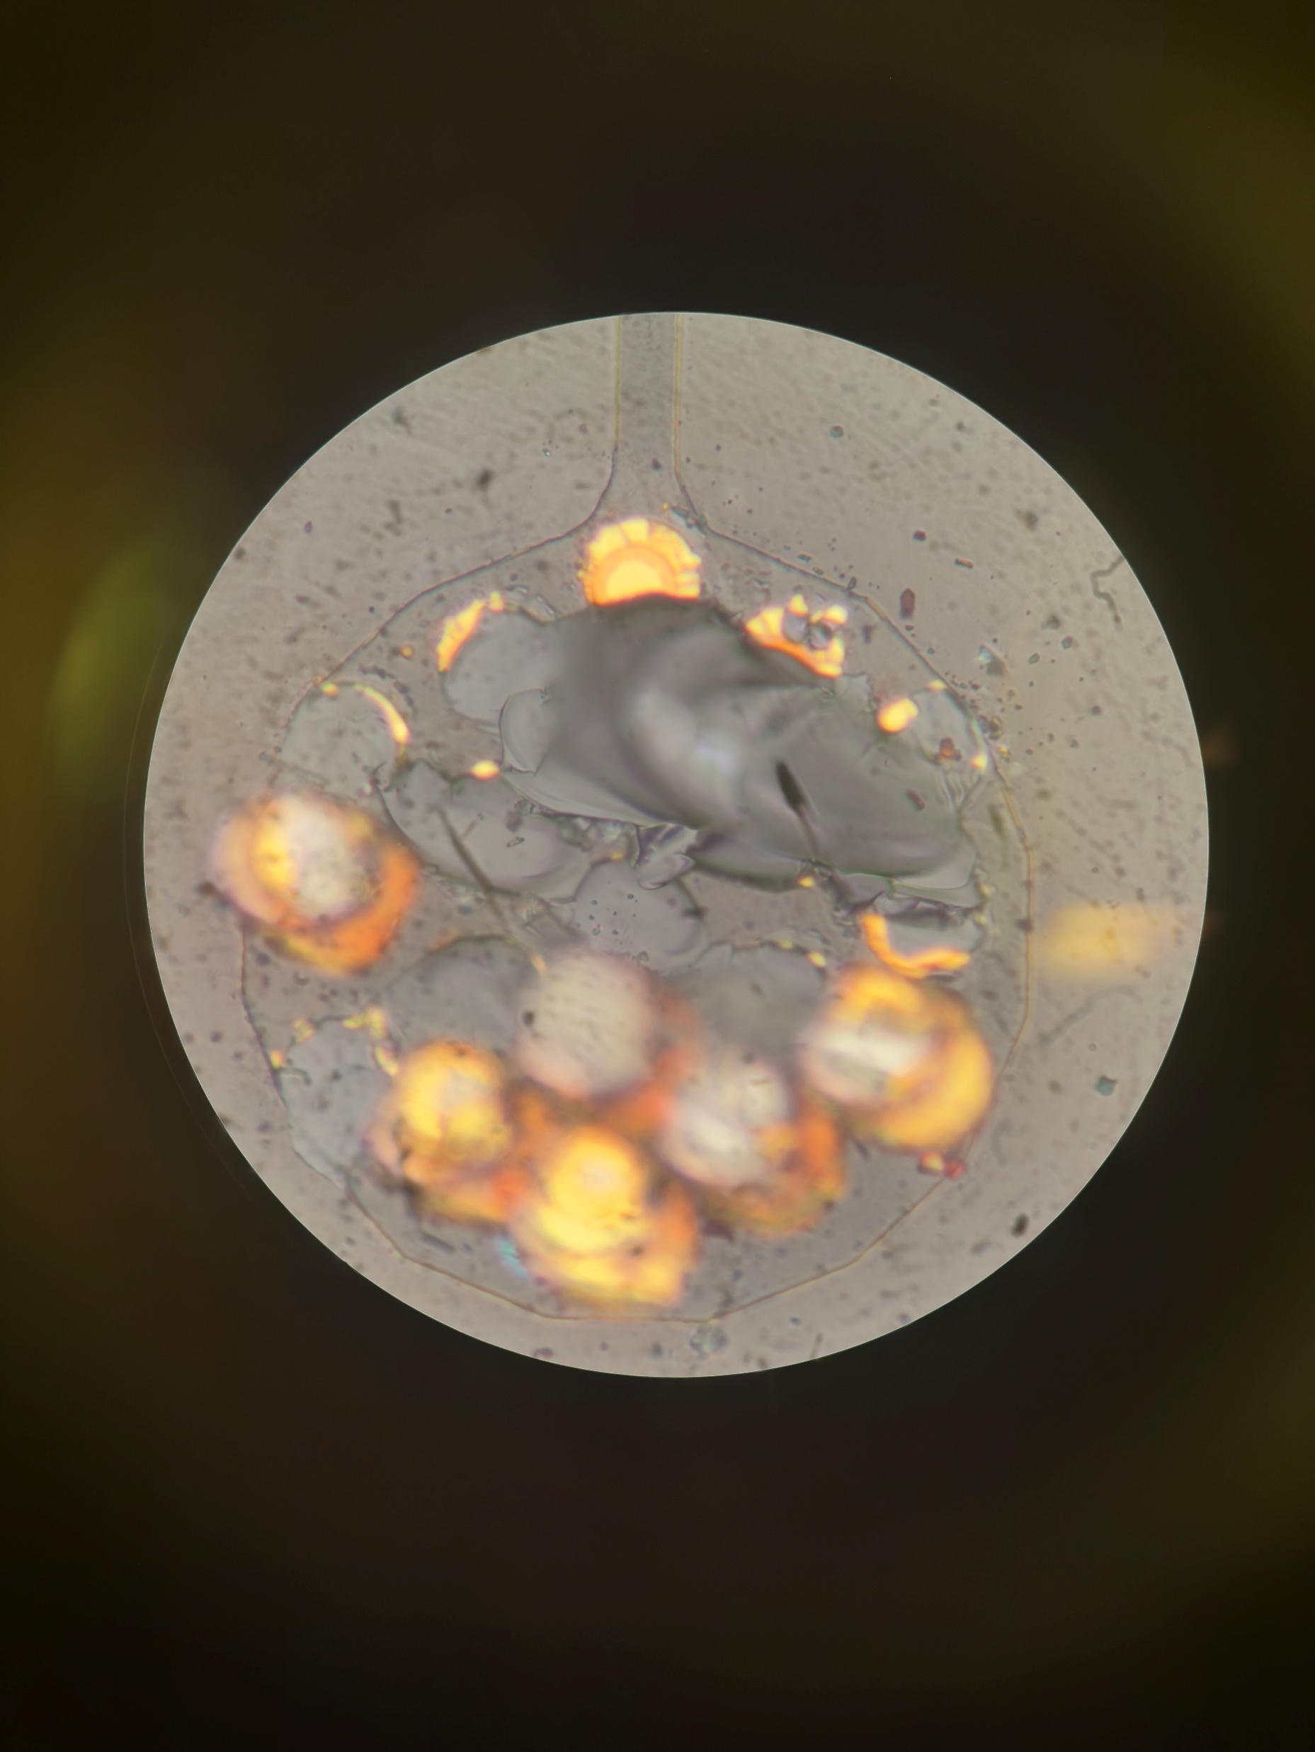
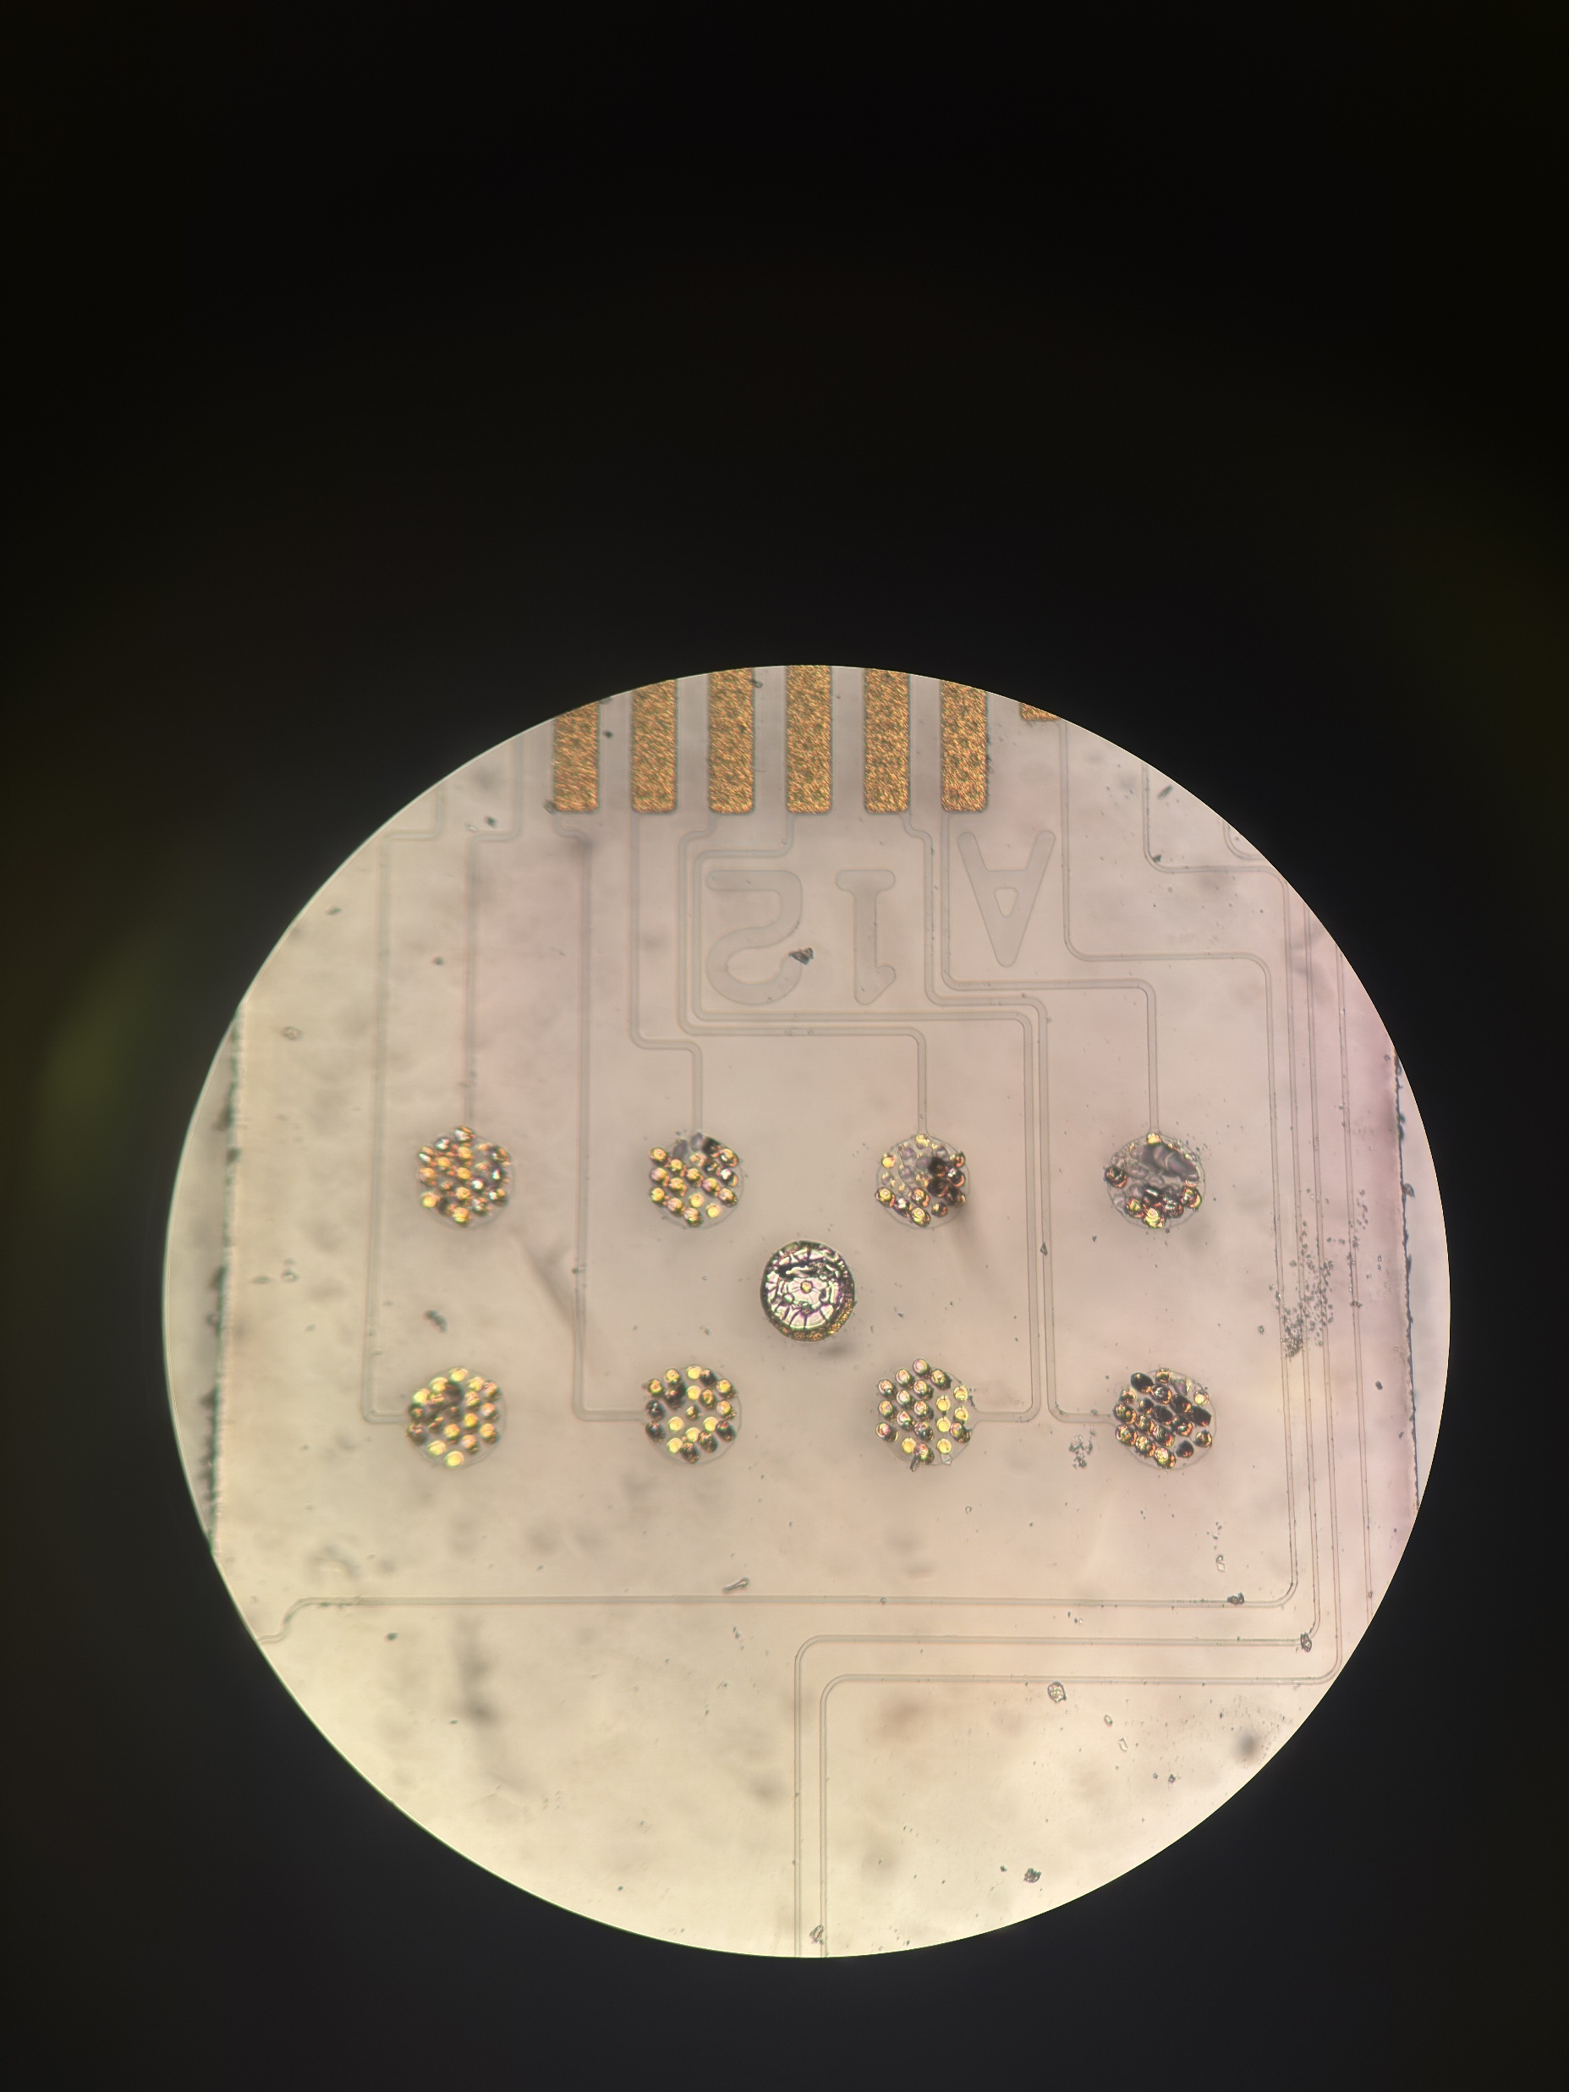
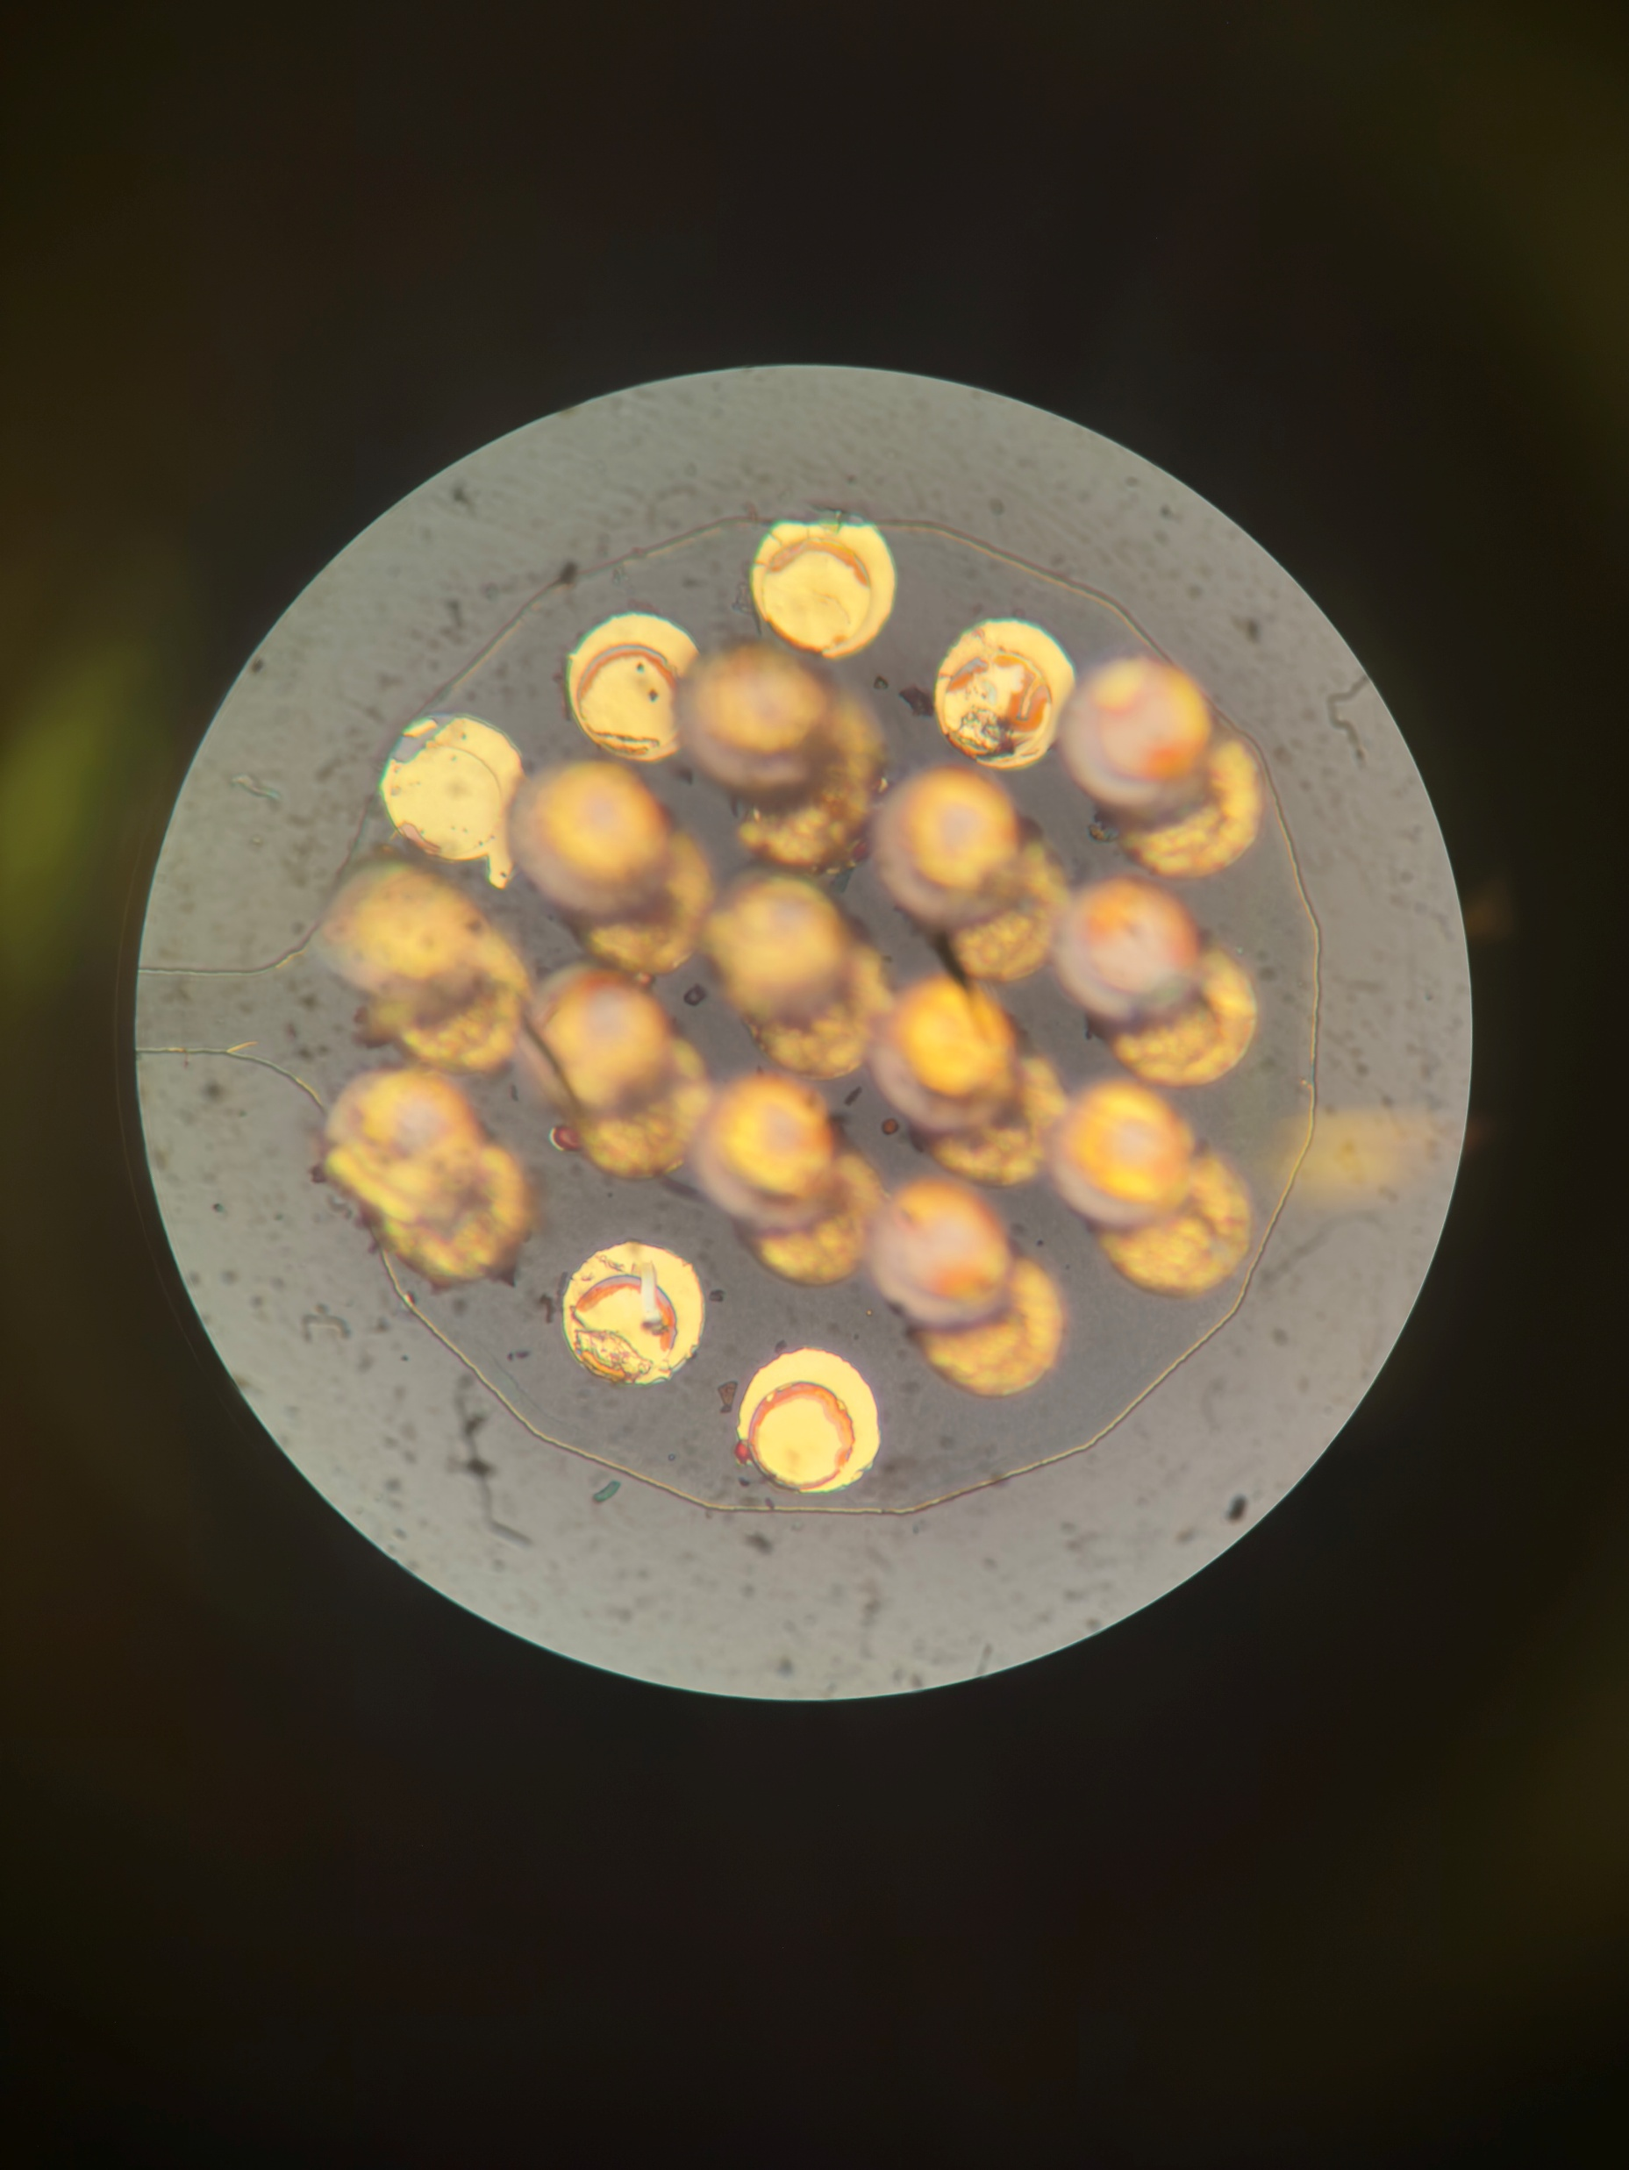
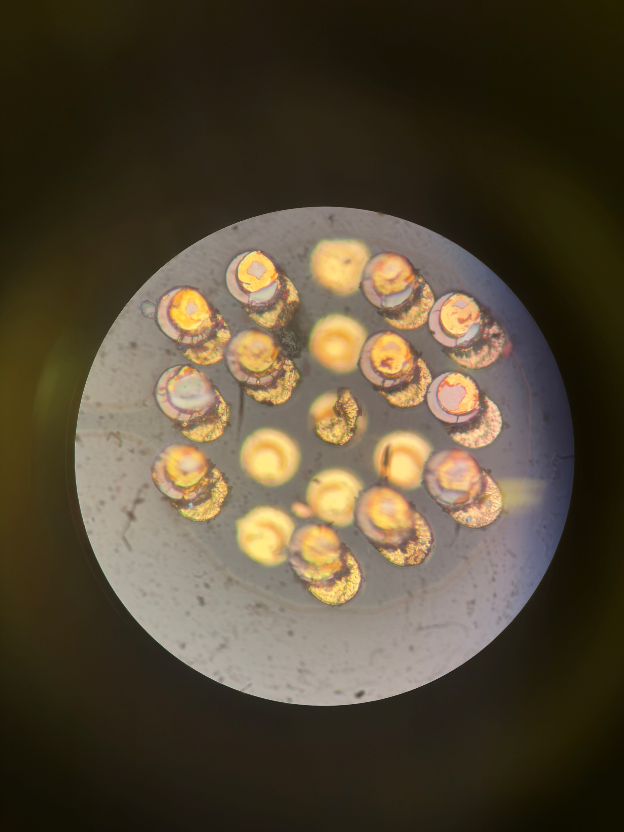
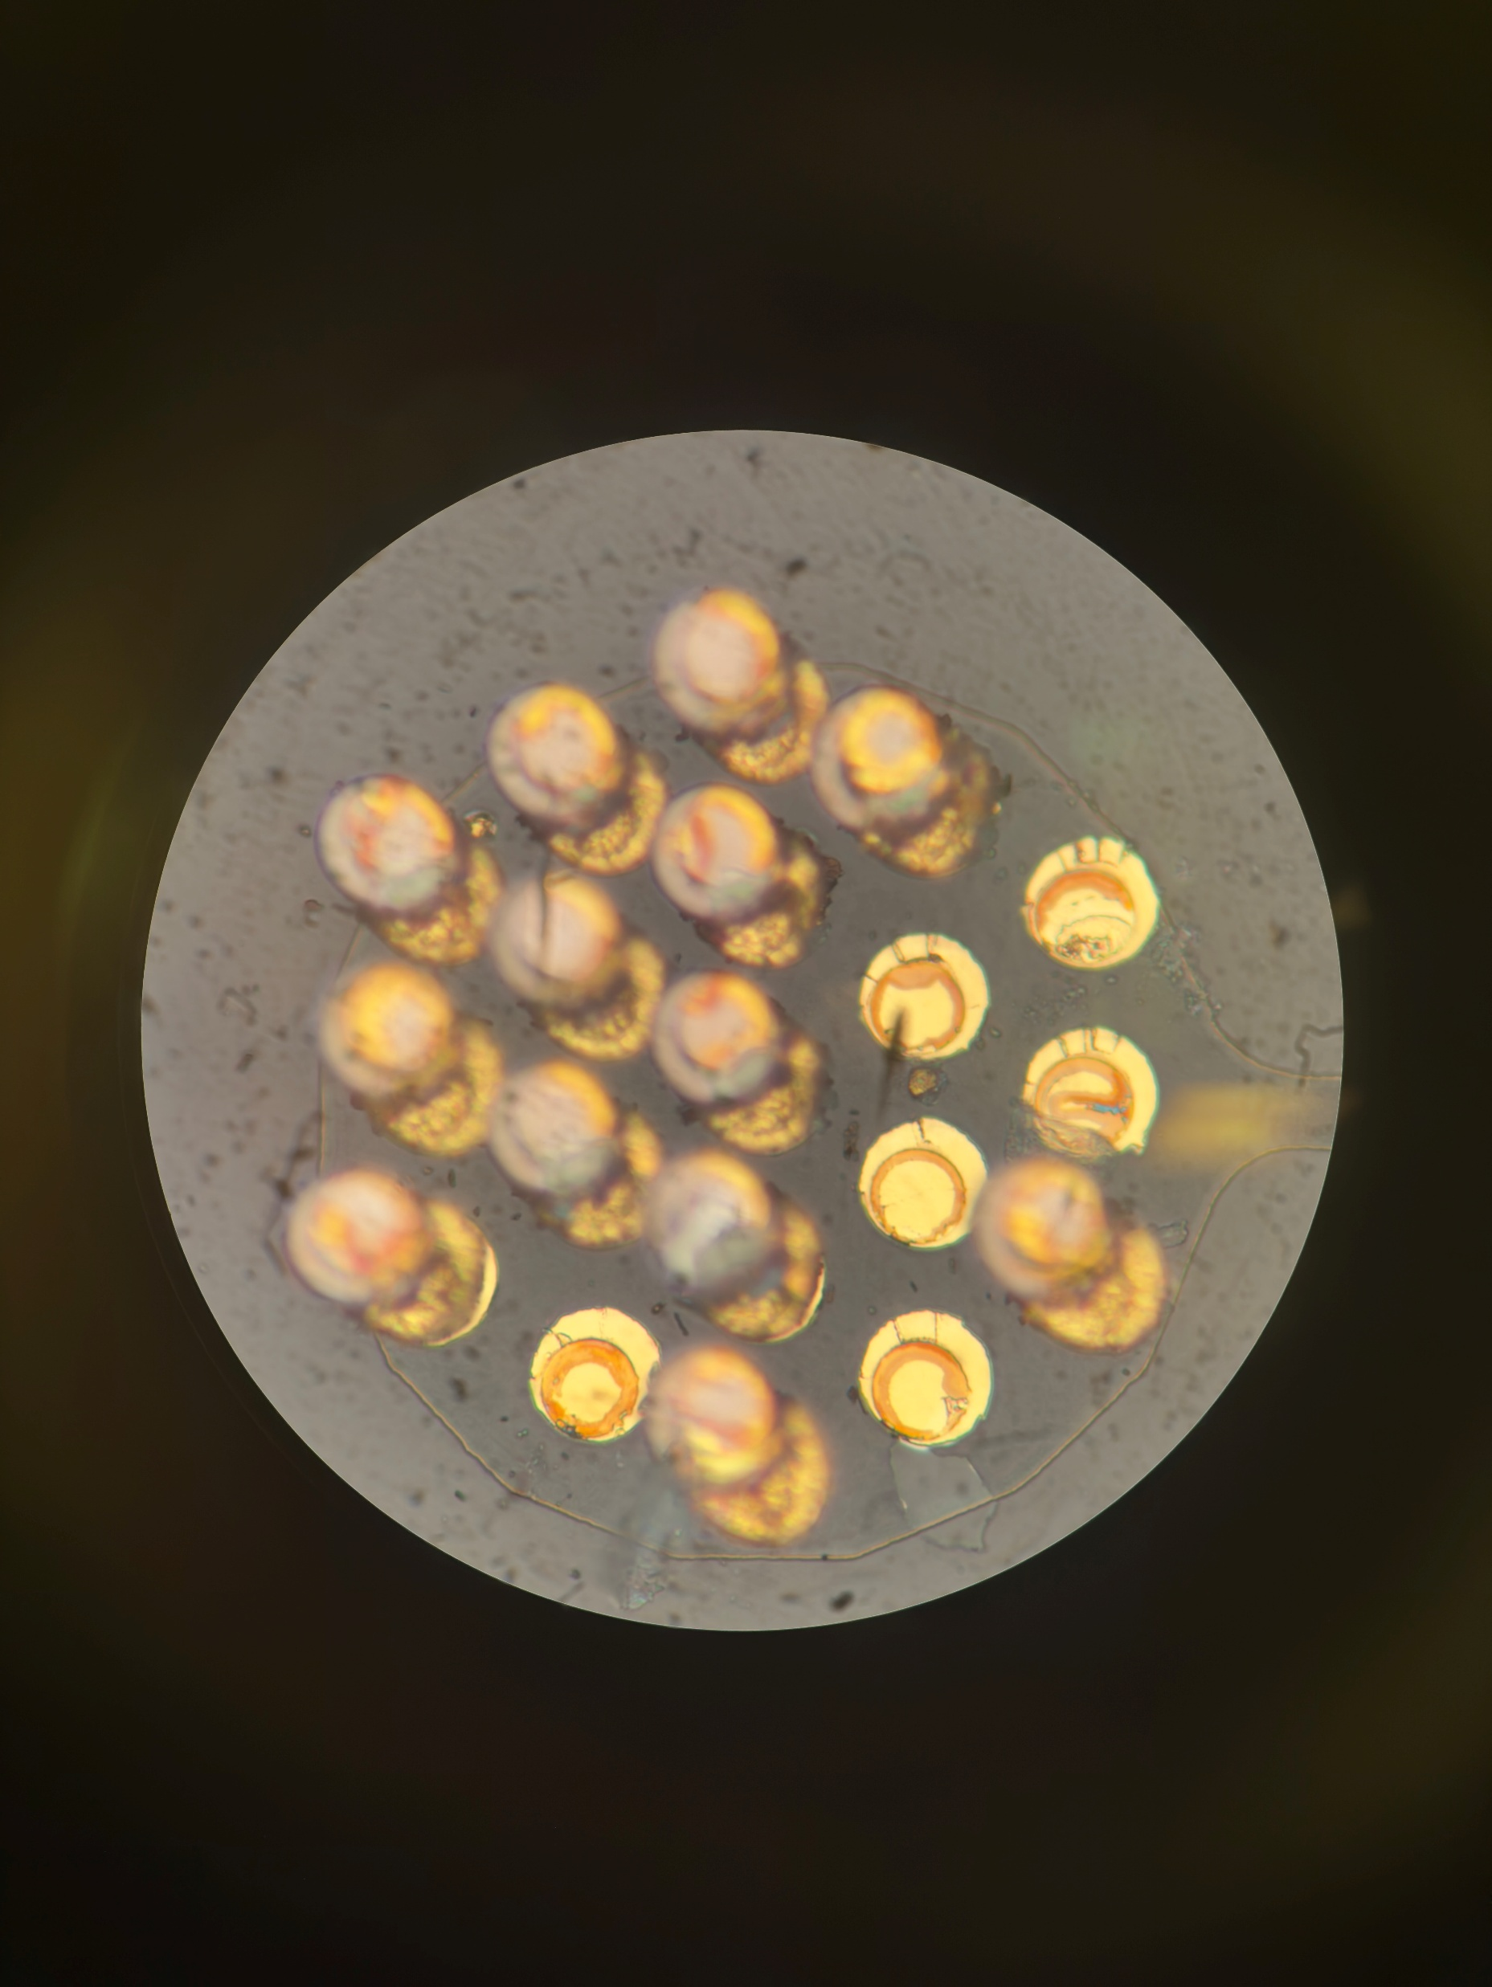
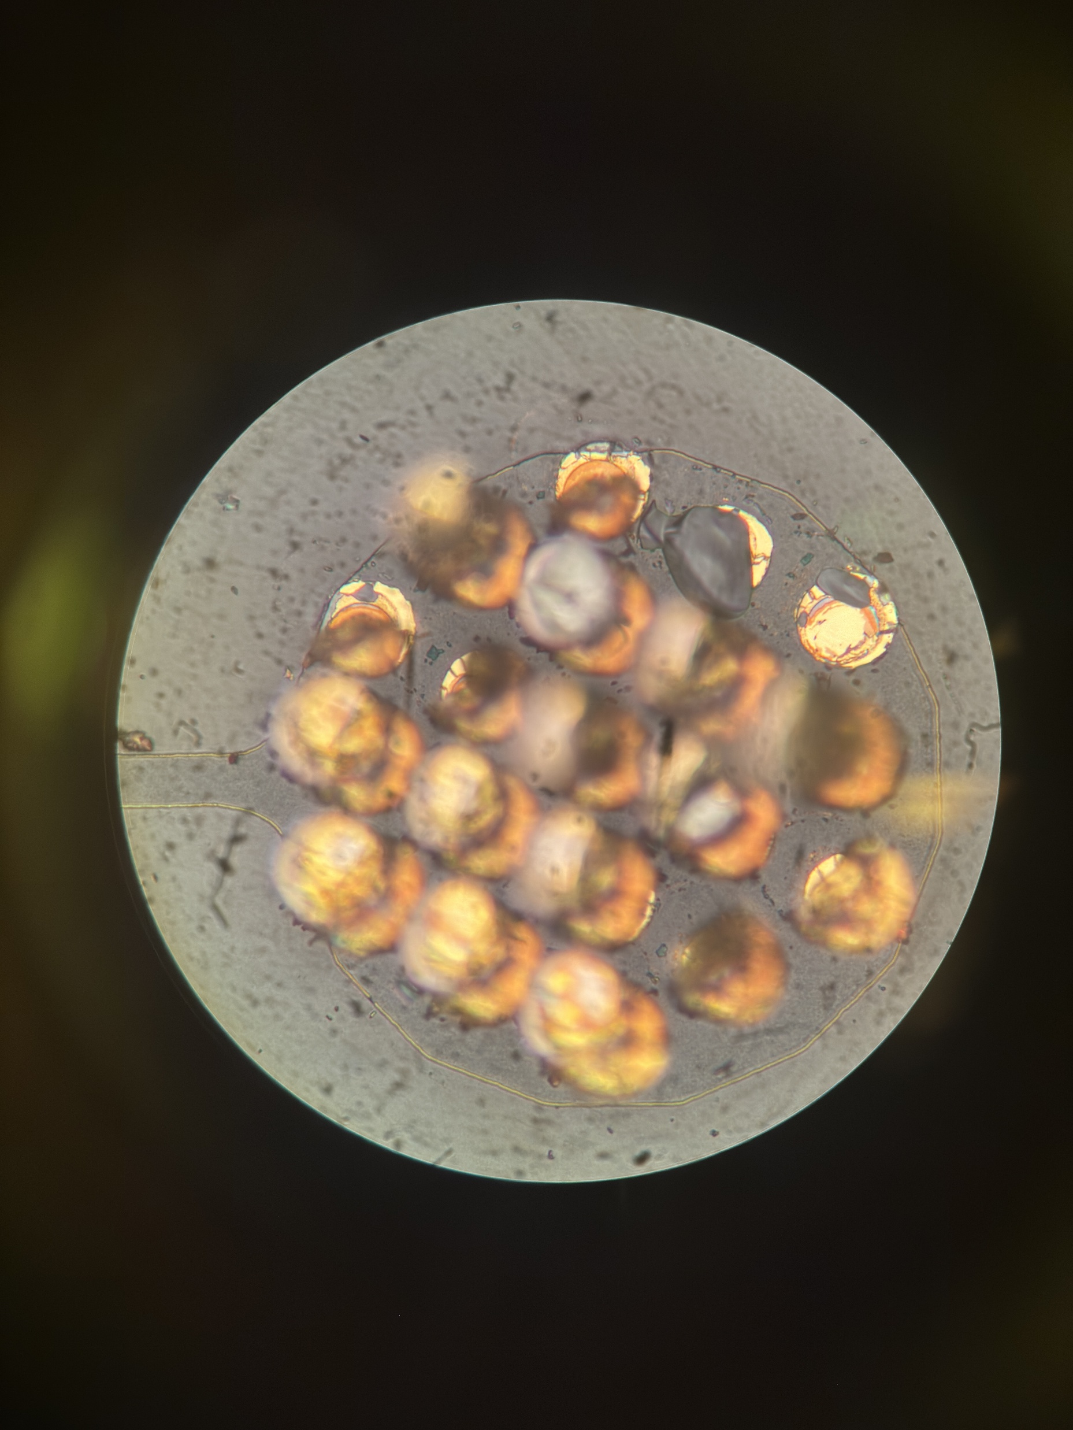
A12 Nearside

Slide 22
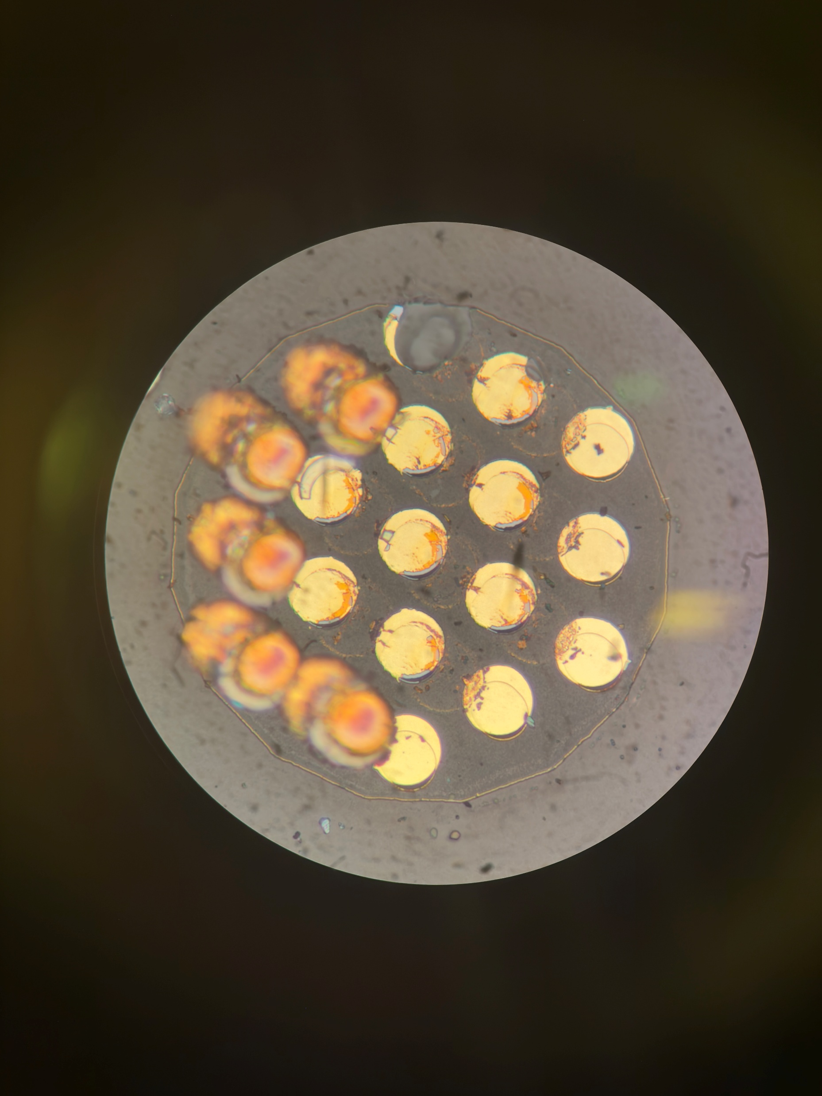
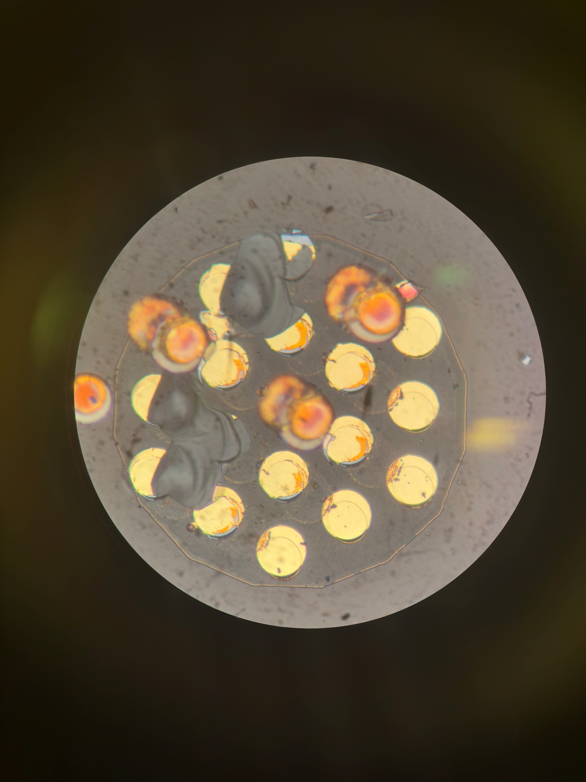
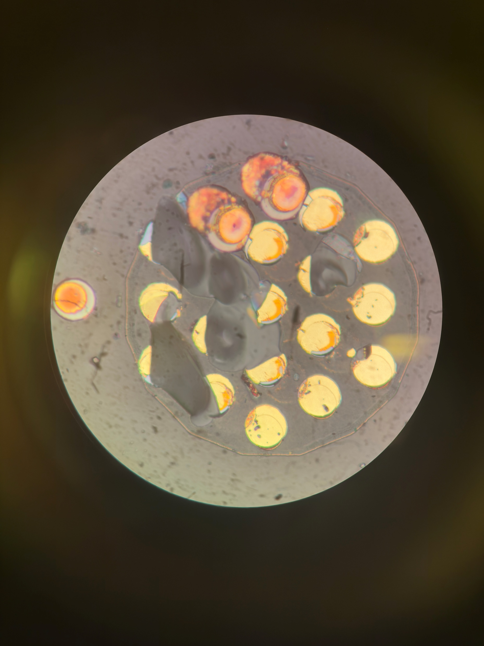
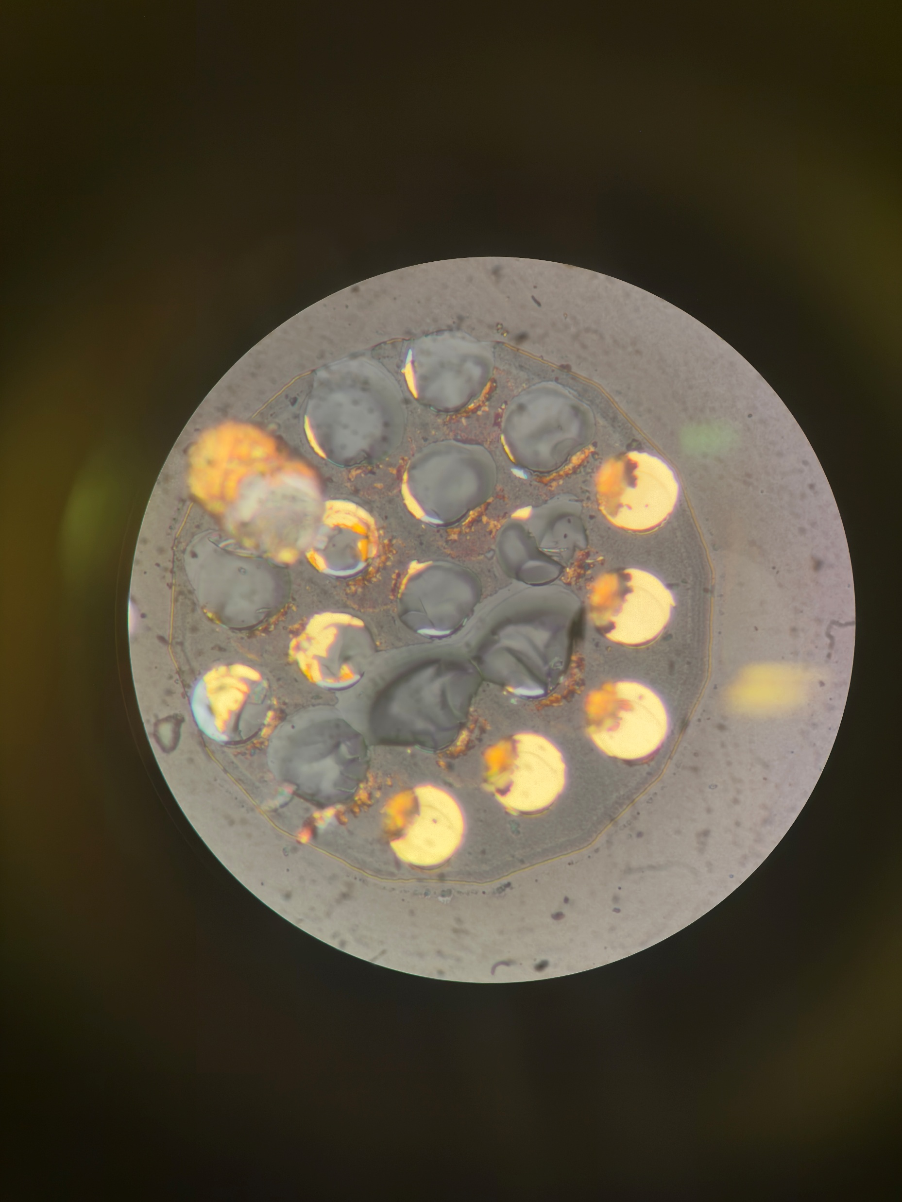
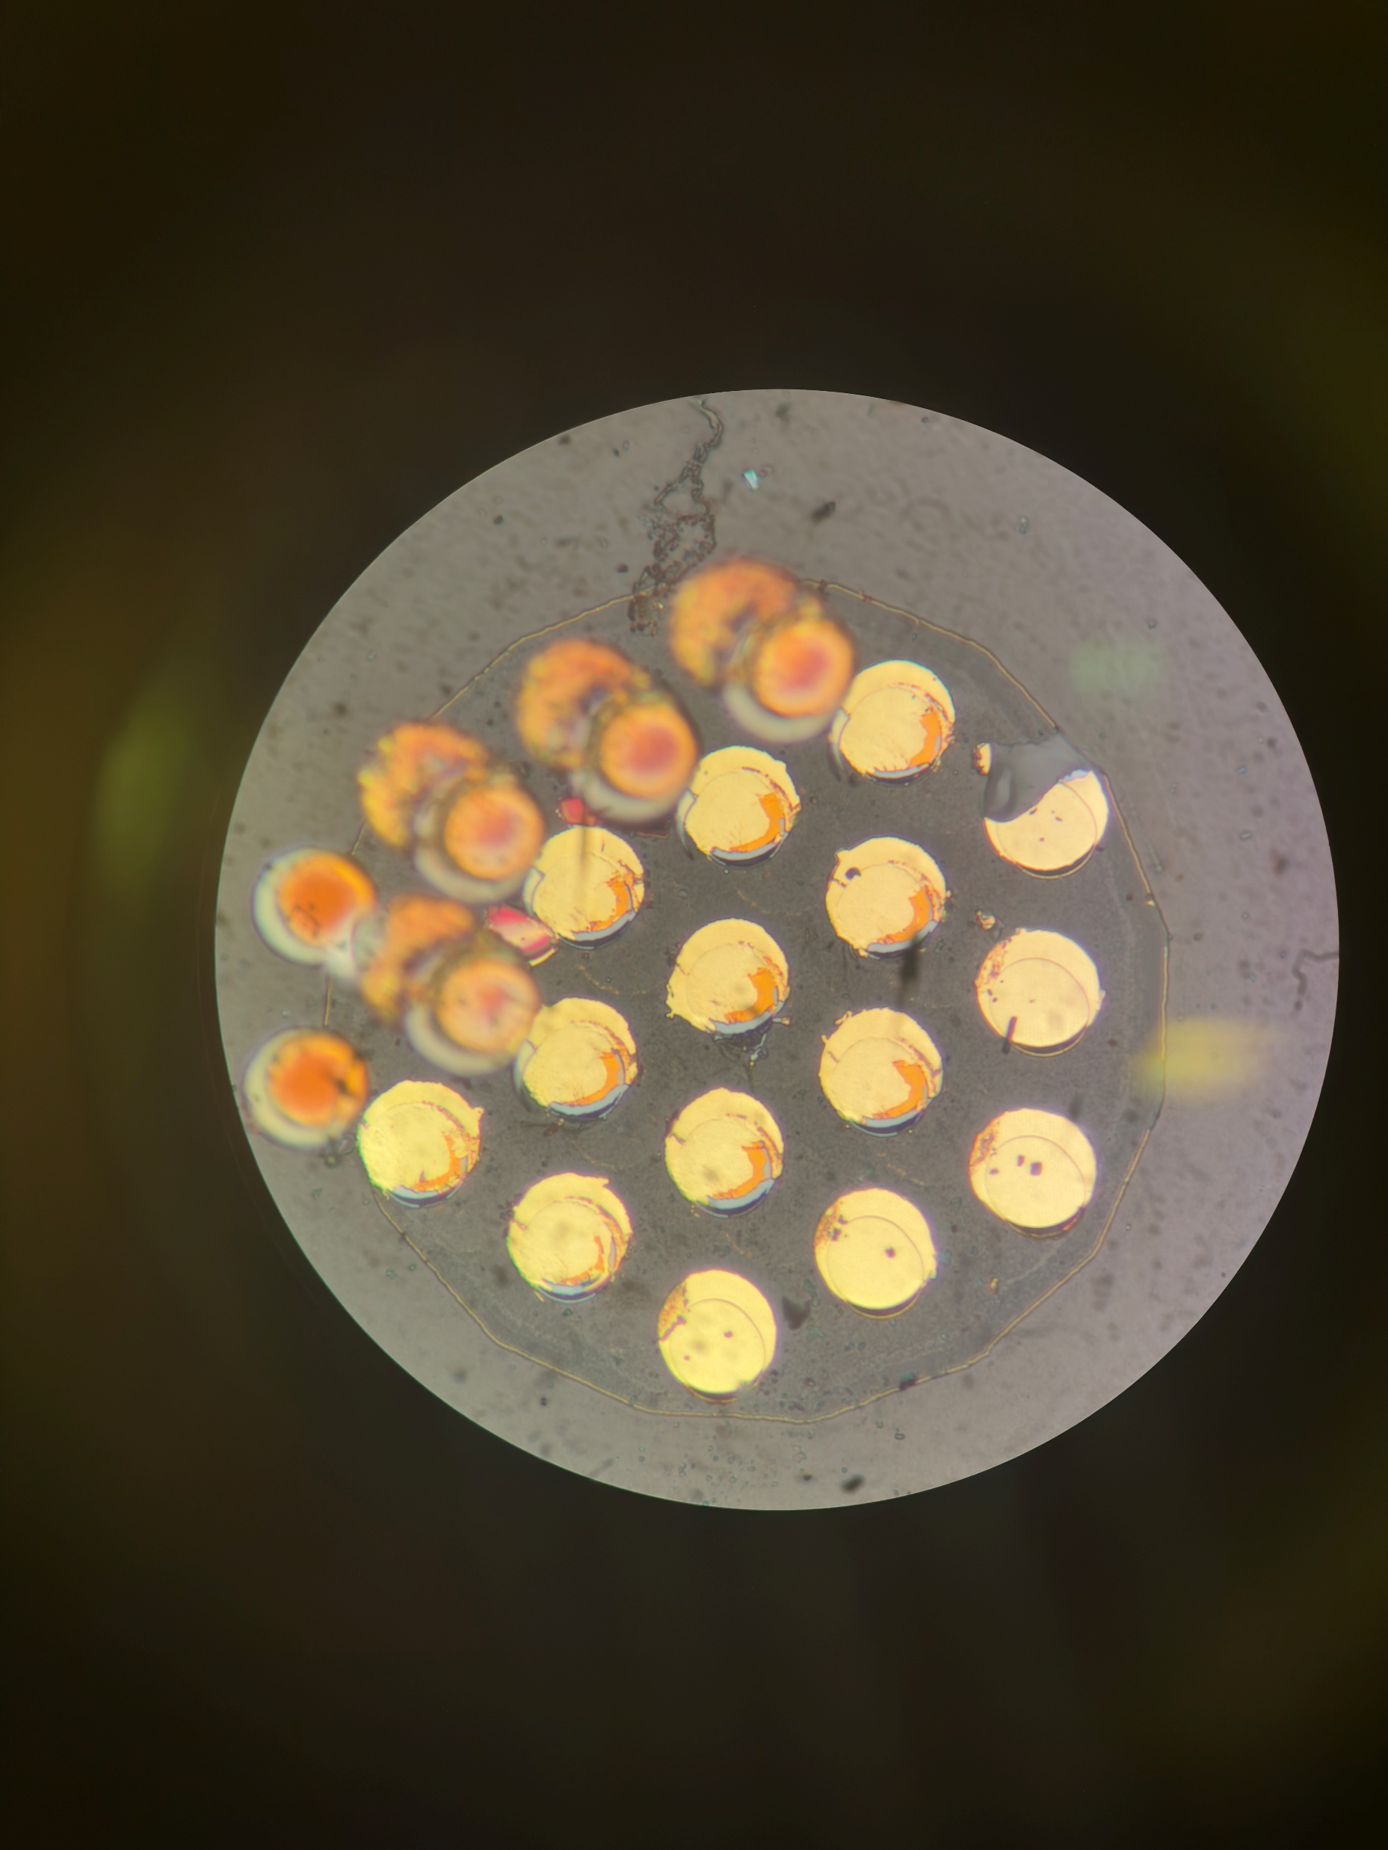
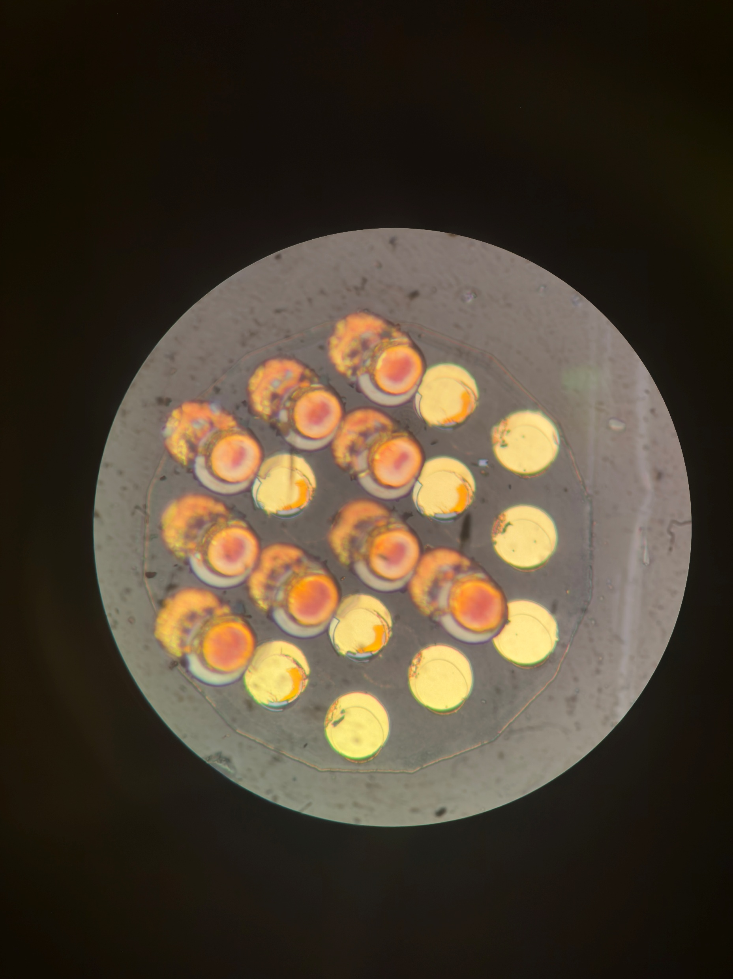
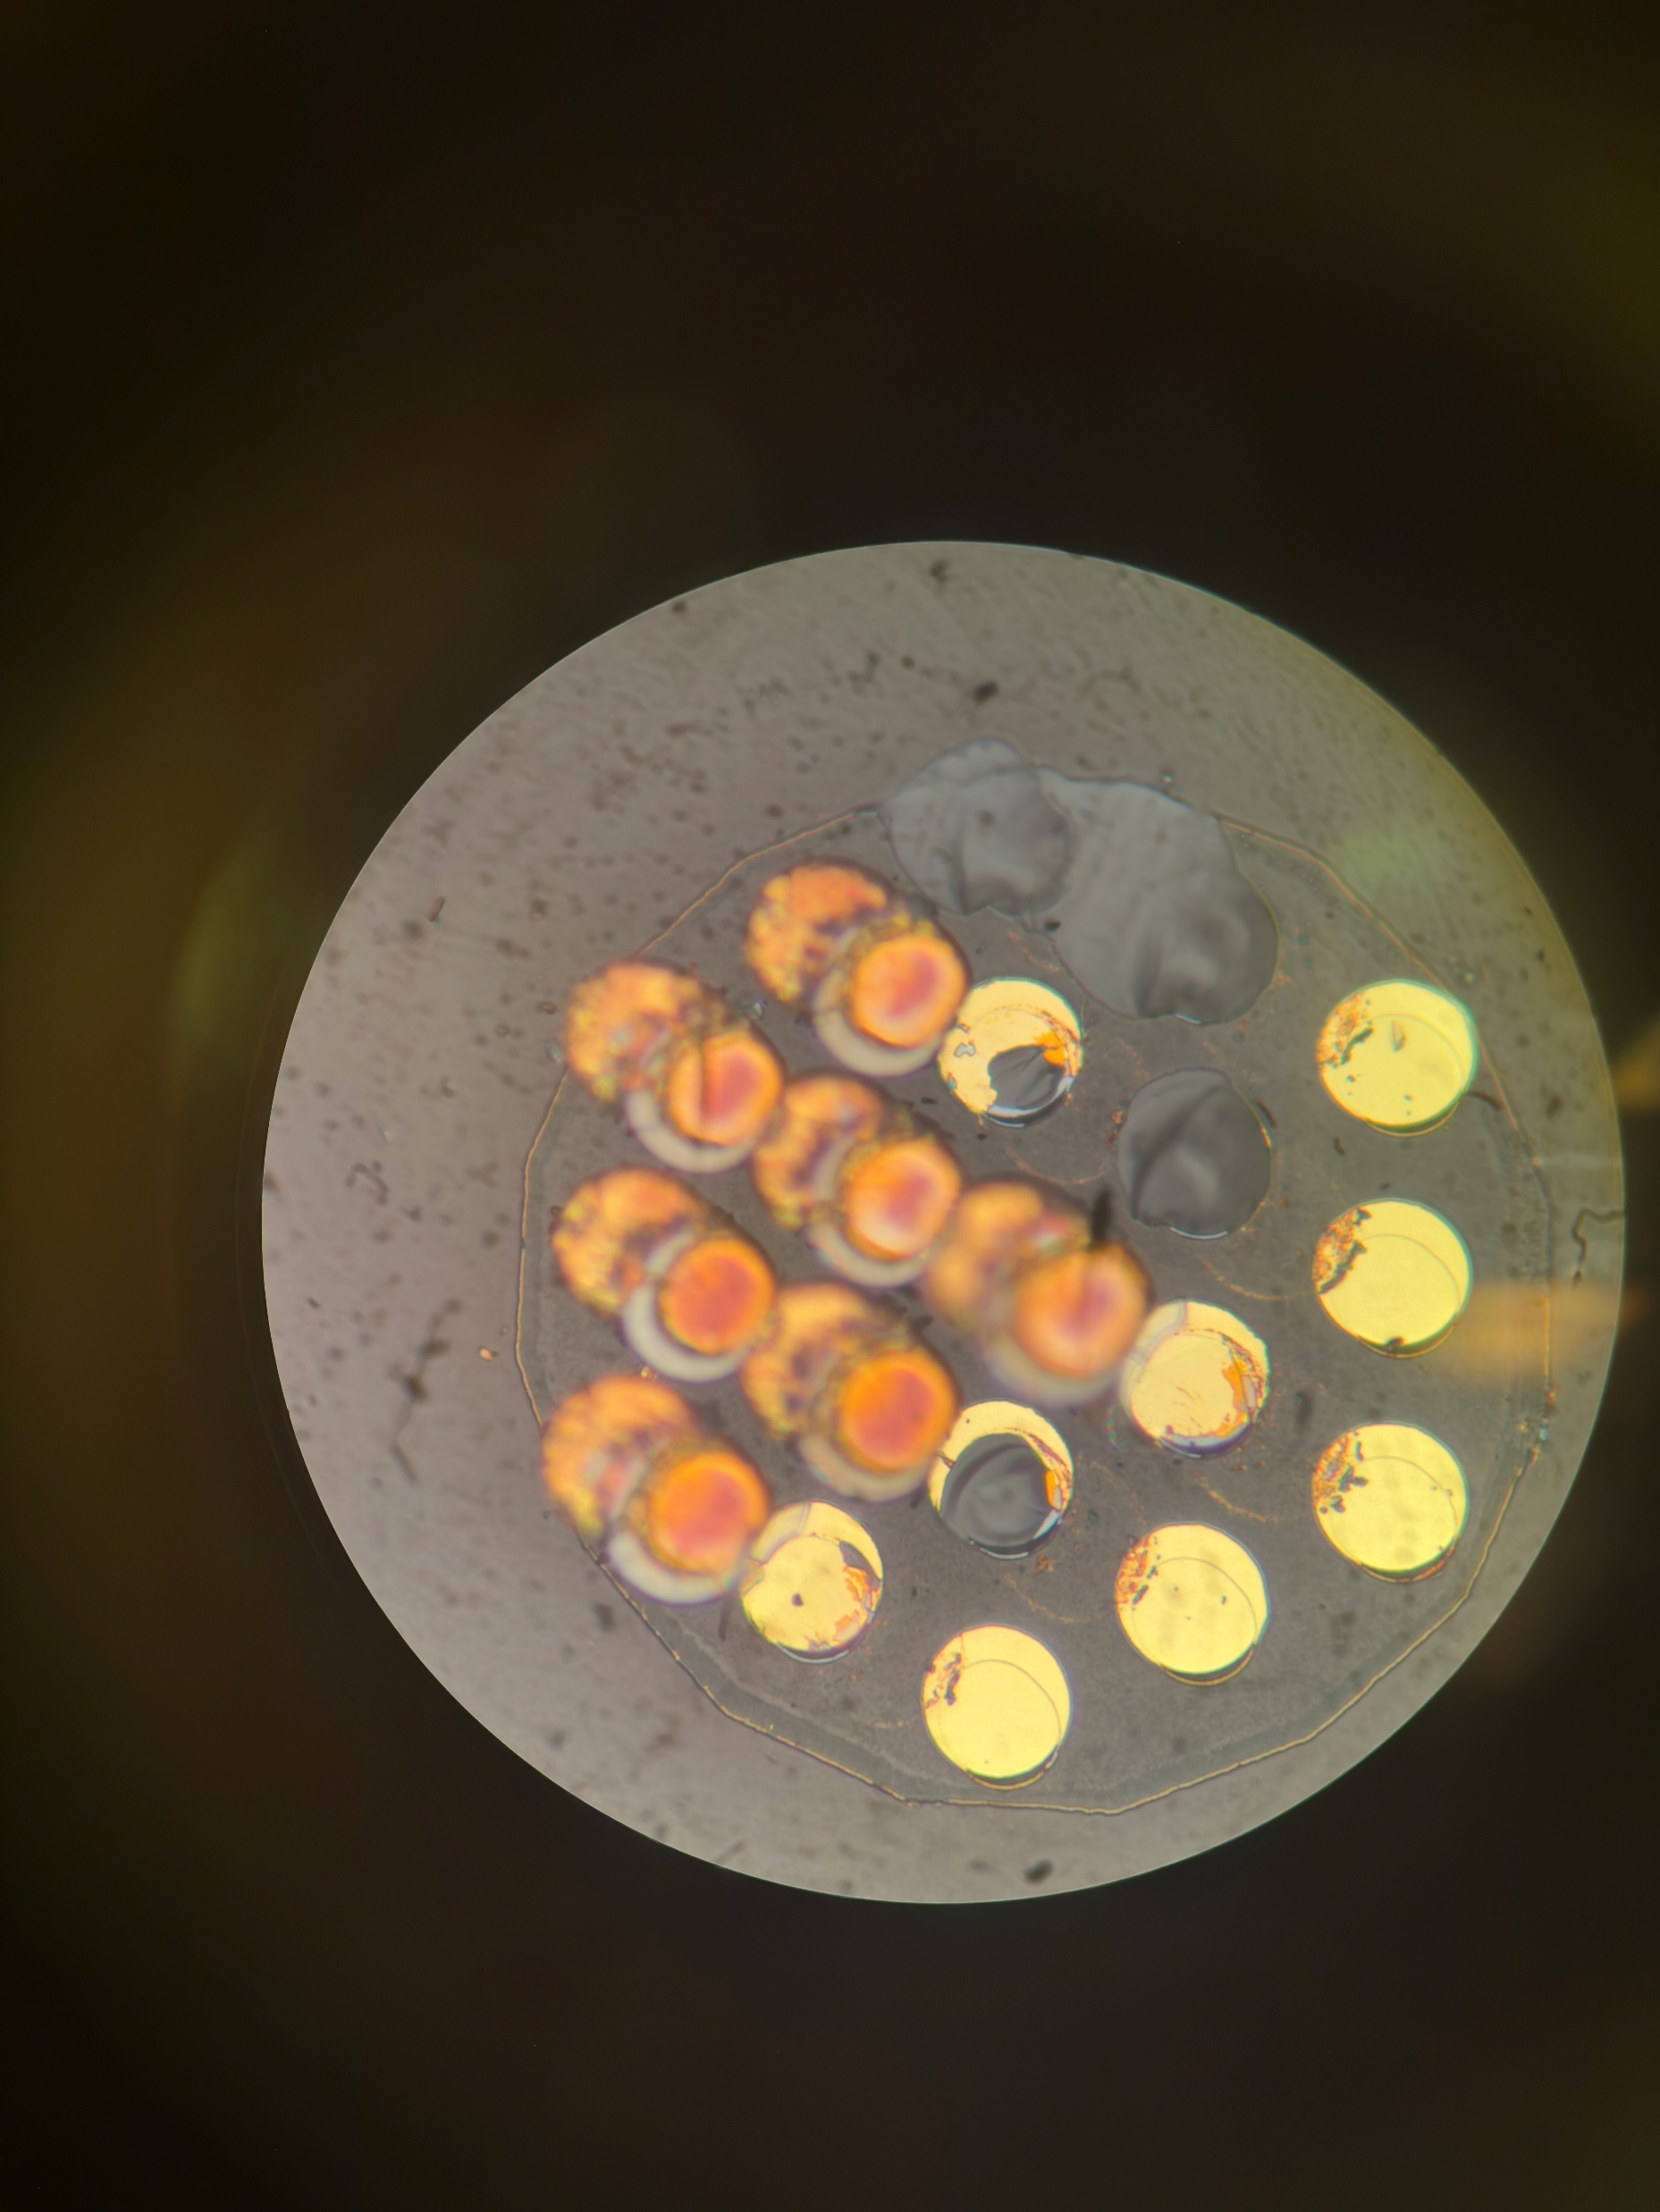
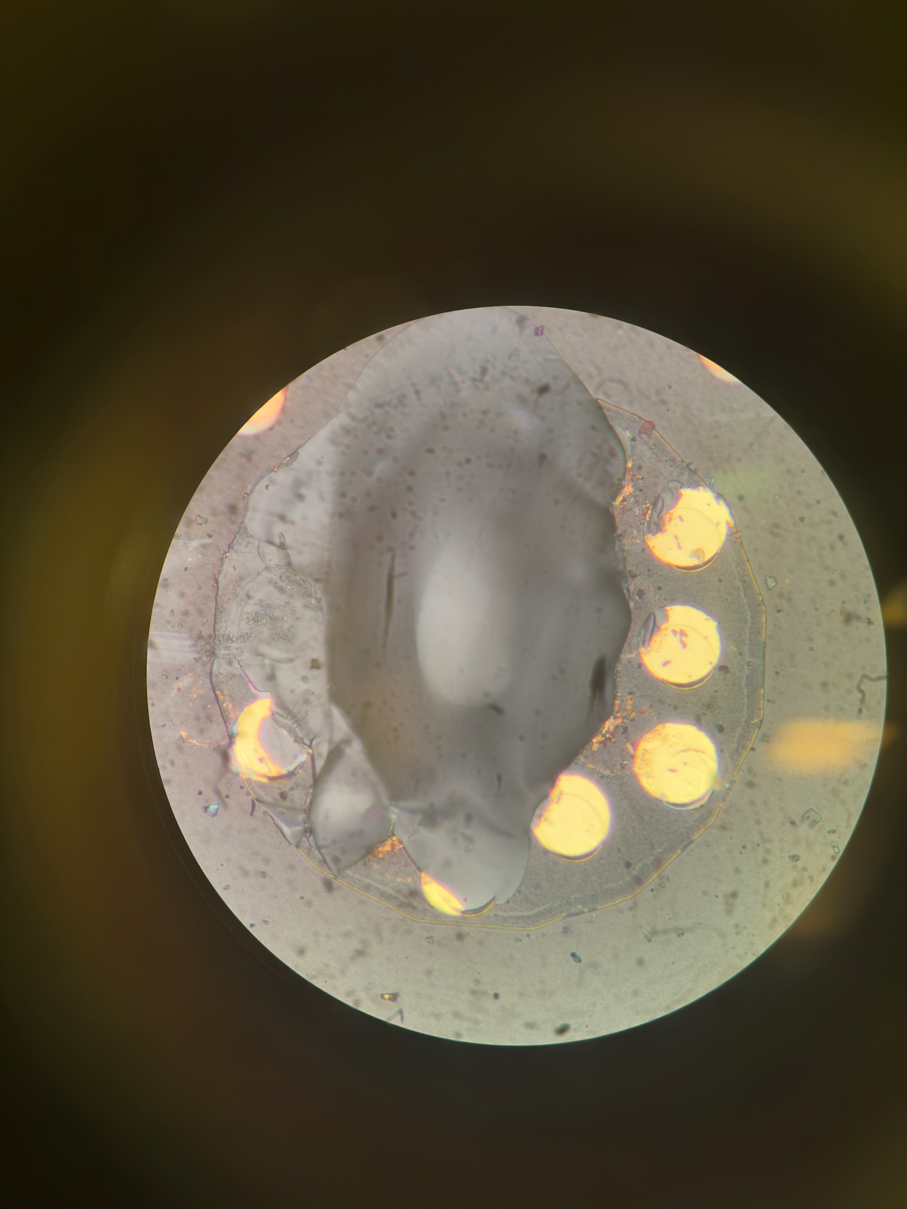
A12 Farside

Slide 23
A72 with A12 Overlay

Slide 24
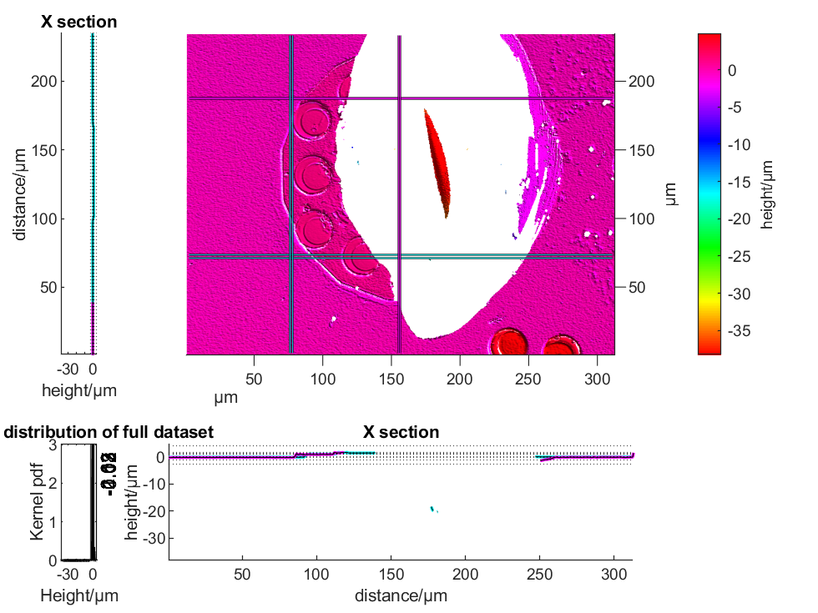
Conchoidal fracture that is larger than each pad, and extends well into the glass.
-20um recorded in the middle
Strip A72 Pad 4 Nearside
Notes:
Evidence of glass fracture – not seen in other samples without anneal. Definitely glass fracture as Pad4 side goes don to -40um, so through the metal 1.

Slide 25
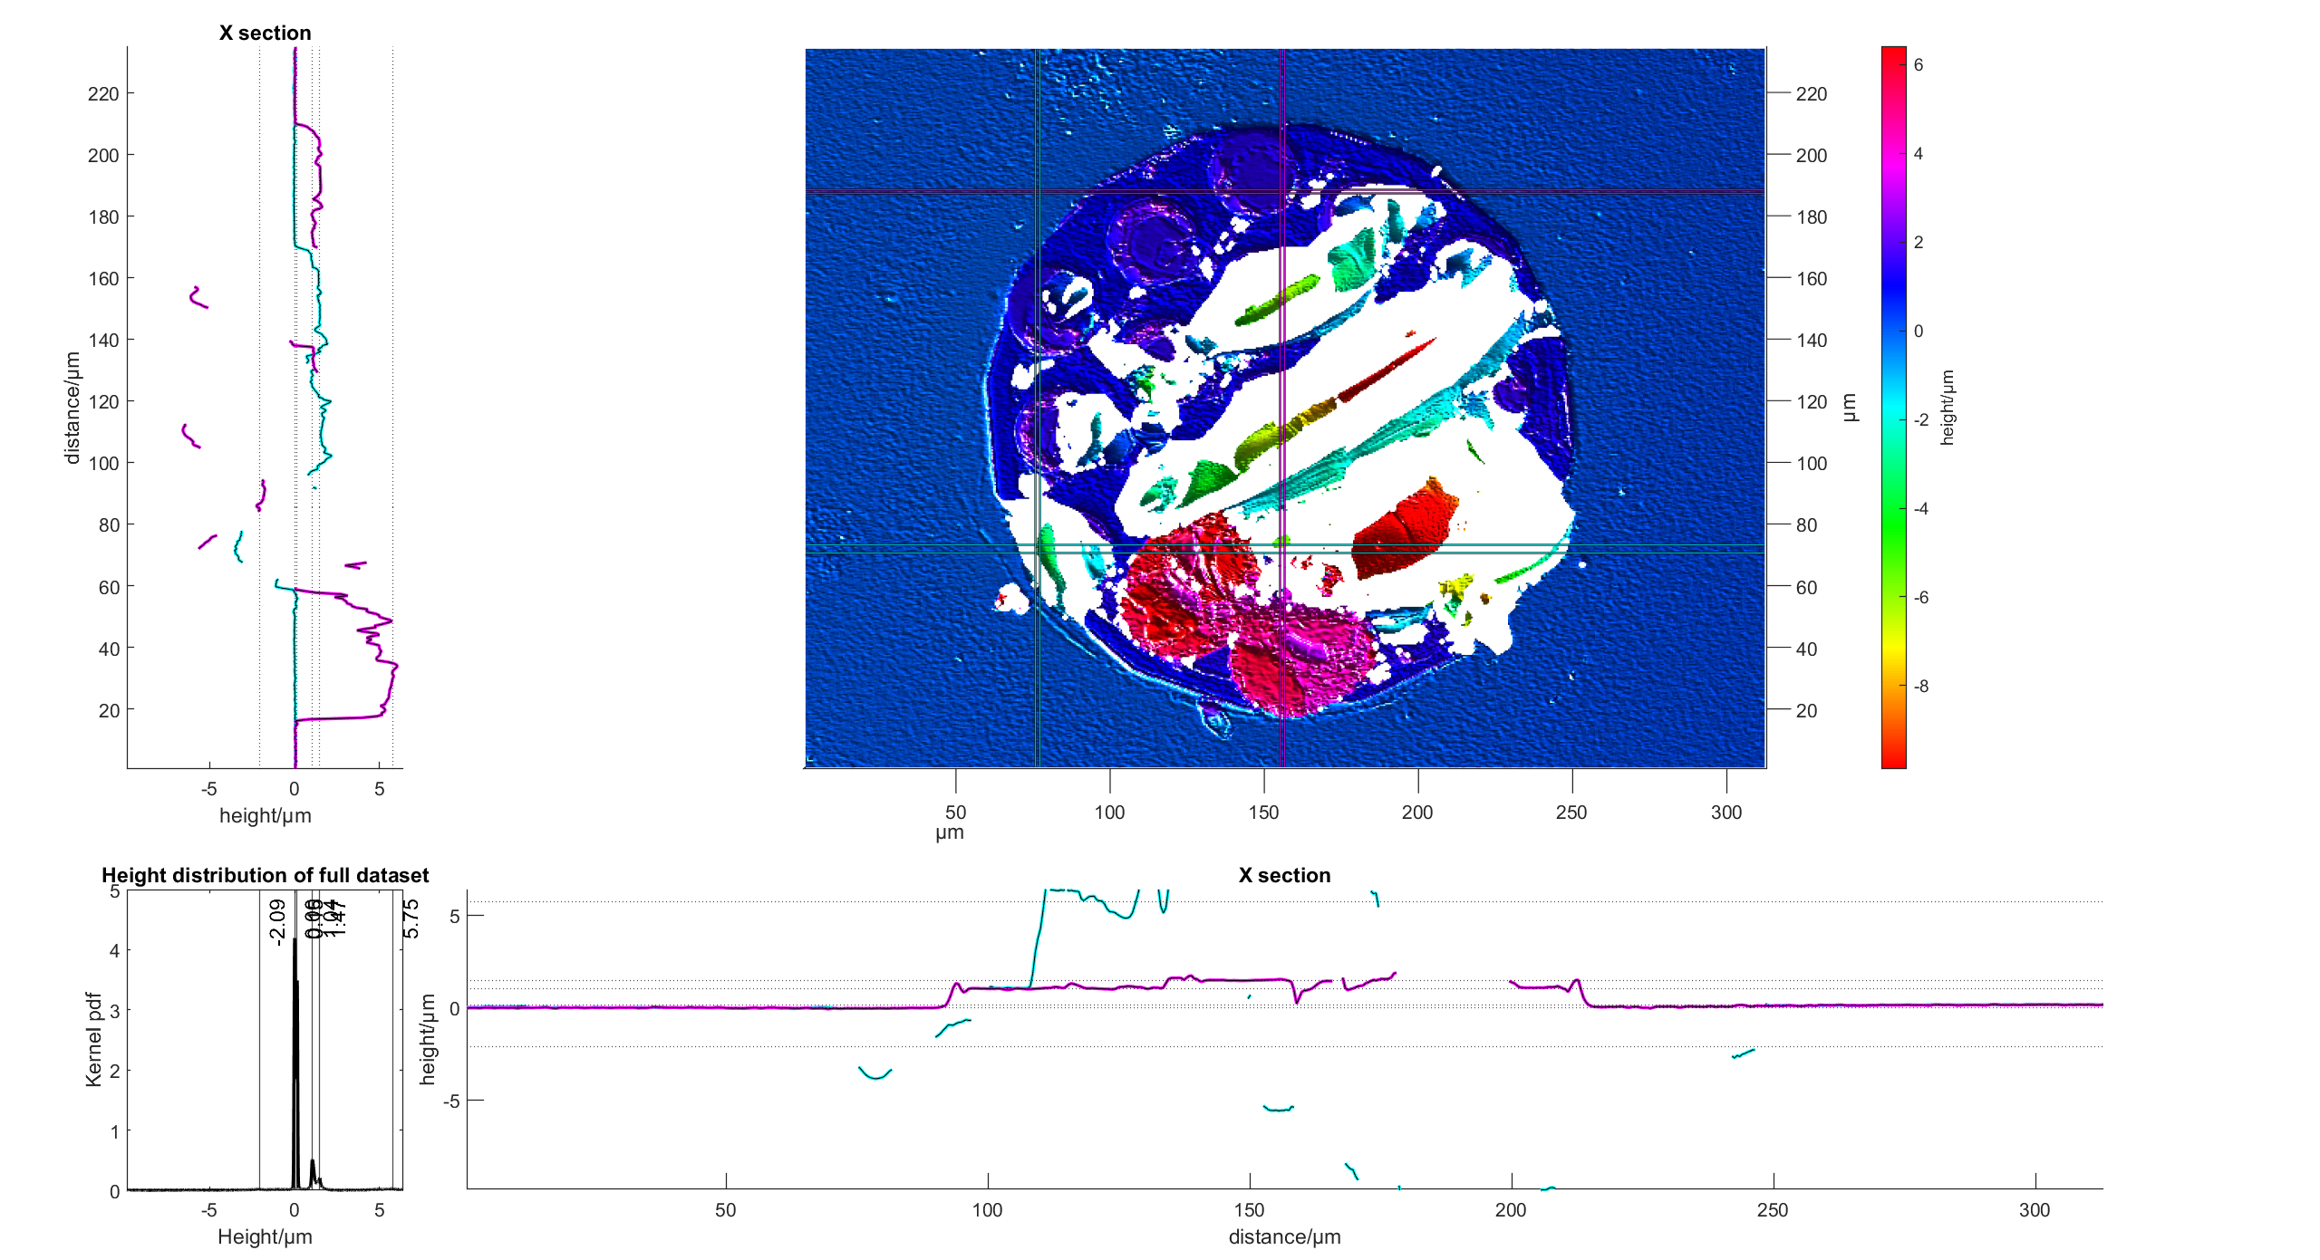
Less loss of material, only going down to -10um.
Loss of material occurs locally around each via vs whole pad
Goes into glass, and fracture is deepest at southwest corner (from this image)
Strip A12 Pad 8 Farside

Slide 26
Summary
18/18 bonds exhibit some form of bonding, good enough for electrical contact
Majority of failure is in gold to titanium adhesion layer
2 Pads show major failure in glass layer, but in different areas – one has failed around the vias, while the other has failed across the whole pad
3 pads show a minor amount of failure in the adhesion layer
9th pad on both sides shows glass failure in both cases
No sign of PECVD failure as PECVD has been removed.

Slide 27
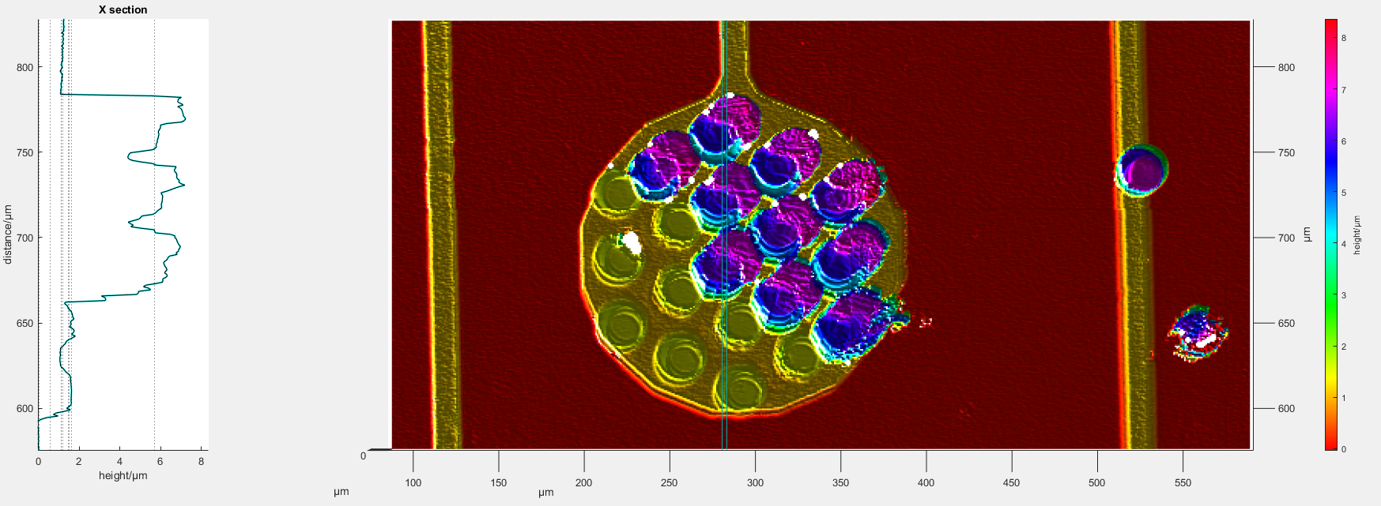

A72 Nearside Pad 1
Via from A
A
B
Via from B
B
A

Slide 28
A72 Nearside Pad 1
Area of Gold bonds
B

Slide 29

A72 Nearside Pad 5
B
A
B
A

Slide 30
A12 Nearside Pad 1

